Slide 1
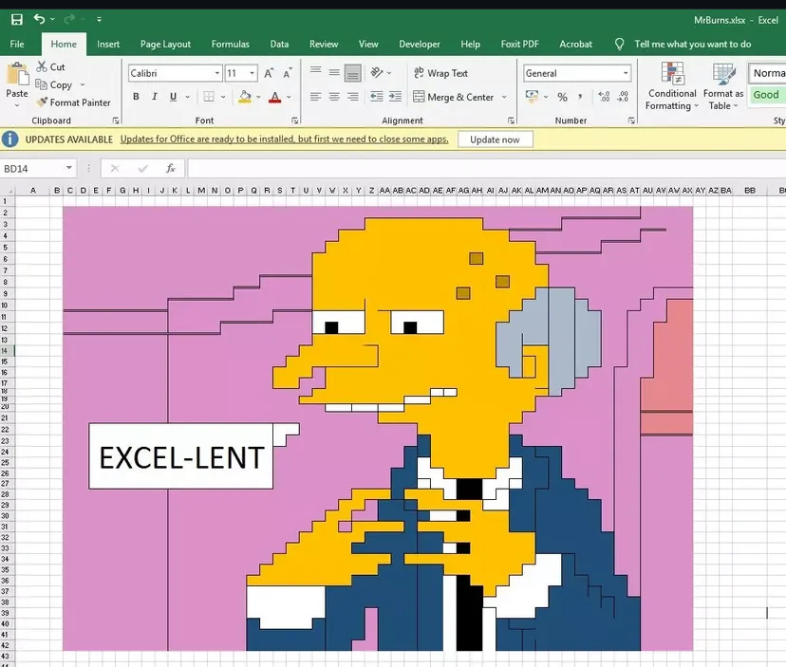
Formula for an EXCELent Inventory: Creating a Successful Barcode Inventory & Shelf-Reading Project at a Community College Library
Matt Raymond
Collections & Instruction Librarian
MWCC LaChance Library

Slide 2
Origins
Last Full Inventory: 2015
In 2021, over 800 new books were purchased & weeding became a priority to make shelf space
After weeding specific call number ranges, new methods for inventory were explored
31,033 circulating monographs
4 Staff Member
  2 Professional Librarians
  2 Para-professional Librarians
Paper report inventory of R/Nursing collection at current staffing:
  968 Monographs
  6 Weeks

Slide 3
Literature Review
“Inventories are seen as labor intensive, and some libraries may decide not to conduct them because either they operate on scarce resources and do not have the required technology, or they are understaffed and can barely perform their daily transactions.” (El Rayess, 2015, p. 2)
“Other considerations include determining the most appropriate time to conduct an inventory, as such an activity would interfere with library routines, and vice versa.” (Xu, 2018, p.10)
“the Library was able to produce an analytical report of its collection with 100% accuracy in only 3 weeks.” (El Rayess, 2015, p.11)
“she divided the collection evenly, achieving the sample of 100 by selecting every 282nd book. She then worked with the library’s technology associate to use Microsoft Excel to identify the call numbers for each of these items and generate a list of items to check.” DeLooper and Gonsalves, 2020, p.7)
“The inventory was begun in late May, as soon as possible after the students graduated May 15. Staff started with the circulating collection, the largest at 28,404 items, and finished that area in fifteen days.” (Ernick, 2005, p.2)

Slide 4
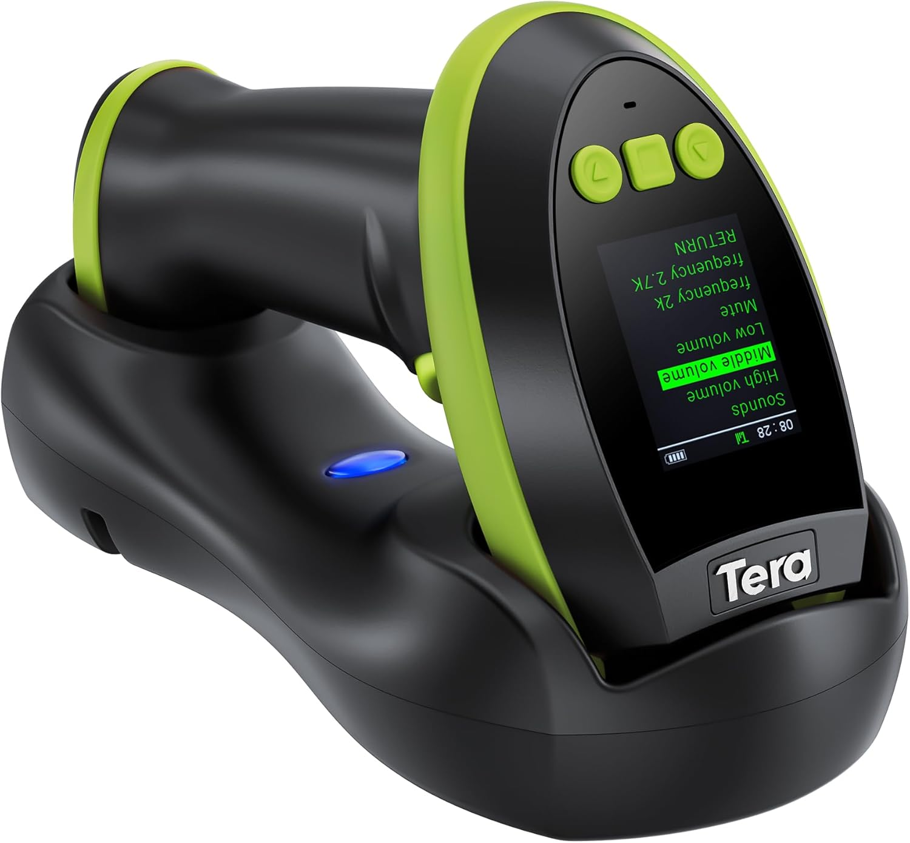

Materials Used
Wireless Barcode Scanner with storage capabilities
Microsoft Excel or similar spreadsheet application capable of specific formulas and highlight rules such as
  =XLOOKUP
  =IF
  Conditional Formatting for unique and duplicate items
Evergreen Workstation client and all reports modules
Evergreen Staff Site to access Metabase report applications

Slide 5
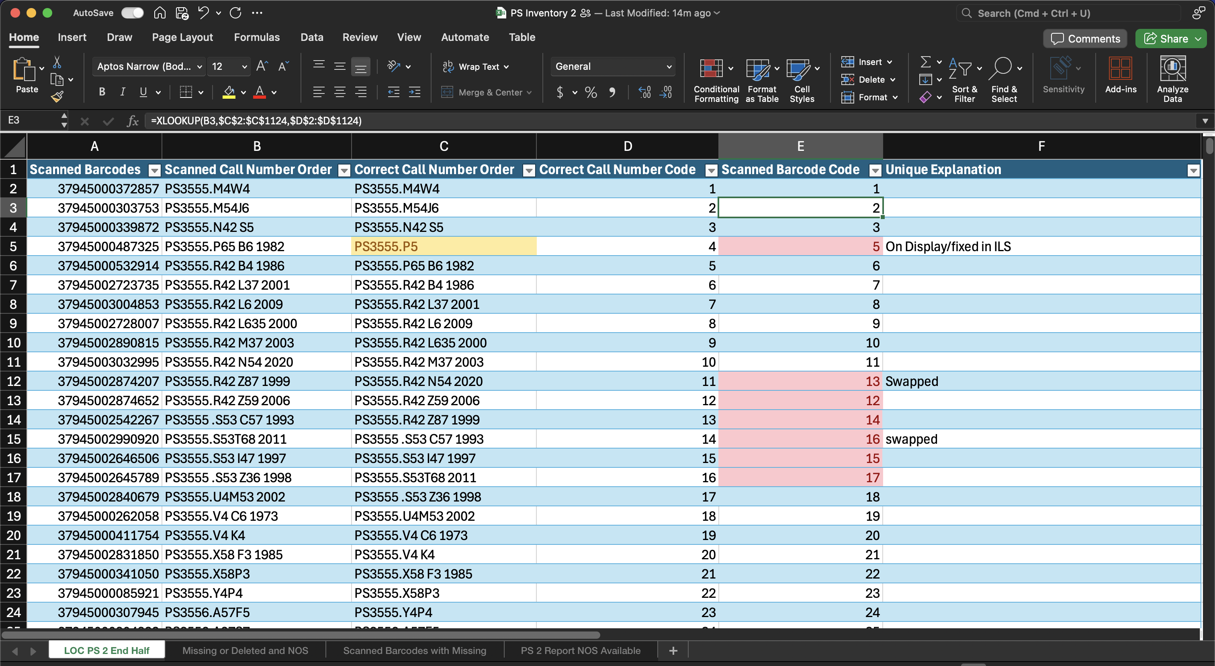
Formatting the Spreadsheet
LOC [call number area]
LOC [call number area] Missing or Deleted
LOC [call number area] NOS
LOC [Call Number Area] Evergreen Report

Slide 6
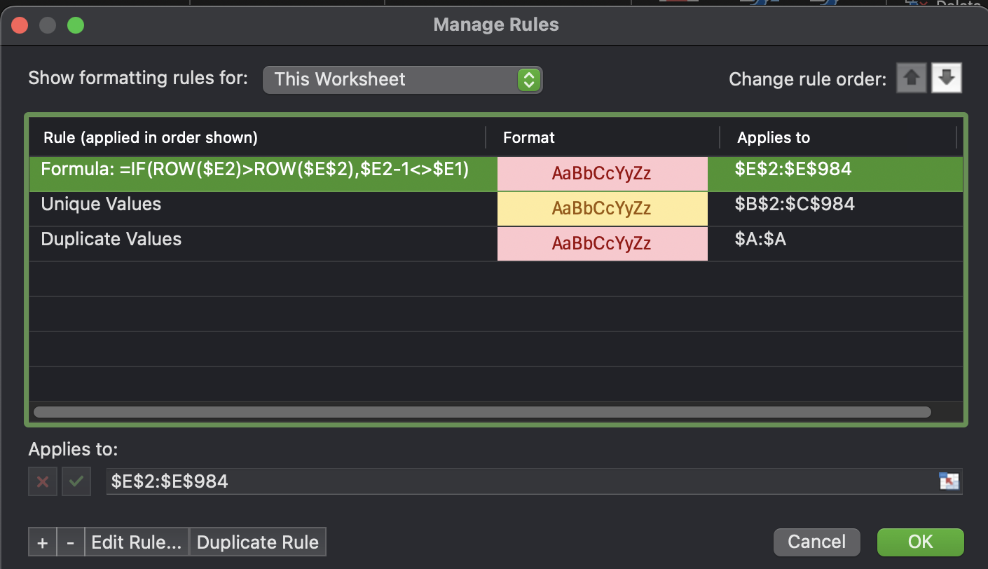
The Formulas
=XLOOKUP(B2,$C$2:$C$984,$D$2:$D$984)
=IF(ROW($E2)>ROW($E$2),$E2-1<>$E1)
Duplicate Values
Unique Values
Yellow Cells
  Scanned Barcode Order Column: these are items that have been entered into the spreadsheet twice. It’s best to correct these during the scanning process.
  Correct Barcode Order and Correct Call Number Order: These are items that are available in the report but not scanned. These items could be misplaced, checked out or missing.
  Scanned Barcode Order and Scanned Call Number Order: These items are scanned and, on the shelf, but not in the ILS report. It’s either mistakenly deleted from the catalog, or something owned by another library mistakenly shelved downstairs.
Red Cells
  Full Row in the Table: This is for items in the scanned barcode code that are not in order based on the correct call number code. This could mean the item is misshelved, the call number is part of a set or multiple copies that the do not have distinctive call numbers.

Slide 7
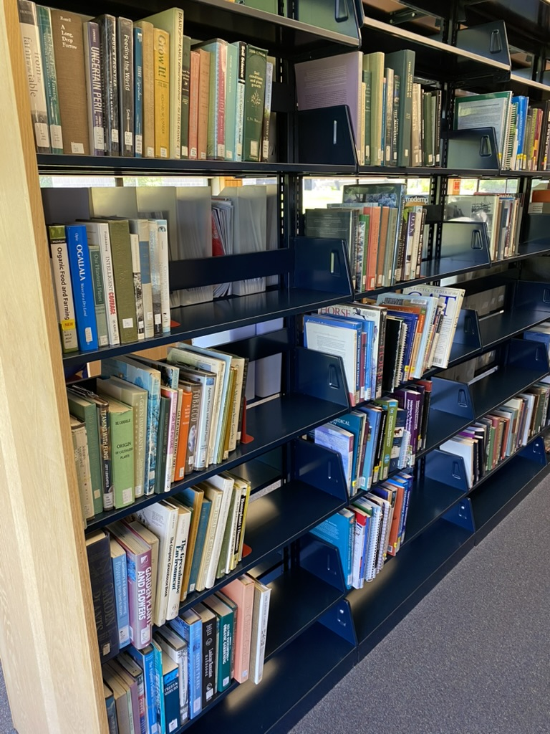
S (Animal Science)
224 Monographs
4 missing
Scanning Time: Approximately 30 minutes
4 missing

Slide 8
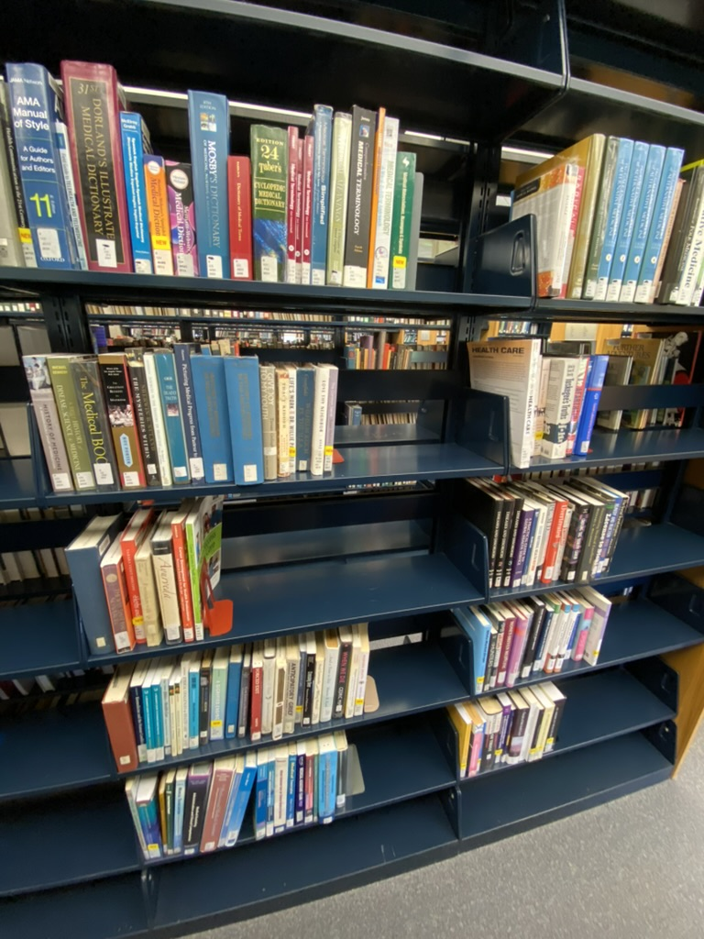
R (Medicine/Nursing)
971 Monographs
Scanning Time: 1 hour 32 minutes
  1 hour 10 minutes
  2pm break
  22 minutes
3 deletions on shelf
  One a QCC book during HELM

Slide 9
Initial Challenges
The order of events
  Set up spreadsheet & formulas
  Scan within the designated range
  Upload barcodes into Evergreen and transfer to spreadsheet
  Confirm statuses
Formulas
  Complicated at first to discover
Interpreting Conditional Formatting
  At first, it was disorienting to recognize what each irregularity meant
Volume Numbers
  Not all call numbers included volume/copy number, throwing off the =XLOOKUP formula
Wireless Connections
  Scanner storage was not consistent
  Wifi was unreliable

Slide 10
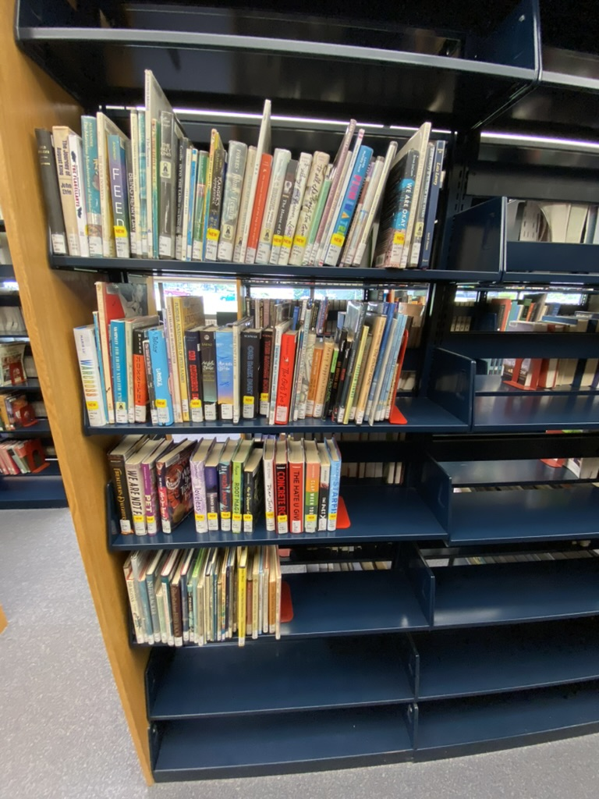
PZ (Juvenile Literature)
165 Monographs
Scanning time: 10 minutes
32 missing
  All of these were weeded and did not get deleted

Slide 11
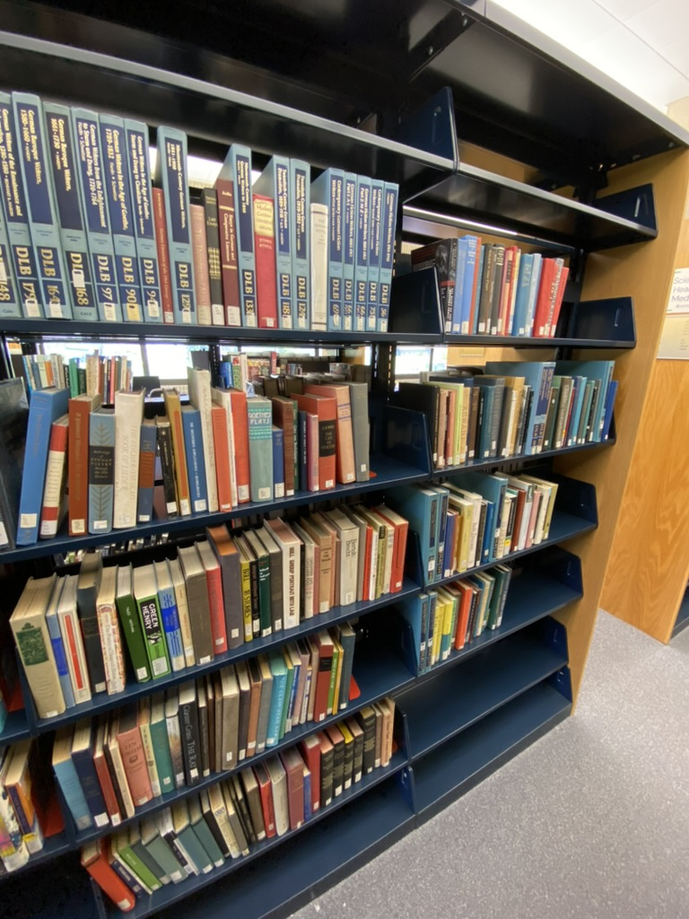
PT (German Literature)
261 Monographs
Scanning time: 20 minutes
20 missing
  All of these were weeded and did not get deleted

Slide 12
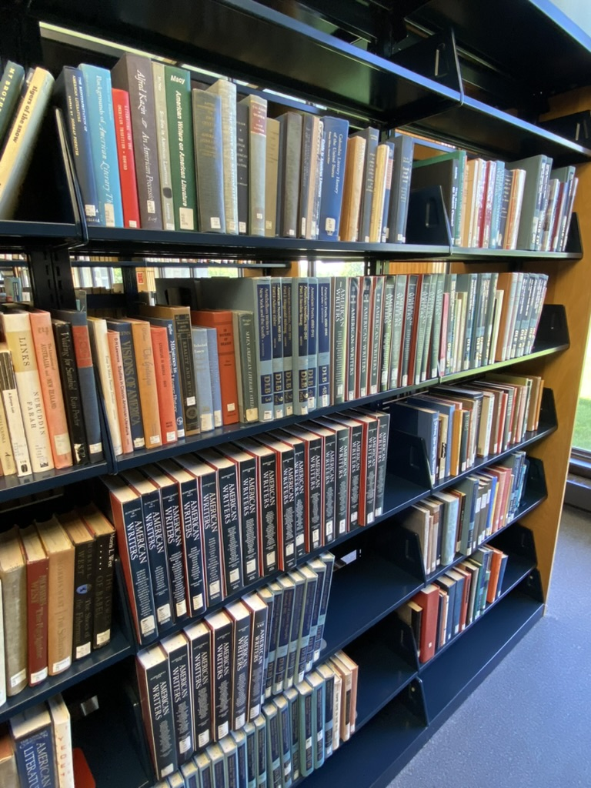
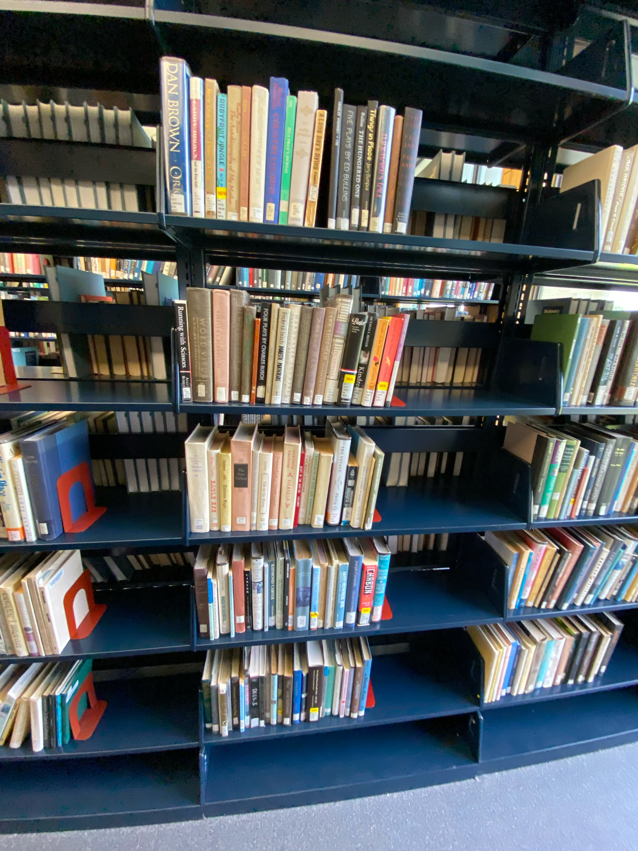
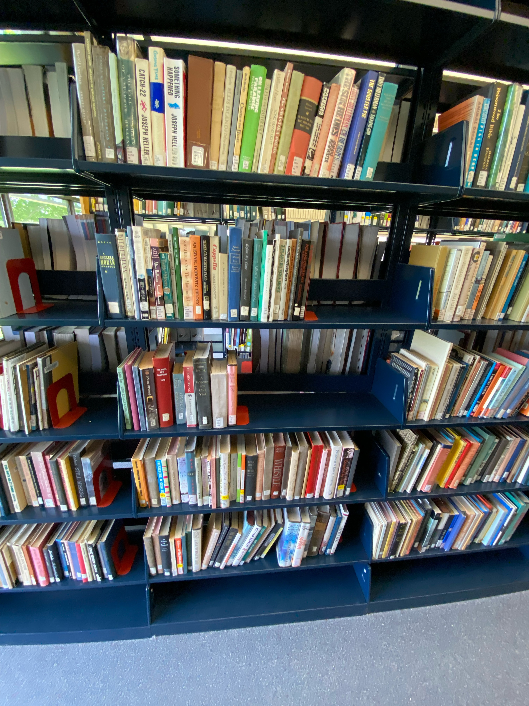
The Dreaded PS’s (American Literature)
Before Scanning
After Scanning

Slide 13
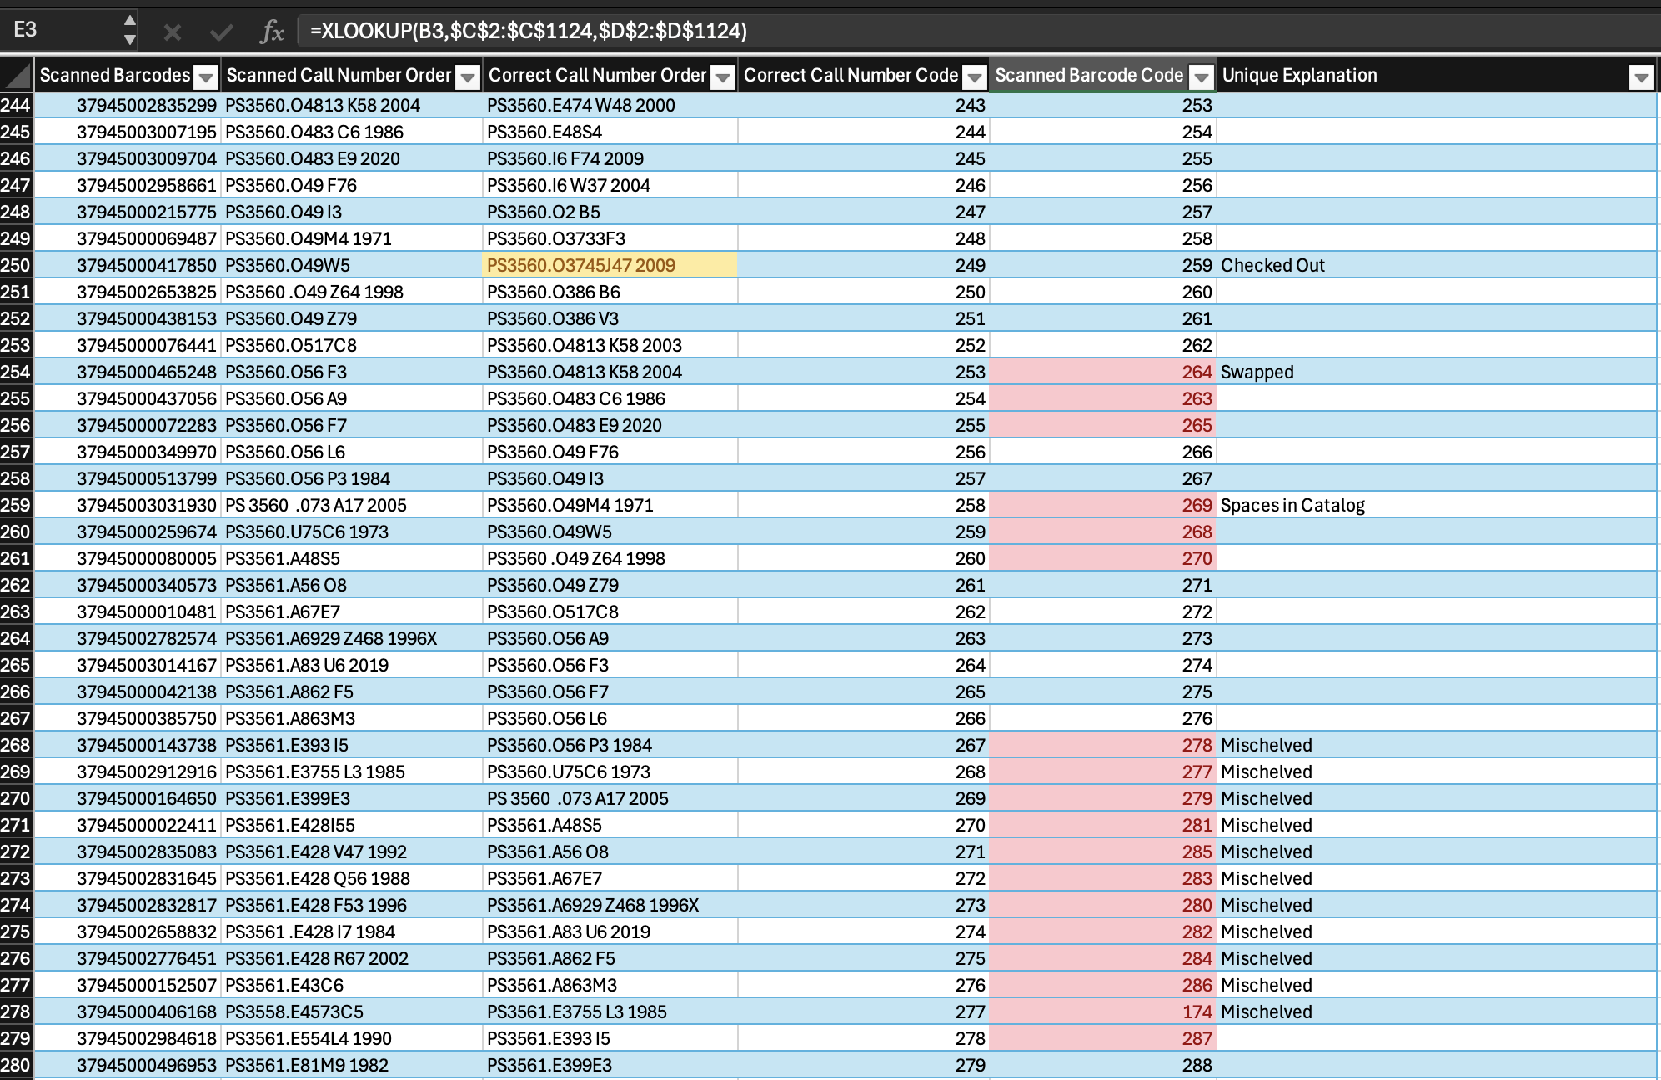
PS Results
PS 1
  984 Monographs
  Scanning time: 1 hour 30 minutes
  20 missing
PS 2
  1,123 Monographs
  Scanning time: 2 hours
  16 missing after finding two marked lost in shelved incorrectly

Slide 14
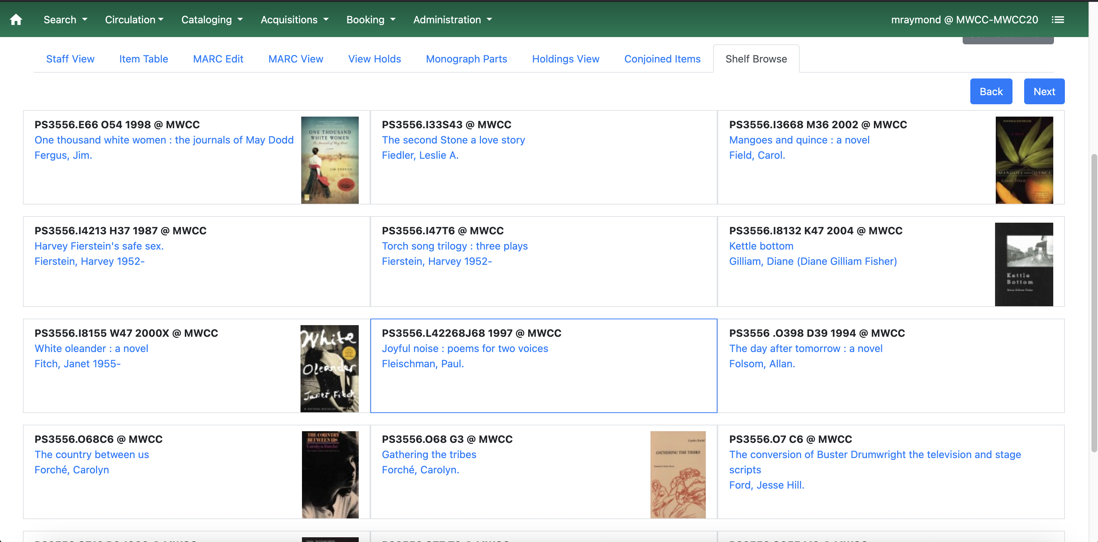
New Developments
Bay and Shelf identification using Conditional Formatting or notes field?
Highlighting the entire row
Volume Numbers in call numbers!
Simplify procedure for confirming checked out/misplaced items.
  Currently can confirm using the Shelf Browse feature in Evergreen.
This summer we’ll finish the last half of PS!

Slide 15
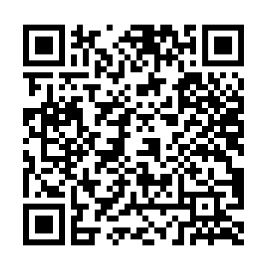
Conclusion & Thank you!
“Managing collections holistically takes each stage of the collection life cycle into consideration when making decisions, and recognizes that each stage of the life cycle has implications for the others.” (Hibner and Kelly, 2023, p.34)
References
mraymond8@mwcc.mass.edu

