Slide 1
20/20 Hindsight:
Mistakes made and lessons learned from a new director
Cori Wilhelm,
Interim Director of Library Services
Southworth Library Learning Commons
SUNY Canton College of Technology
Notes:
Became Interim Director in Summer 2016 after a challenging time.
Often, we look back on the past and say, “What was I thinking?”
I’d like to share with you my thoughts as I began the transition, my reflections on “What was I thinking?”, and the lessons that I learned along the way.

Slide 2
Preparing for the Transition
The plan:
  Start making the changes I had been planning
  Remain friends with staff – be the “cool” boss
  Communicate departmental needs to my supervisor
  I knew exactly how I wanted everything done
Notes:
I took over from a director that was difficult to work with, and knew some of the changes I wanted to implement.
I was popular with my peers, who were to become my staff.
I had been in the library for 4 years, and knew exactly what I wanted changed, and planned to present that to my supervisor.

Slide 3


It was going to be perfect…
I was going to be the perfect director…
“Rainbow Bubble”, Hoffnungsschimmer (Flickr)
https://www.flickr.com/photos/hoffnungsschimmer/14817533613
Notes:
It was going to be perfect.

Slide 4
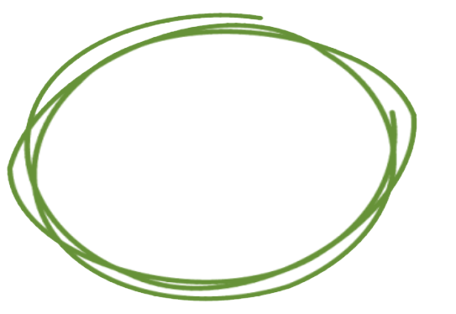
Relationships with Supervisors
What I was thinking:
I know what’s best for my department and staff
Departmental vs. administrative goals
LESSON LEARNED:
MANAGE UP, MANAGE DOWN
Notes:
It doesn’t pay to challenge your supervisor in a combative way – there is a reason they are in their position and you are in yours.
Managing up and Managing down means Communicating between your staff and your supervisor or administration, making sure each side understands the others’ perspective and goals.
You can create the culture you want, while setting priorities in cooperation with your supervisors

Slide 5
Setting Team Expectations
What I was thinking:
They understand what needs to be fixed, right?
Things will get better – this is just a bump in the road
We can all be friends ☺
LESSON LEARNED:
Annual performance reviews are a MINIMUM, not a MAXIMUM
LESSON LEARNED:
DOCUMENT EVERYTHING!
Notes:
If you aren’t checking in regularly with employees about performance (I wasn’t), they won’t know how they’re doing or where they stand.
If you don’t address things right away, small problems can get much bigger. When things get bad, it’s often after a pattern of things getting worse.
Documenting everything will never hurt, and when you need it, you will really appreciate that you did it. I send follow-up emails after each individual meeting reviewing what we discussed.

Slide 6
Communicating with Staff
What I was thinking:
I already know:
What we need to do,
Why we need to do it,
How I want it done,
Who I want to do it, and When
LESSON LEARNED:
DON’T BE THE SMARTEST PERSON IN THE ROOM
Notes:
Just because you are in charge doesn’t mean you know more than everyone else, or know the best way to accomplish goals .
Diverse ideas from different people are often better than a singular approach, and recognizing and encouraging talents in staff often makes them want to work harder and better.
Provide direction so that they work moves toward a shared goal, but allow them the autonomy to make decisions and contribute in the ways that they individually can.
As a follow up, when things go well, it is critical that you recognize the team and each member’s contributions – don’t take the credit when things go well.

Slide 7
Handling the Transition & Beyond
What I was thinking:
I’m not qualified/good enough for this job – someone else could do it better
I’m a total mess/failure and my entire staff and supervisor know it
LESSON LEARNED:
STOP DOUBTING YOURSELF!
LESSON LEARNED:
WRITE IT ALL DOWN!
Notes:
At a recent conference, I learned the culture of “Imposter Syndrome” is prevalent in academic libraries.
Journaling – write down what you are doing well

Slide 8
Questions?
Cori Wilhelm
wilhelmc@canton.edu
www.canton.edu/library

