Slide 1


Open Education at UMass Amherst
MassPIRG Higher Education Panel
April 18, 2018
This work is licensed with a Creative Commons Attribution-NonCommercial 4.0 International license

Slide 2
What is OER?

Slide 3
Teaching, learning, and research resources that reside in the public domain or have been released under an intellectual property license that permits their free use and re-purposing by others.
-William and Flora Hewlett Foundation

Slide 4
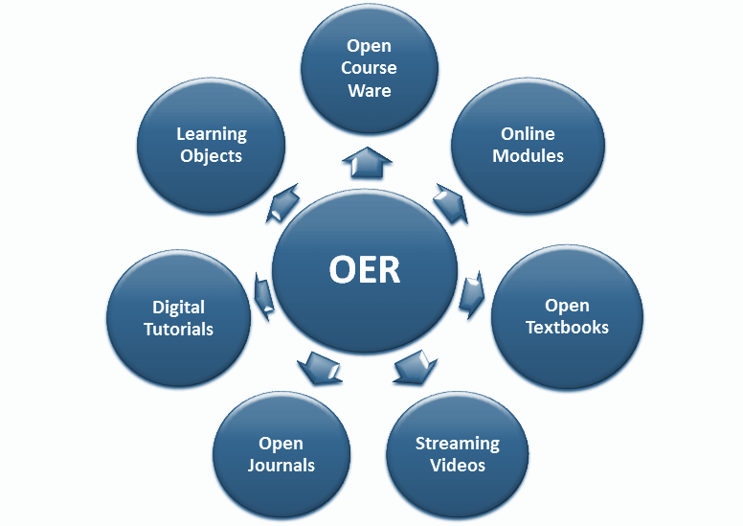
Types of Open Educational Resources

Slide 5

What makes OER open?
www.opencontent.org
The 5Rs
Retain
Reuse
Revise
Remix
Redistribute

Slide 6
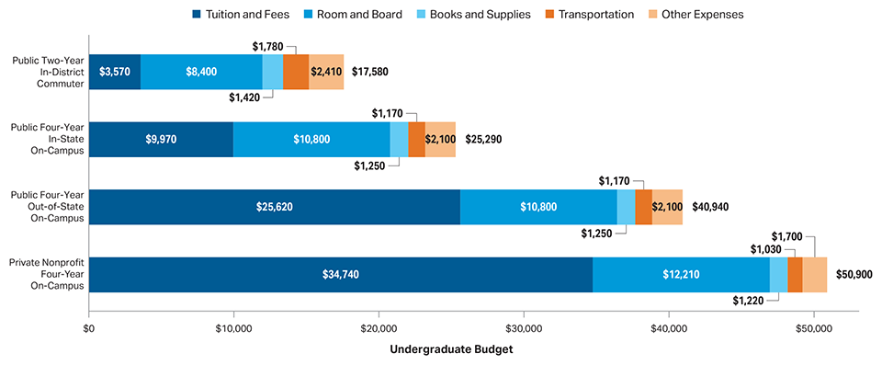
Why OER?

Slide 7
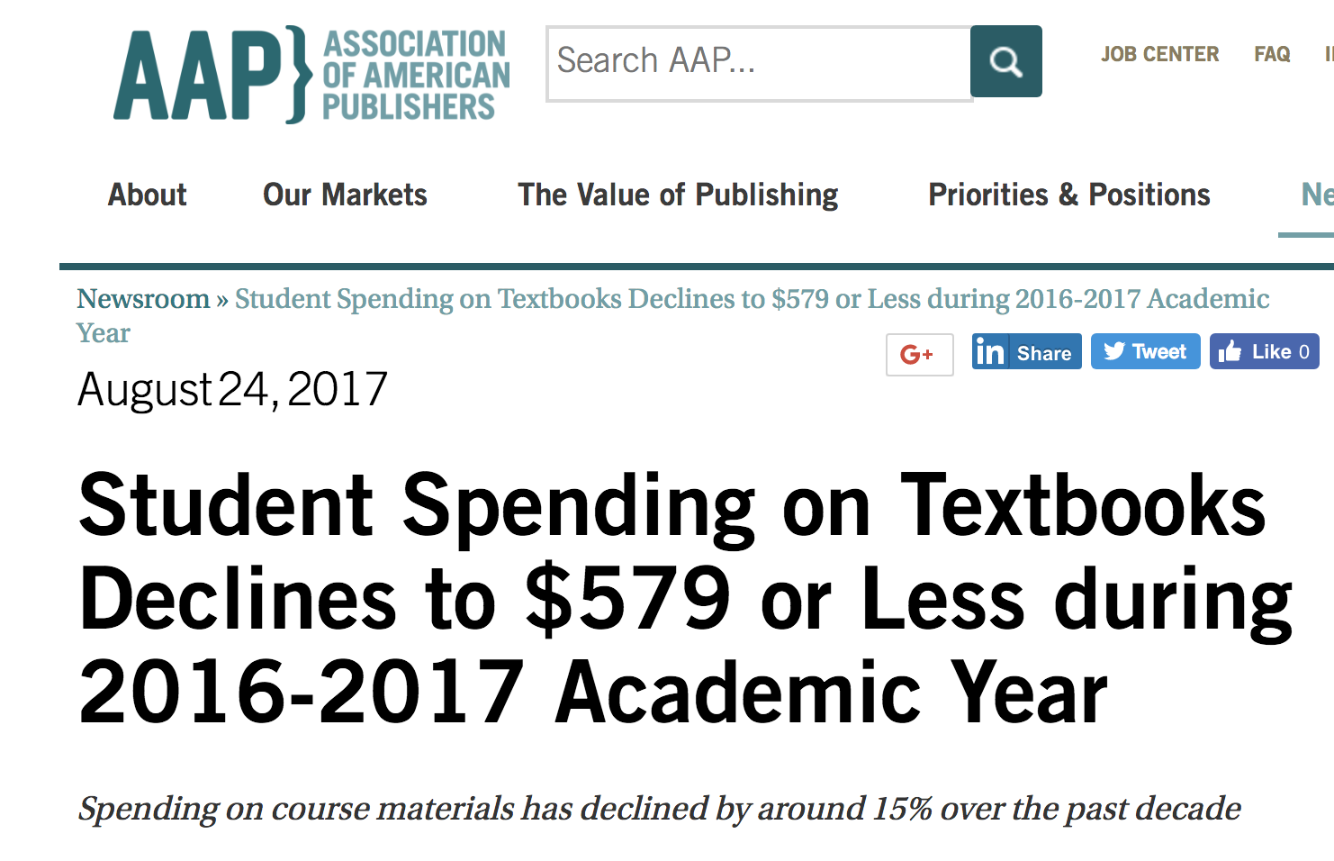
Why OER?

Slide 8
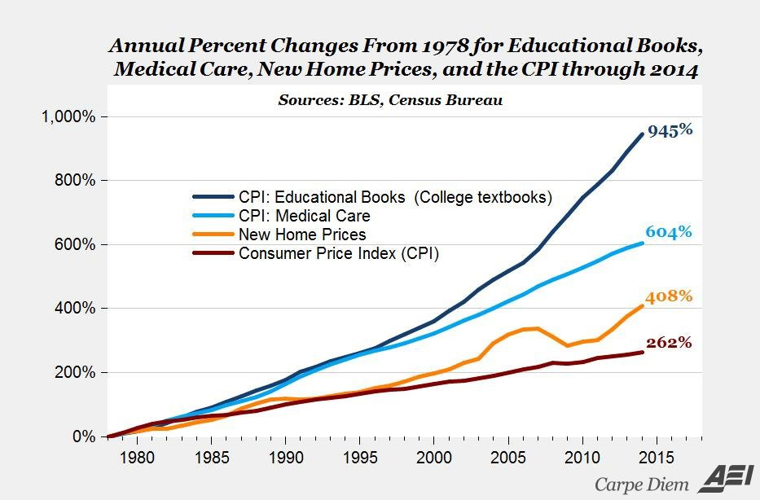
Why OER?

Slide 9
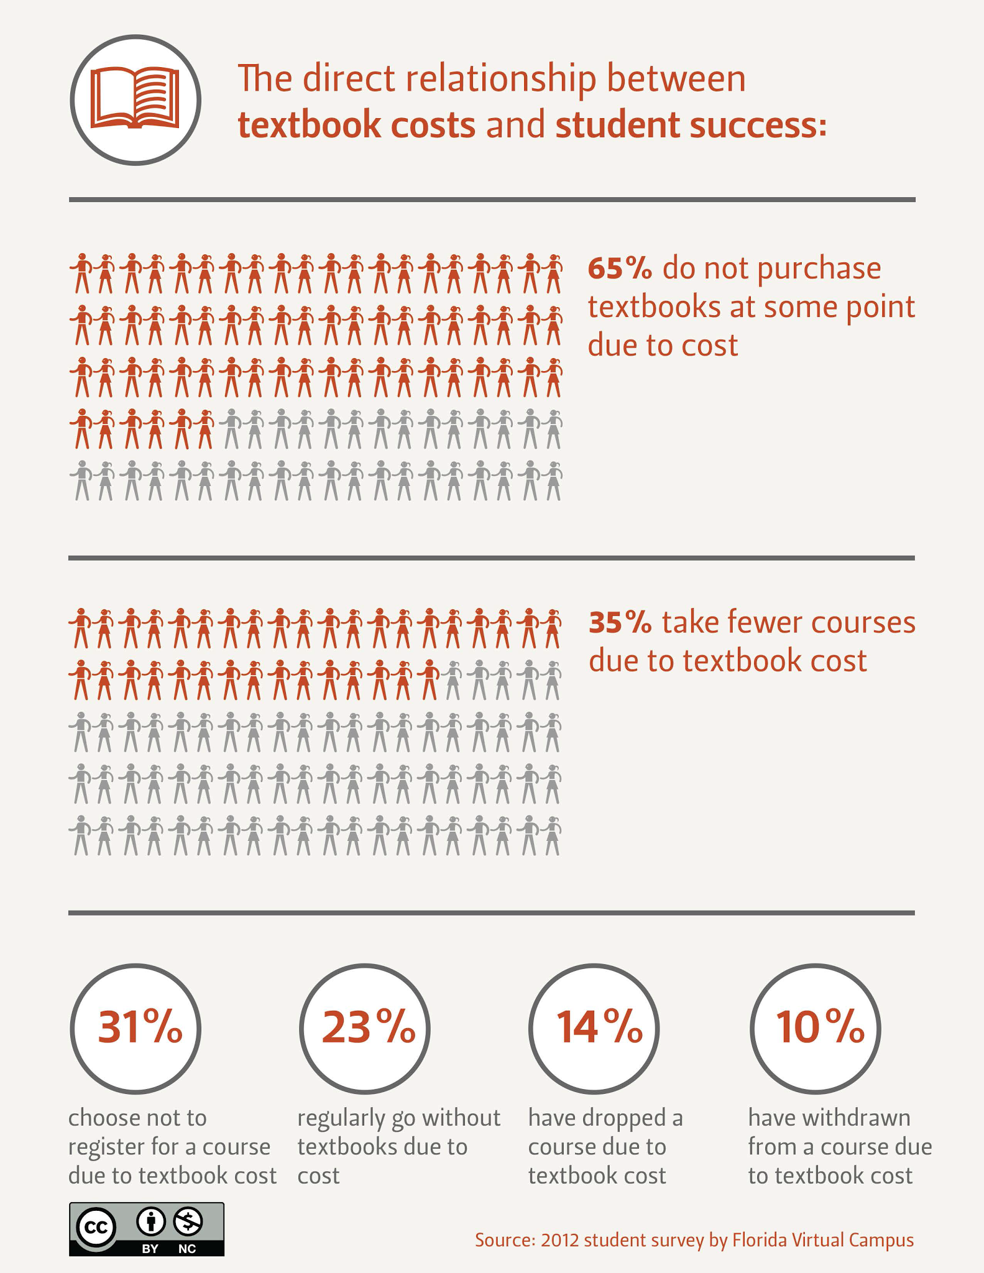
Why OER?
2012 Florida Virtual Campus Textbook study
Notes:
This 2012 survey by the Florida Virtual Campus mirrors much of what we found in our survey.

Slide 10
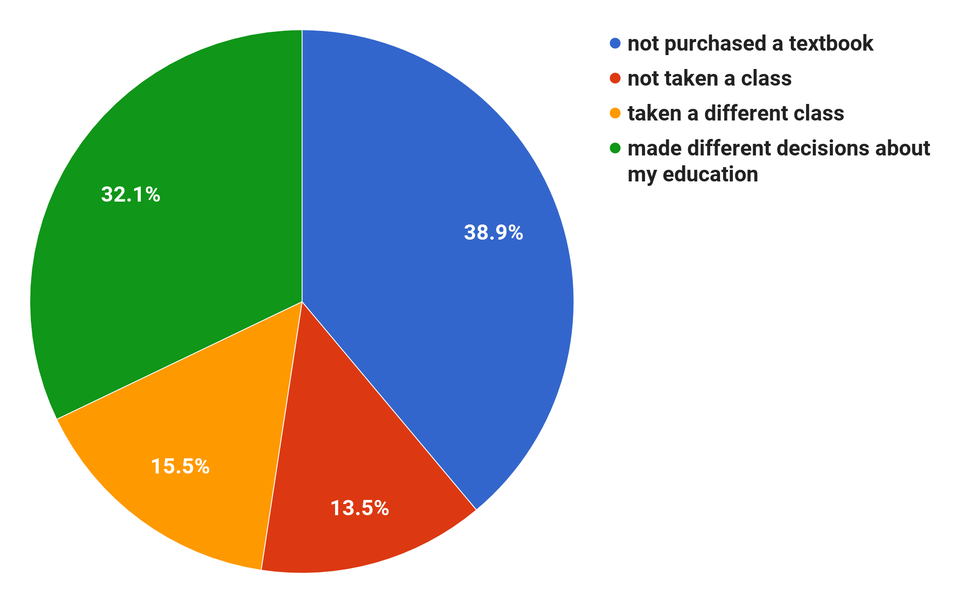
Student Feedback
2016 survey of 458 UMass Students
Notes:
This shows how textbook costs are affecting the academic decisions of our students. From a 2016 survey of 458 students in courses that took part in our program

Slide 11
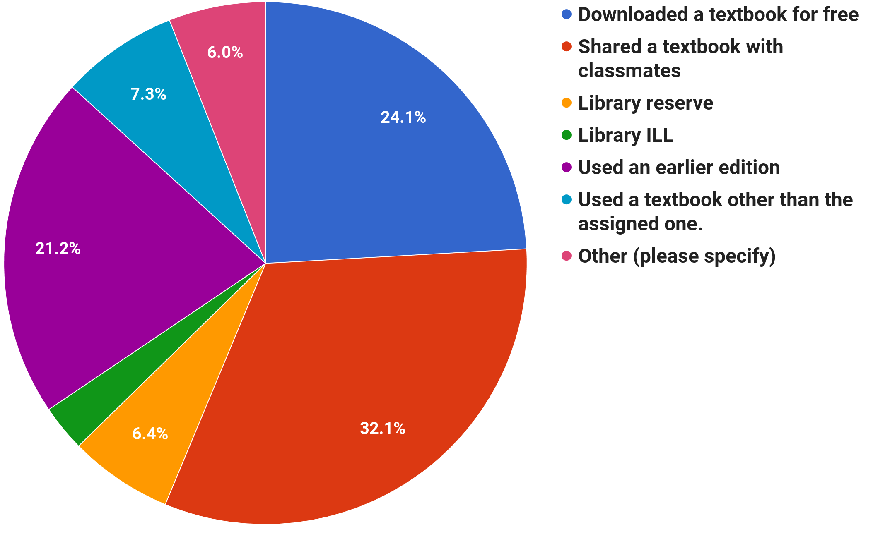
Student Feedback
2016 survey of 458 UMass Students
Notes:
This shows how textbook costs are driving students to seek alternatives to buying their own textbooks including a quarter of whom are illegally downloading textbooks.

Slide 12
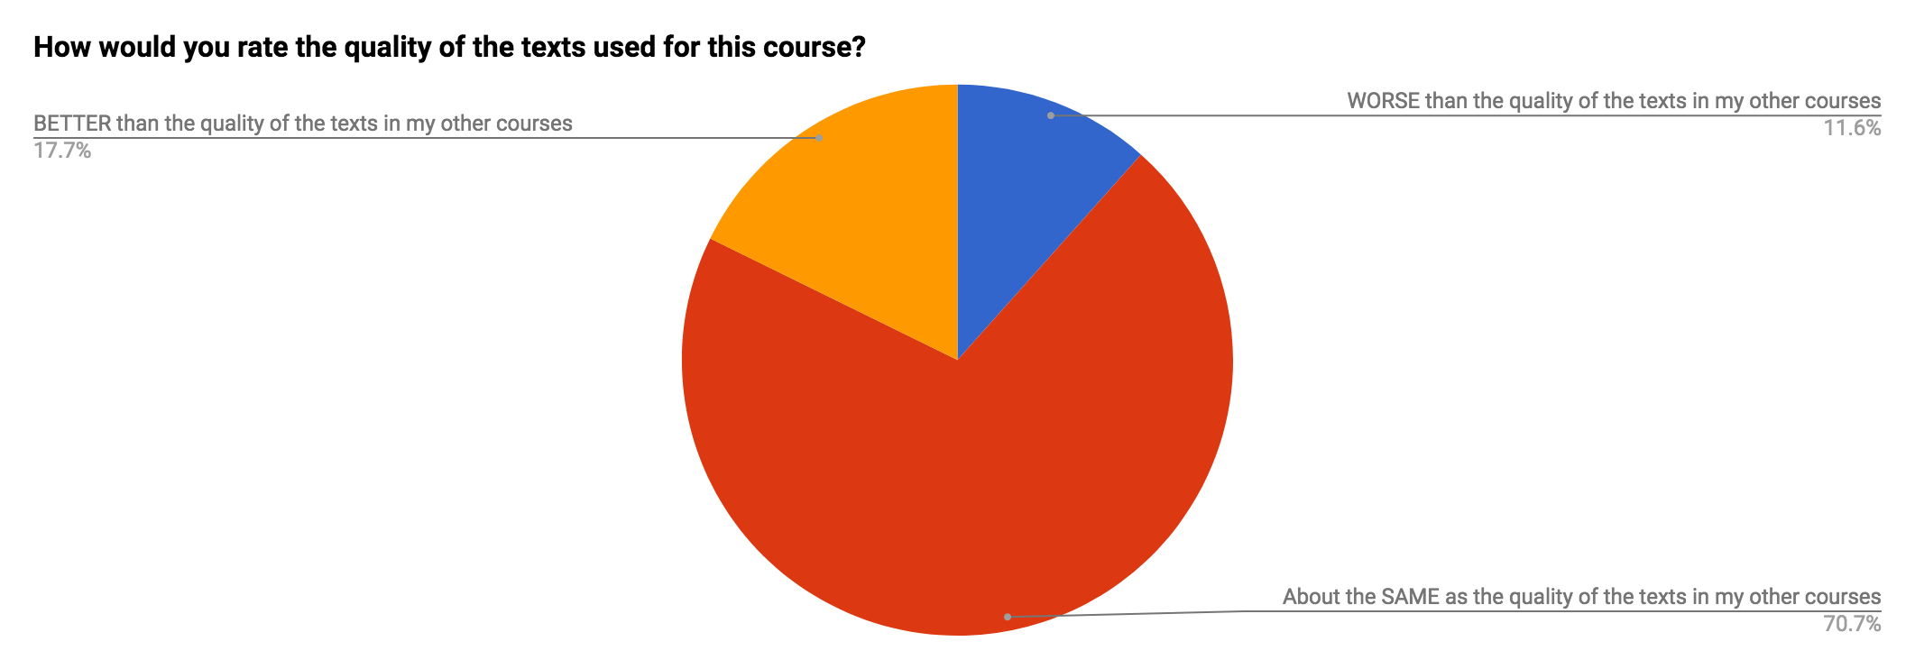
Student Feedback
2016 survey of 458 UMass Students

Slide 13
Seeking Solutions
Open Education Initiative
Notes:
•OEI started in 2011 with money supplied by the then provost and the library. To fund grants of between $1000 and $2500.
•Subsequent funds came from the Friends of the Library, and the Institute Teaching Excellence & Faculty Development office and the IT program.
•The grants have been offered in 8 grant cycles.

Slide 14
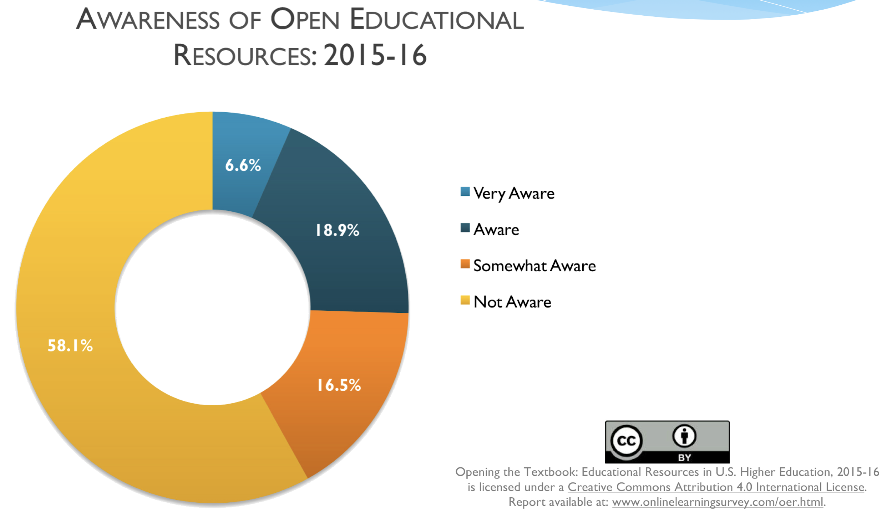
Faculty Awareness
Notes:
This Babson Survey Research group report shows how unaware faculty are of OER today. It’s getting better, but not by much.

Slide 15
Seeking Solutions
The OEI is a faculty incentive program that encourages:
the creation of new teaching materials
the use of existing open (free) information resources to support student learning
the use of library subscription materials
the development of open technologies

Slide 16
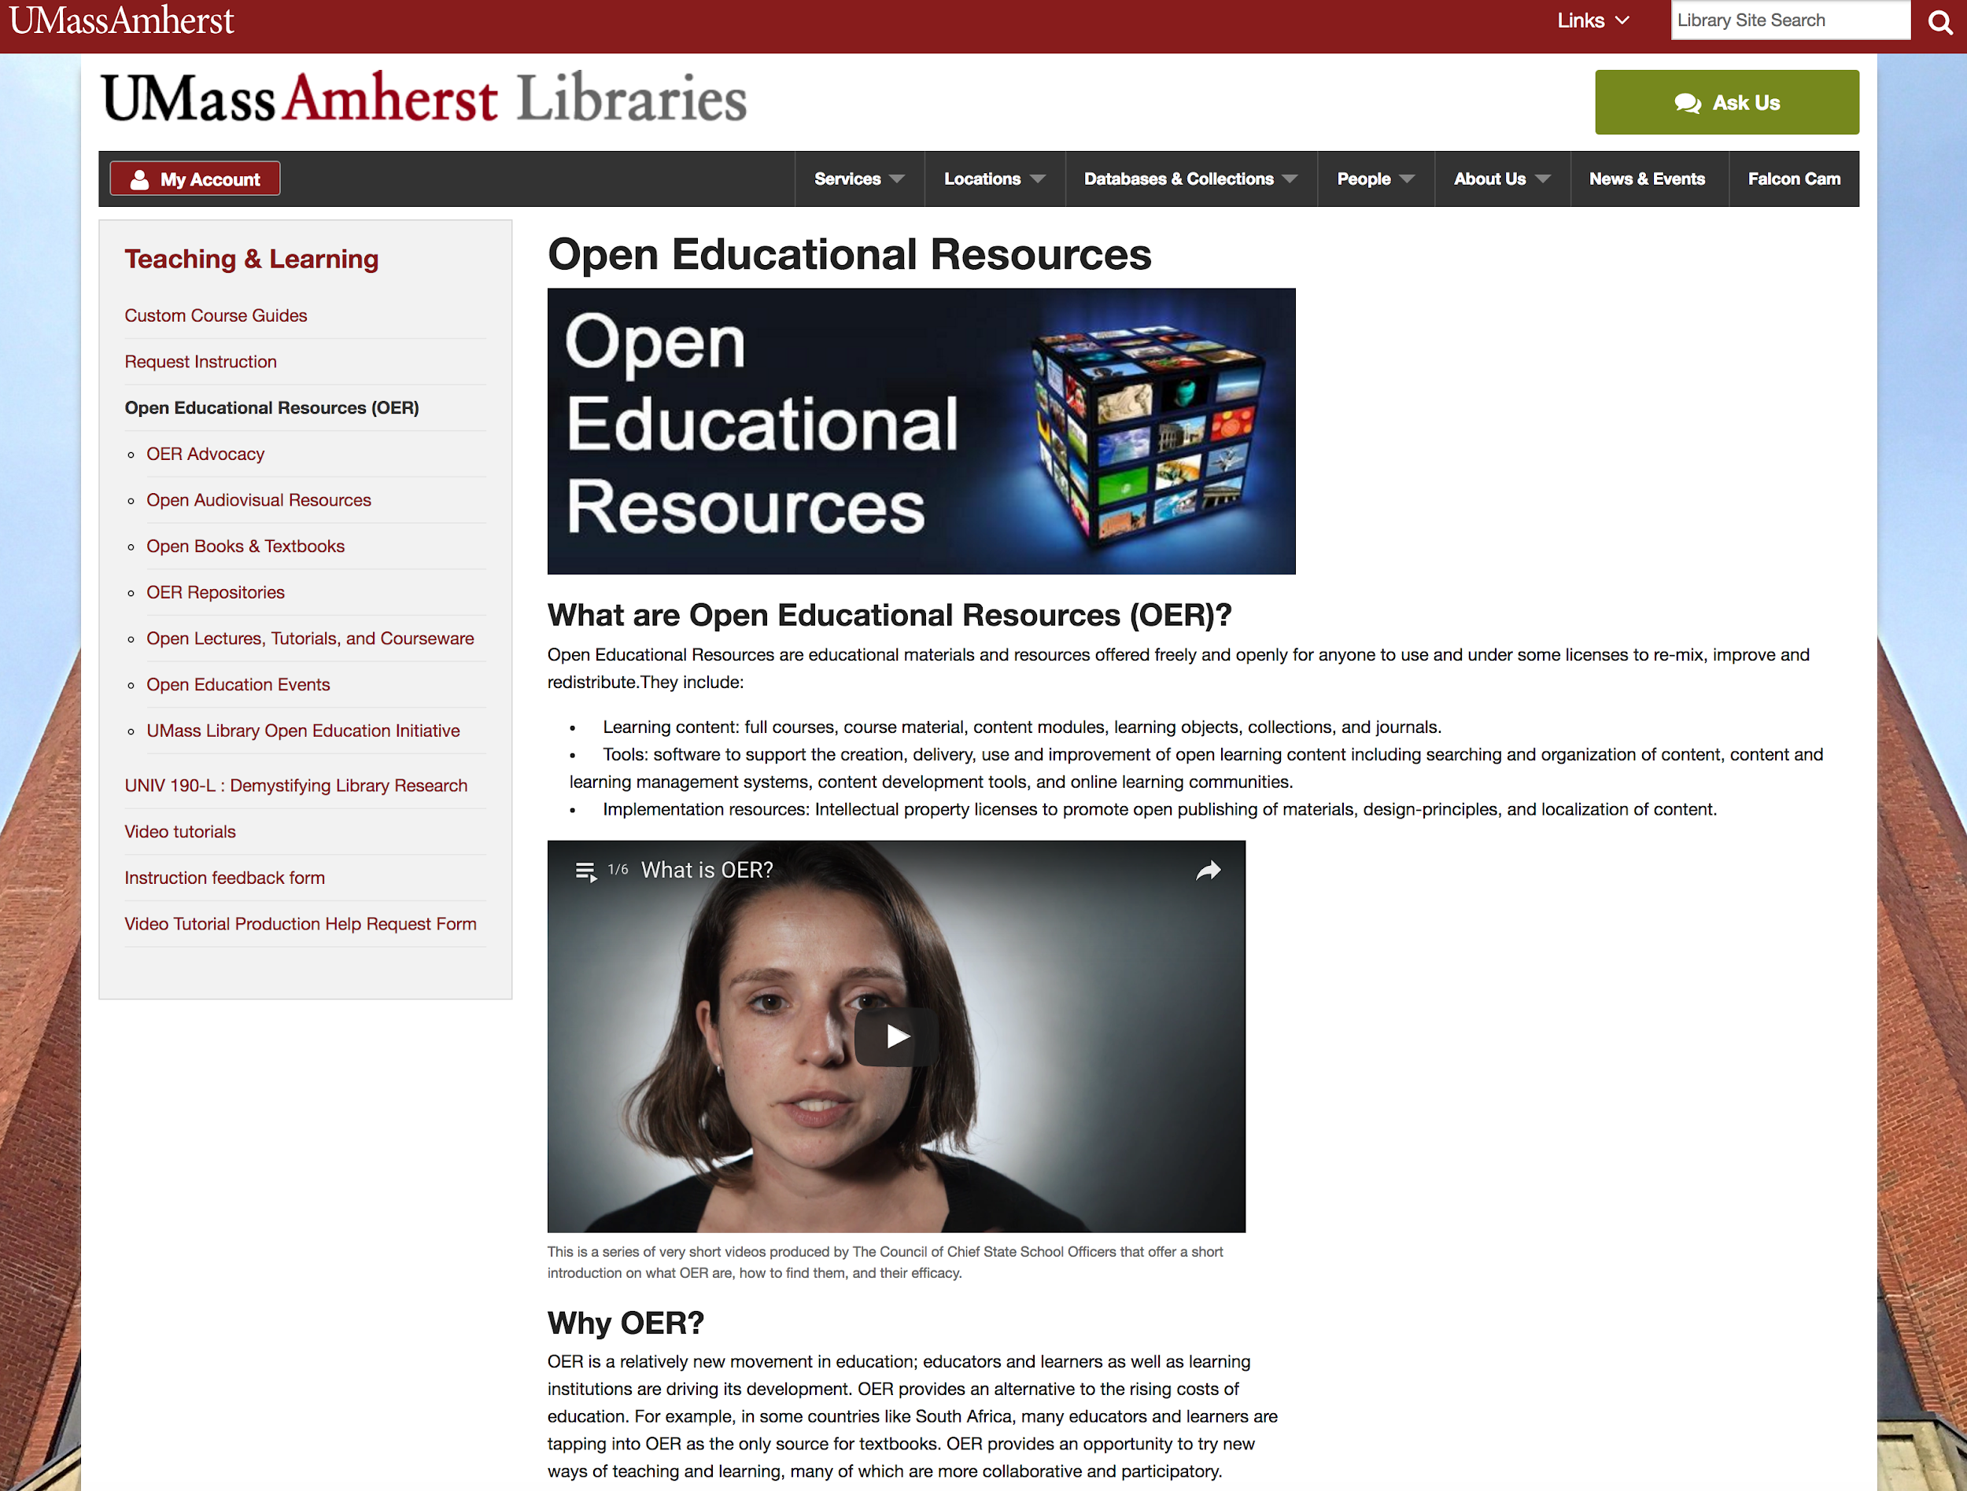
Library OER Website

Slide 17
Faculty Project Types
Adopt
Replace commercial textbook with open textbook
Adapt
Combine existing OER, library resources, and newly created material
Create
Create entirely new open course materials

Slide 18

Faculty Success Stories

Slide 19
OER Assessment

Slide 20
Results Since 2011
$1.6 million
student savings
$100,000
invested
10,000 students, 60+ faculty, & over 100 classes
impacted

Slide 21
Total Savings Over Time By College
College of Natural Sciences | 5,203 | $860,773
College of Social and Behavioral Sciences | 1,630 | $219,085
College of Humanities & Fine Arts | 699 | $96,709
College of Engineering | 818 | $169,091
College of Education | 727 | $85,098
College of Nursing | 146 | $17,785
Honors College | 187 | $7,835
Stockbridge School of Agriculture | 275 | $51,838
Isenberg School of Management | 612 | $57,085
School of Public Health and Health Sciences | 307 | $66,135
 | 10,793 | $1,631,433.25

Slide 22
Thanks!
Questions?
Jeremy Smith
jlsmith@library.umass.edu

