Slide 1

Creating a
rightSpace
for Library Instruction
Maureen Perry
Elizabeth Bull
Megan Mac Gregor
University of Southern Maine Libraries

Slide 2




Developing the Concept

Slide 3


Background
public institution
total undergraduate enrollment of 6,675
3 Campuses
57.4% of classes have fewer than 20 students
251 Tenure track & non tenure track full time faculty
73 part time faculty
9 reference librarians (non-faculty)
pre-Covid 23% of our courses were online
U.S. New Reports, “University of Southern Maine” https://www.usnews.com/best-colleges/university-of-southern-maine-9762
University of Southern Maine “Department Indicator Report (AY2020 - Fall)” https://usm.maine.edu/department-analysis-applications-institutional-research/departmental-indicator-reports
Notes:
We, like all librarians,
struggle with getting into the classroom
once there,
having enough time
get everyone on the same page with basic library skills.
We never seem to be able to have time for some of the
knowledge practices and frames.

Slide 4


Opportunities
Notes:
In Fall 2019 our faculty were told
course management system
BlackBoard to Brightspace in Fall 2020.
Our librarians saw this moment of change as a perfect way to engage with faculty in a new way.

Slide 5

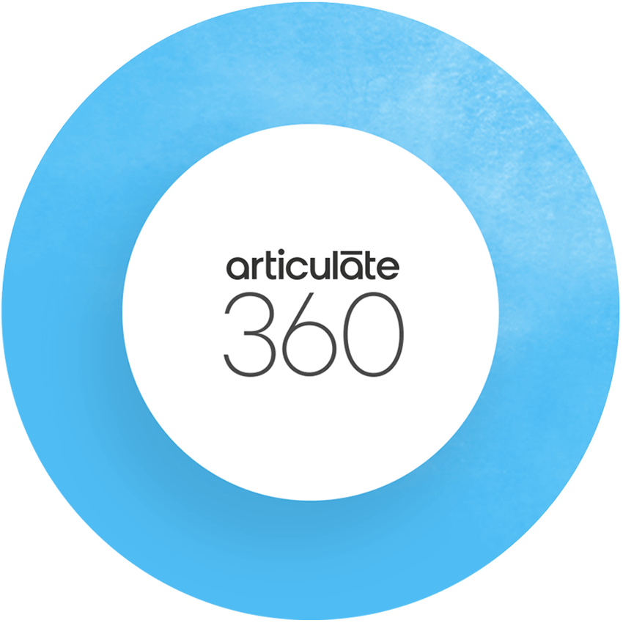



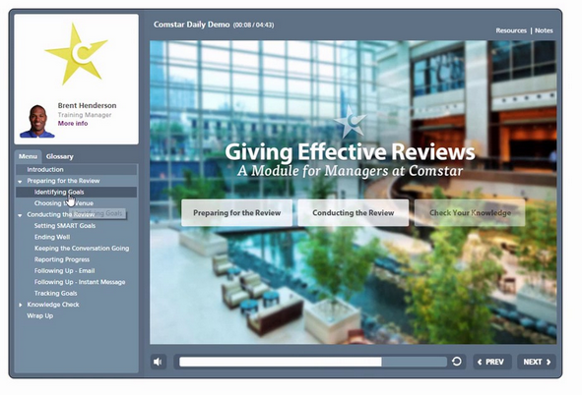



Notes:
Our team of 7 Librarians across two campuses had planned:
creating a suit of 6 professionally produced videos
purchasing Articulate, a video creation platform.
Using the Professional videos as a starting point we planned to use Articulate to create Courses to further flesh out the videos.
videos
focused on the research process
scripted by the librarians.
We applied for a USM Provost's Pillar Grant: Aims to funt intiatince
demonstrate support for one or more of USMs four academic pillars,
can sustain itself after being funded,
and has a direct impact on students.
shy of $15,000
video creation by an outside company
Articulate for 3 years.
Just as we hired & started working with the company Swallowtail to produce these videos to begin this process, COVID hit.

Slide 6

Notes:
When COVID came in March 2020 100% remote.
The transition was a rough one for a faculty body who had very little prior online teaching experience. (23%)
By the end of the Spring semester our faculty were faced:
realization that the majority of them would have to transition all of their Fall classes into BrightSpace, (unfamiliar with)
learn how to teach online.
Our Center for Technology Enhanced Learning (CTEL) stepped up to the challenge:
workshops
short courses
. The librarians participated as learners AND teachers.
With the learning environment in a state of epic upheaval,
the librarians were able to use the state of constant change to
introduce faculty to one more new thing;
Library BrightSpace Modules,
required the faculty to do very little
and didn’t make them learn something new.

Slide 7




Dividing the Workload
Notes:
When it came to dividing up the content outside of the Swallowtail videos, we decided to break out the various parts of the Information Literacy process by student experience level.

Slide 8
BrightSpace
Modules
Basic Searching
Pre-Research Checklist
Citations and References
Categorizing Information
Developing a Search Strategy
Using Information: Synthesis, Copyright, & Plagiarism
Library Starter Kit
(What to Know & What to Do)
Assessing Information Sources
Notes:
Here is a list of the library’s Information Literacy Brightspace modules

Slide 9
Beginner
Intermediate
Advanced
Library Starter Kit
(What to Know & What to Do)
Citations and References
Assessing Information Sources
Pre-Research Checklist
Using Information: Synthesis, Copyright, & Plagiarism
Developing a Search Strategy
Basic Searching
Categorizing Information
Notes:
And here are the modules categorized by student experience level
We wanted these new Brightspace modules to complement and expand upon the professional videos from SwallowTail
The Swallowtail videos were used as a focal point for many of the modules
Used the Brightspace modules to dig deeper into university specific nuances regarding the research process

Slide 10




Creating
Various Modalities
Notes:
To share the workload for these various modules, some volunteered to take on specific categories that they felt the most well-versed in, and others were randomly selected to be the primary creator of a module.
3 members had access to the creation of Articulate videos
included a variety of modalities such as text, video, interactive elements (such as a scavenger hunt), diagrams, quizzes, and infographics.
Using this skill-sharing method, those of us with a more graphic design experience offered to work on the more image based materials while others with a background in instructional video creation developed the Articulate video tutorials.

Slide 11
Workflow
Process
Reviewer
If no change is needed
Primary
Creator
Group Approval
First sends to
This was the process for each individual module and reduced the amount of time it took to both create and review the module materials. As we had a short deadline to have these published, an efficient workflow such as this was essential.
If change is needed
Notes:
For each module, there was a Primary Creator as well as a Reviewer to provide feedback and highlight potential areas of improvement before being sent for final review and approval to the team,
This created a more streamlined workflow by avoiding sending each module to the entire department for approval
helped to ferry-along the completion of the modules in a timely manner since we were on a fairly tight deadline

Slide 12
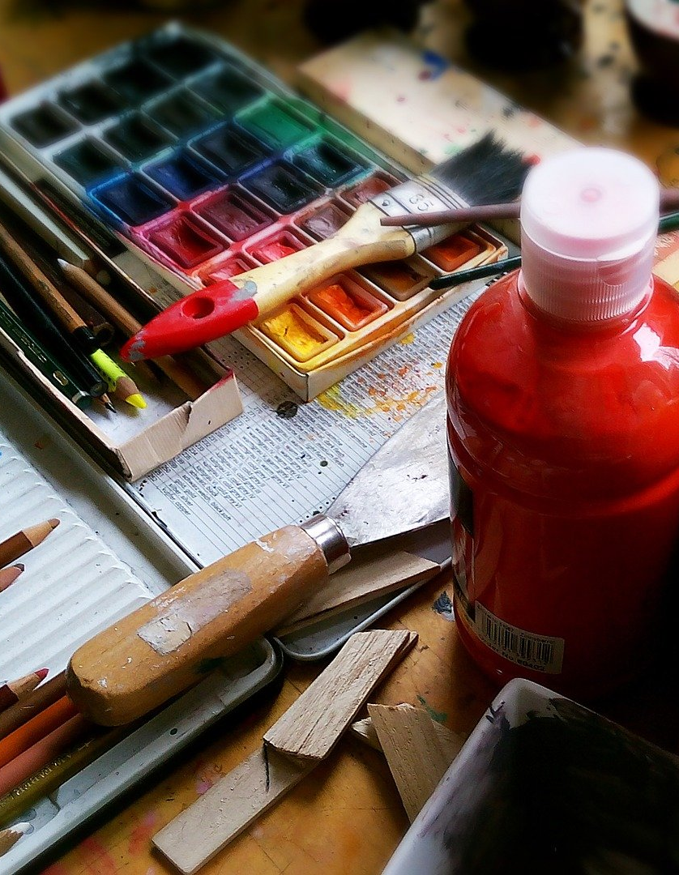



Creating Content

Slide 13
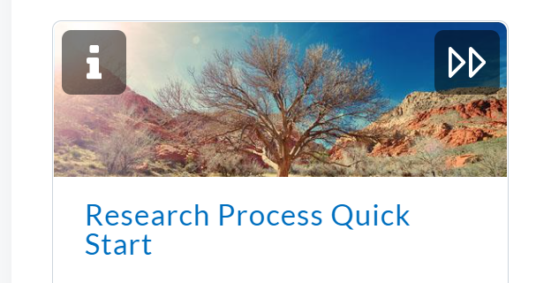
Professionally
Produced Videos
Notes:
Final product from Swallowtail June 1
Videos gathered into one module, overview of research process

Slide 14
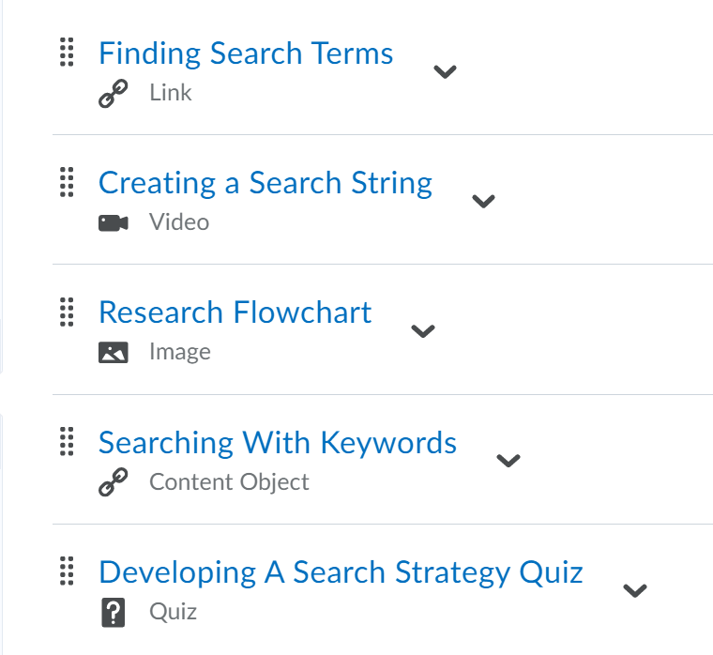
Homegrown
Content
Notes:
Remaining modules focused specific aspects of research (for ex. Different search strategies, citations and references, etc.)
Homegrown materials
As Elizabeth mentioned, Varied items: Videos, infographics, handouts, quizzes, etc.
Developing a Search Strategy module (as sample)
Different for each module, but considering what would best suit the material and how to balance different modalities

Slide 15

Learning
Curves
Varied tools
BrightSpace itself
Accessibility
Photo by Mark König on Unsplash
Notes:
Note use of the plural: Multiple learning curves at once
Varied tools (for ex. Adobe Spark for videos, Pictochart and Canva for infographics, Articulate)
Different for each person, depending on experience
As mentioned earlier, work divvied up according to different skill sets, but sometimes needing to step outside of one’s comfort zone.
Turned to colleagues who knew the specific tool or could recommend a tool
My example of learning Adobe Spark
BrightSpace itself
Learning as we’re using it
Learning along with all of the faculty across the UMaine system
As Megan noted, Support from CTEL and from each other
Accessibility
Did not want to neglect, in the midst of other considerations
Editing captions a common issue: Kaltura (video hosting) slow to generate them
Particularly challenging for some content

Slide 16
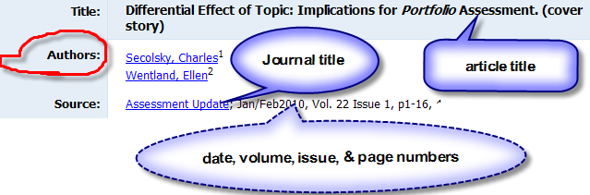
Notes:
Example of my intended infographic (Alt text a nightmare)
Support from CTEL to improve it

Slide 17
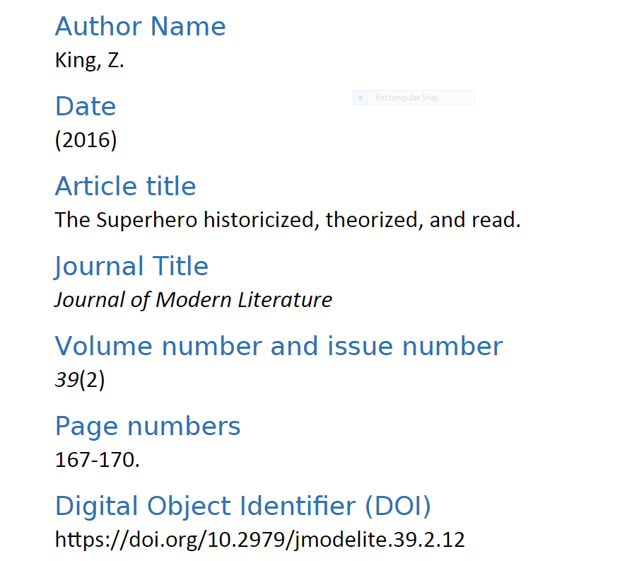
Notes:
My more accessible alternative (Headings and plainer text better for screen readers)

Slide 18
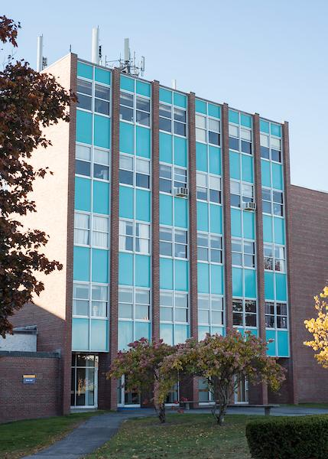
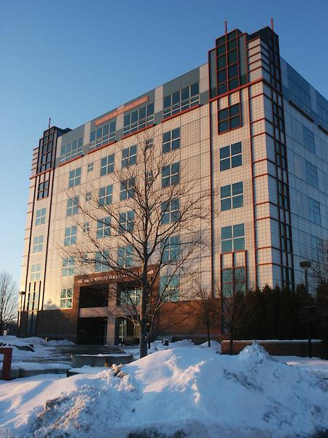
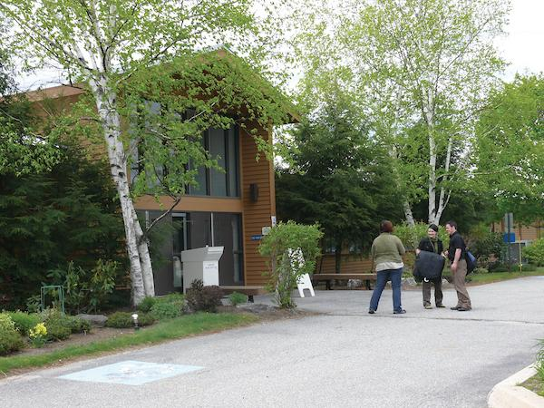
Group Synergy while
Working Remotely
Notes:
Collaborative effort overall
Getting together already a challenge pre-COVID due to 3 campuses
Gorham (residential campus)--roughly 11 miles from Portland
Portland (largest campus)
Lewiston (satellite campus)--roughly 35 miles from Portland
All working remotely, needed collaboration tools

Slide 19
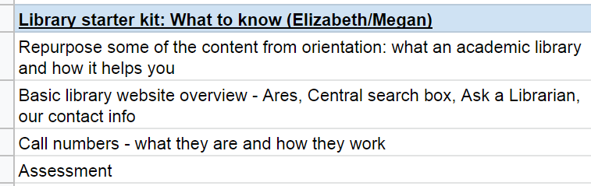
Collaboration
tools
Google Drive
Notes:
Had used pre-COVID (UMaine system using Google suite), but worth mentioning for this project too
Portion of our spreadsheet

Slide 20
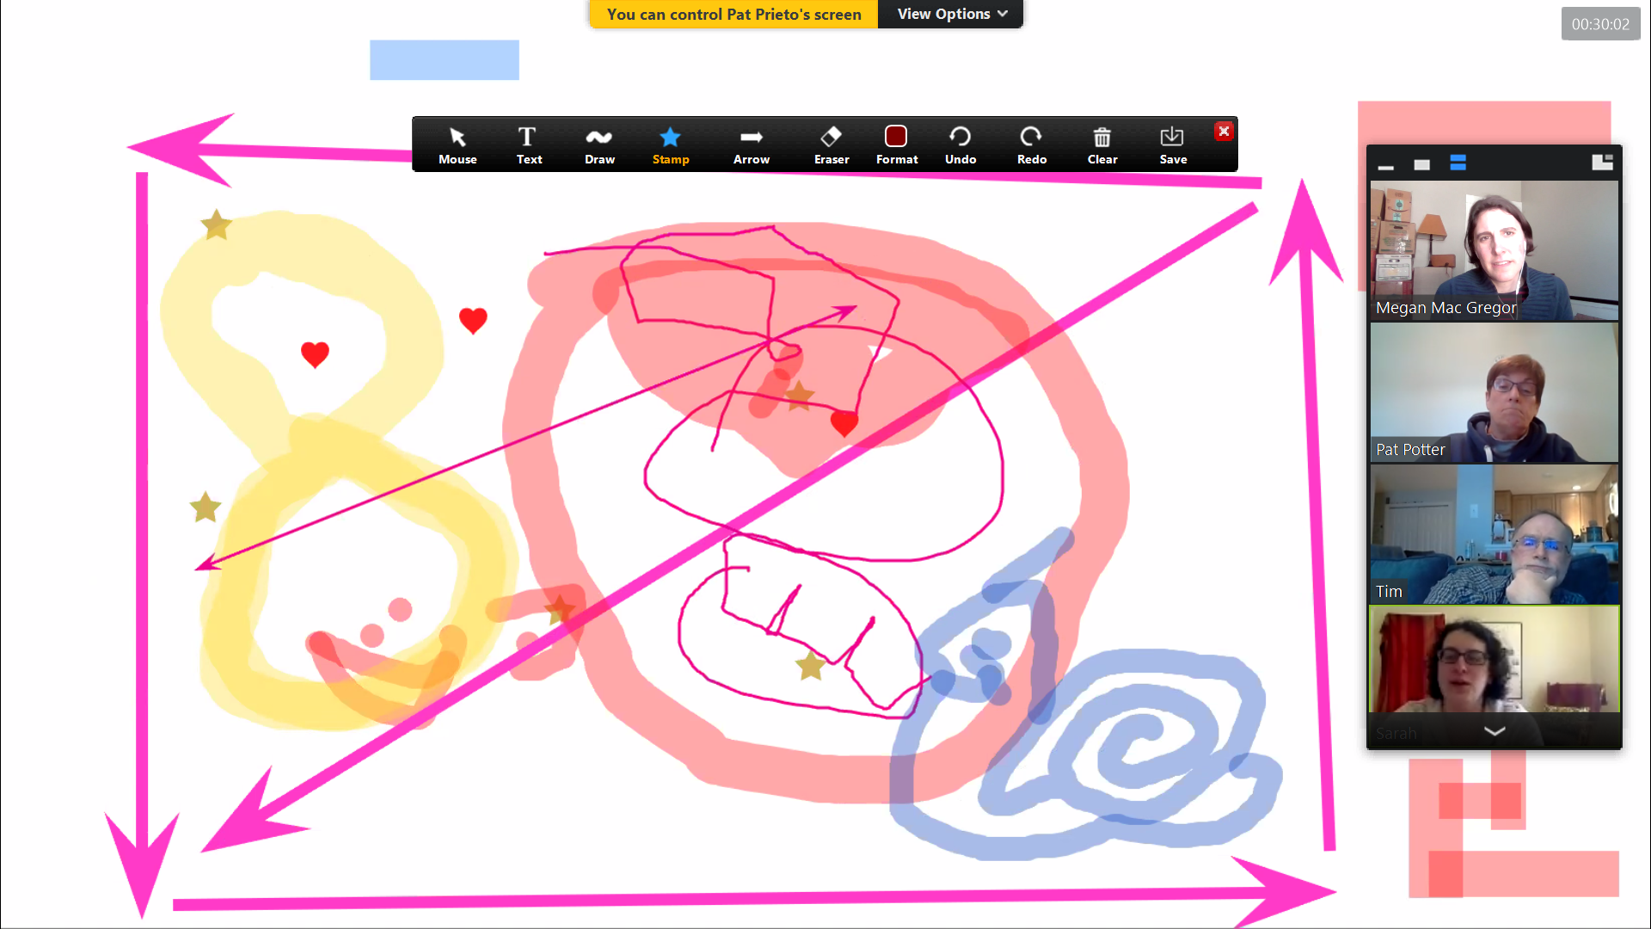
Zoom
Notes:
Also obvious, but important
Had used pre-COVID (traveling for meetings sometimes impractical), but more extensively since
Discussed the modules at dept. Meetings
Social element increasingly important (Example of shared whiteboard)

Slide 21
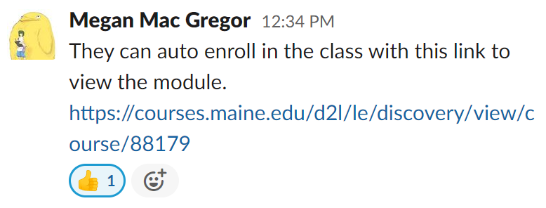
Slack
Notes:
Collaborative workspace where people can share messages, links, documents, etc.
Implemented due to COVID
Social aspect (profile picture and emoji response)
Useful for quick troubleshooting, not clogging email inboxes (Example of post concerning faculty previewing the module

Slide 22



Spreading the Word
to the Faculty
Notes:
Having a majority remote campus, and a preoccupied faculty, posed issues with promoting the new Modules and getting the word out.
We promoted the modules to the faculty:
mass emails
one on one conversations
Over the summer
At start of Semester

Slide 23
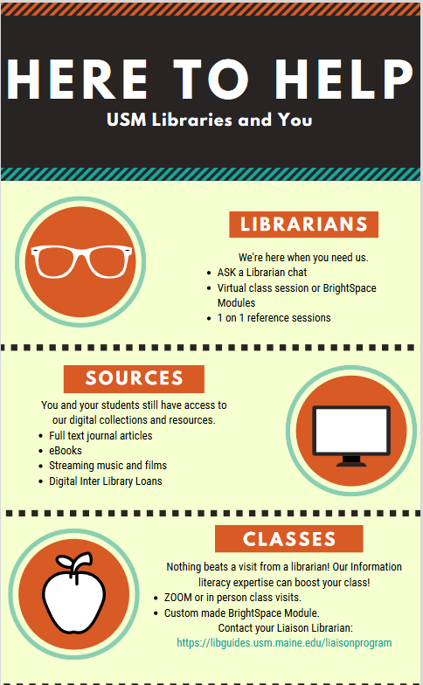
Notes:
mass emails
Over the summer,
designed to keep the library in their thoughts,
we hinted at the coming Bright Space modules
By August completed Modules (9) - Ready to share
BS sharing a bit tricky.
Created Course
-CTEL helped us create an Auto enroll function for the course in BS
-Link
-Allow fac to see content before requesting it in their course(s)

Slide 24
[Your greeting of choice]
The USM librarians have created a collection of asynchronous Brightspace modules about information literacy and the research process. These modules can be easily copied into your Brightspace course so your students can work through them seamlessly with your other course content. We have set up the modules in Brightspace so that you can auto-enroll and preview the content if you would like: https://courses.maine.edu/d2l/le/discovery/view/course/88179
The first two modules, What to Know and What to Do, would be ideal for first-year students who need a basic introduction to the library website as well as how to activate their ID card for library use.
Research Process Quick Start contains 6 short videos that walk students through the research process from start to finish. The remaining modules dive into the steps of the research process in more detail.
The Pre-Research Checklist ensures that students have thought through their information needs and strategize about their research process before diving in.
Developing a Search Strategy shows students how to identify keywords and combine them using Boolean operators to get the best results out of a search.
The Basic Searching module leads students through searching in URSUS, OneSearch, and article databases, as well as how to make sense of their search results.
Using Information shows students how to paraphrase and synthesize information, how to avoid plagiarism, and the basics of citation and copyright.
Citations and References takes students on a deeper dive into how to cite their sources properly.
If you would like to import any of these modules into your course(s), just contact your department's liaison librarian! We will be happy to assist you. We can also create a custom module of library-related content for your course, tailored specifically to your syllabus and assignments.
Notes:
Email
Overall purpose of modules
How they could be used
Summary of each
Repeated in Announcement in Course

Slide 25
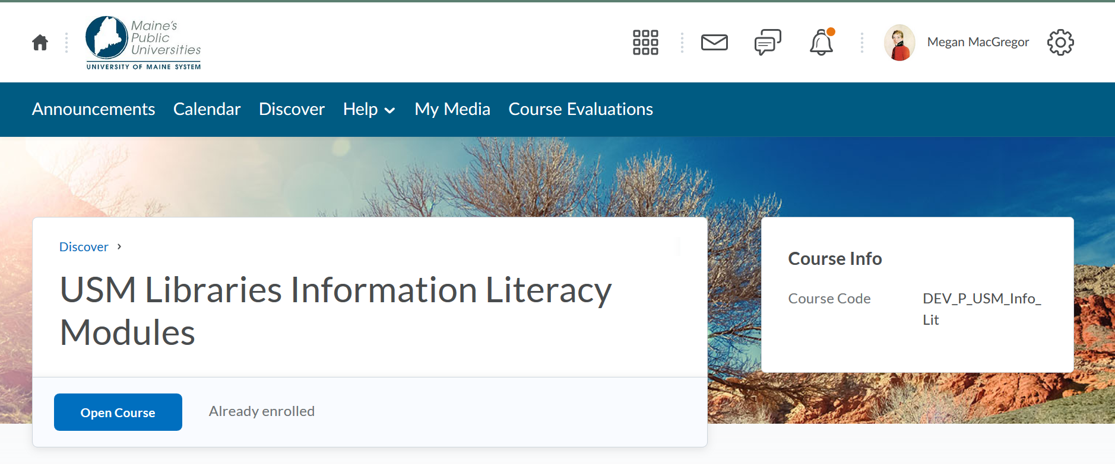
Notes:
What Faculty would see once they clicked the link, except that “Already enrolled” would be “Enroll”

Slide 26
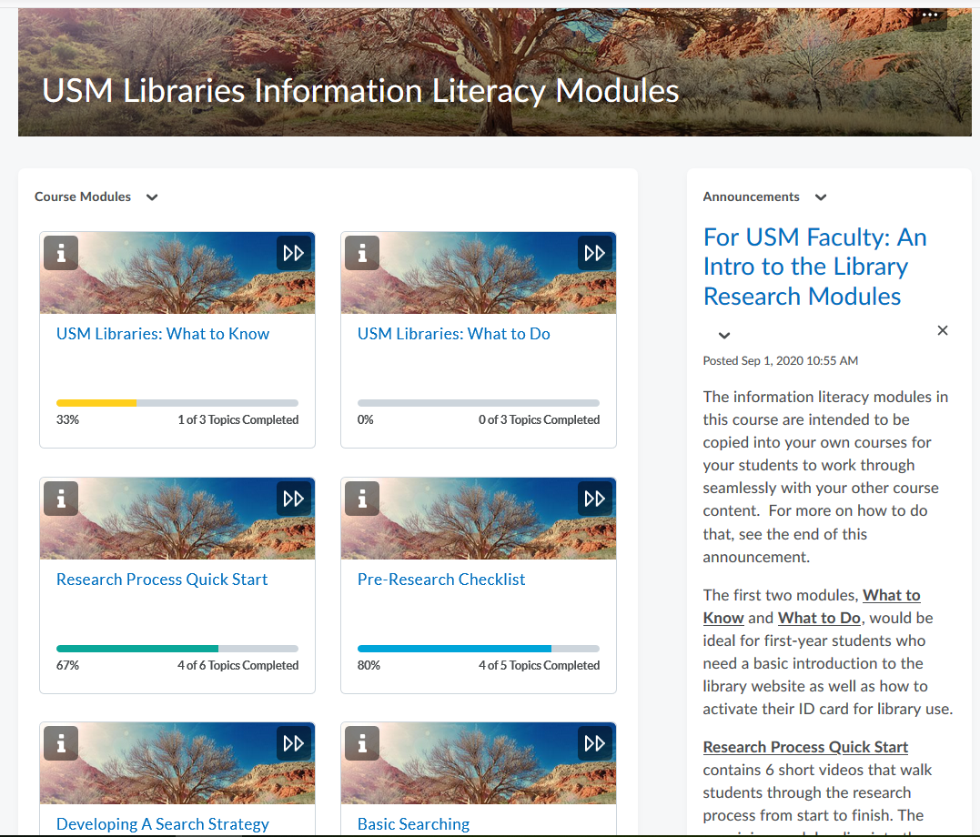
Notes:
What they saw once they were in. Note how we reiterate the message about what each module did in the announcements

Slide 27
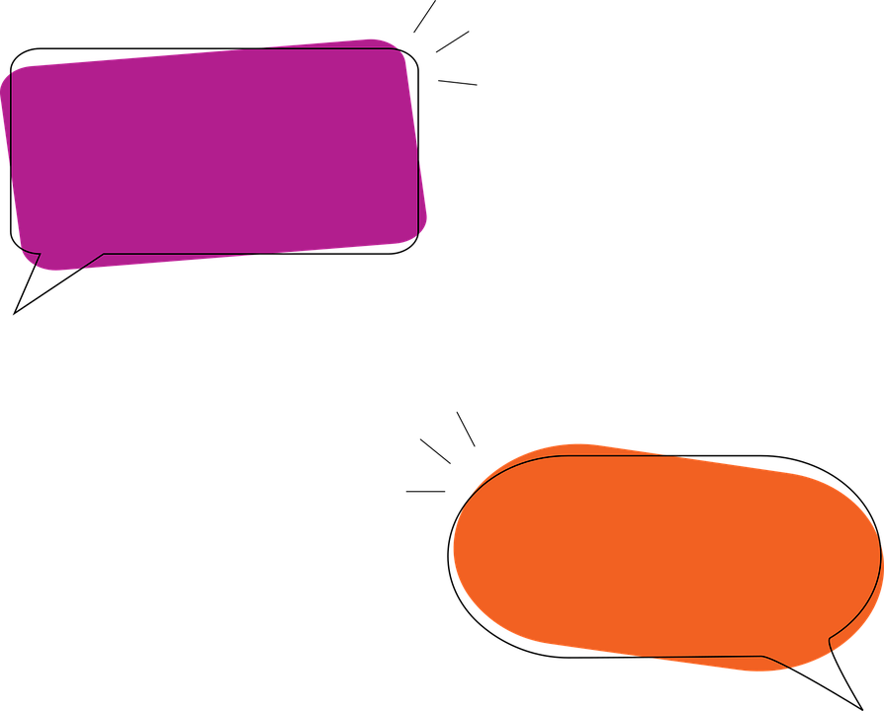
Notes:
Our most important form of outreach
one on one conversations we had with faculty
leading up to
After the start of semester.
Faculty had lots of questions about library in COVID
Emails and Zoom mention how coming modules might help.
Once the semester started
requests for teaching, librarians were able to:
offer option of one of the modules as:
a lead up to the instruction session,
as a post session work through,
OR as a way to replace a session in a asynchronous class,
-Several faculty who had never used our services were willing to import a Module.

Slide 28
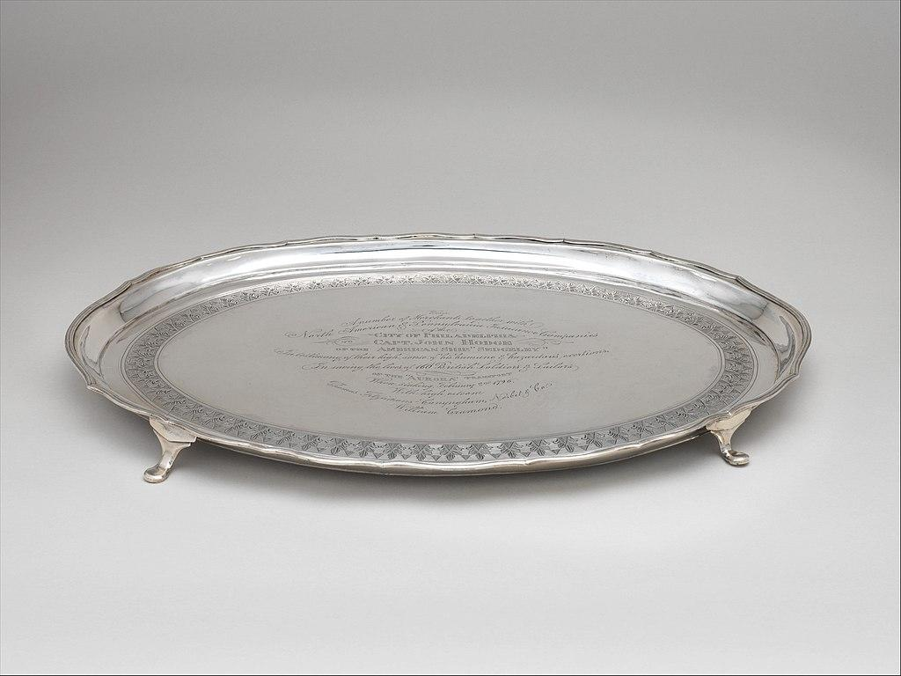
Notes:
Gave librarians a short hand to create tailored mod for a specific class.
In all of our communications:
emphasize that including these modules were incredibly easy
required no effort on the part of the faculty member
Anything that did require effort we spelled out:
How to guide to add librarians as an “Instructor” in the course
We presented the modules to them on a silver platter.

Slide 29



Feedback
Notes:
Modules are still being used and surveyed for student experience

Slide 30

Direct Statistics
& Overall Usage
Total Visitors: 69
Total Users: 58
Users who have visited content: 29
Average Number of Individual Logins: 48
Most Used Module:
“Research Process Quick Start: Finding Search Terms” (Video)
Second Most Used Module:
“What to Know: Library Website Overview” (Video)
Notes:
Current data and statistics available directly from our course through the LMS show:
68 total users
29 who have directly accessed (“dug into”) the content
The top module was accessed 15 times
Second most accessed module was one point behind: 14 times
Once these modules leave our course, we cannot retrieve stats or data about their usage - which requires us to depend on faculty for the feedback about how much they are used within their own courses

Slide 31
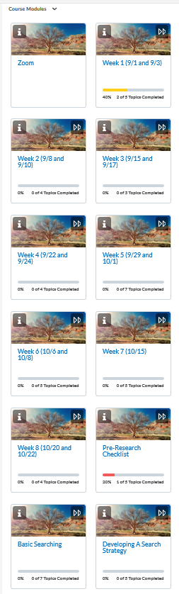

Modules
in Action
Copied and embedded in the Faculty’s own course
Provided to students by the visiting Librarian before and/or after their Zoom session
Students independently ‘enrolled’ in the full course
Faculty chose individual resources (links, documents, etc.) from the modules to include in their course(s)
When the libraries’ modules are embedded in a separate course, this is how they appear below the courses main modules.
Notes:
As Megan mentioned, there are many instances wherein a faculty member who has never had a librarian visit their class for instruction has integrated one or more library modules in their Brightspace course.
Additionally, we have received some verbal and written direct feedback from faculty members, although most of it has been received through conversation
some of faculty have taken a module and dragged them into their own weekly course modules so they flow better in the class
Faculty appreciate being able to drop the modules into their courses at will and organize them within their course content as they see fit
Also like having the modules shared either before or after a zoom session with a reference librarian
Others have taken content (ie. individual resources like documents) and worked them into their courses

Slide 32
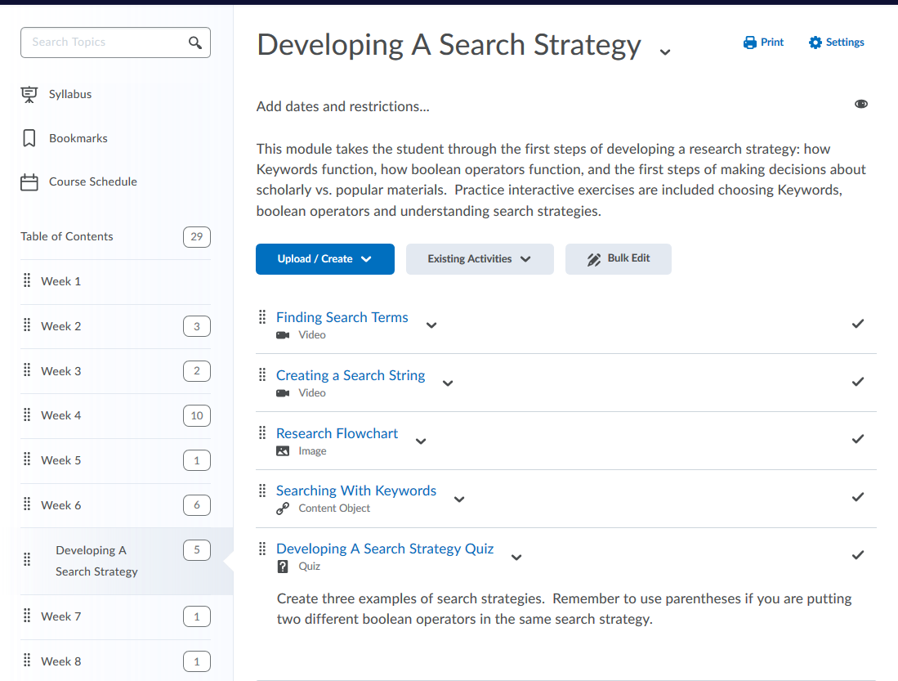
Notes:
Example of how the library modules appear when directly embedded into an instructors course and their own weekly modules

Slide 33

Direct Faculty
& Student Feedback
"Wow, what a great set of resources!"
ECON Faculty Member 1
“The one negative comment I heard from one student was that it was a little overwhelming having so many tools to look at.”
ECON Faculty Member 2
“The modules are fine, and they were definitely a helpful reminder for some things.”
Student
“Overall I think my students liked them. Those who used them said that the information was really helpful.”
ECON Faculty Member 2
Notes:
Intend to pursue a more direct, personalized method of receiving student feedback through the usage of a Google Form or other type of survey (perhaps located within the module itself) once things have settled for our student population.
Our job is not done!
These modules will require routine maintenance on our part, in order to keep such modules like the library website tour up to date.

Slide 34

Q & A
Ask Away!

