Slide 1
Acquisitions
IRM Showcase 2018
Scott Stangroom
Acquisitions Unit Coordinator

Slide 2
Acquisitions FY-2018
Acquisitions overview & cross-collaboration
New approach to subject liaison discretionary budgets
Real life license negotiations in a nutshell
The gap between CORAL 1.0 and 2.0
To the ends of the earth – global marketplace

Slide 3
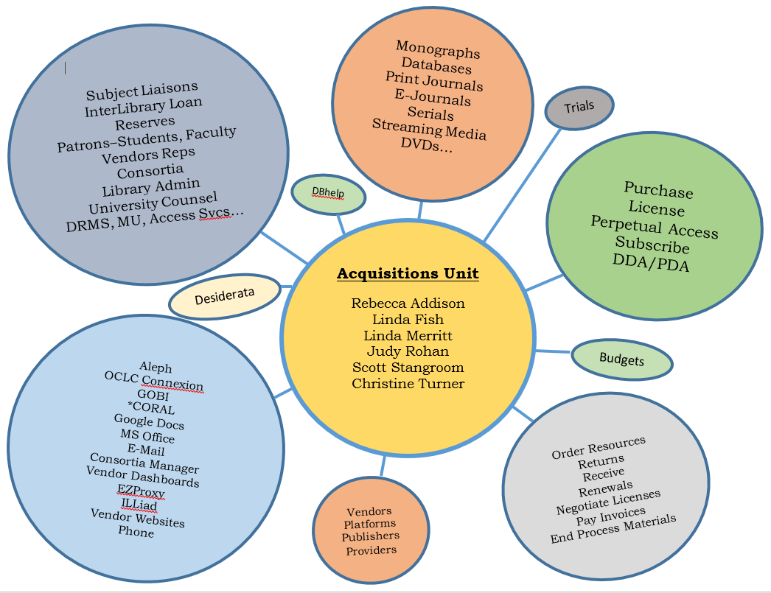
Acquisitions overview
& cross-collaboration

Slide 4

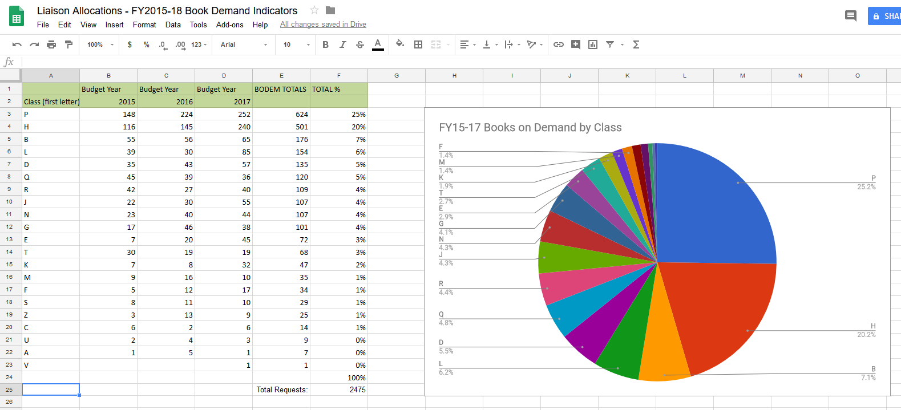
New approach to subject liaison discretionary budgets

Slide 5
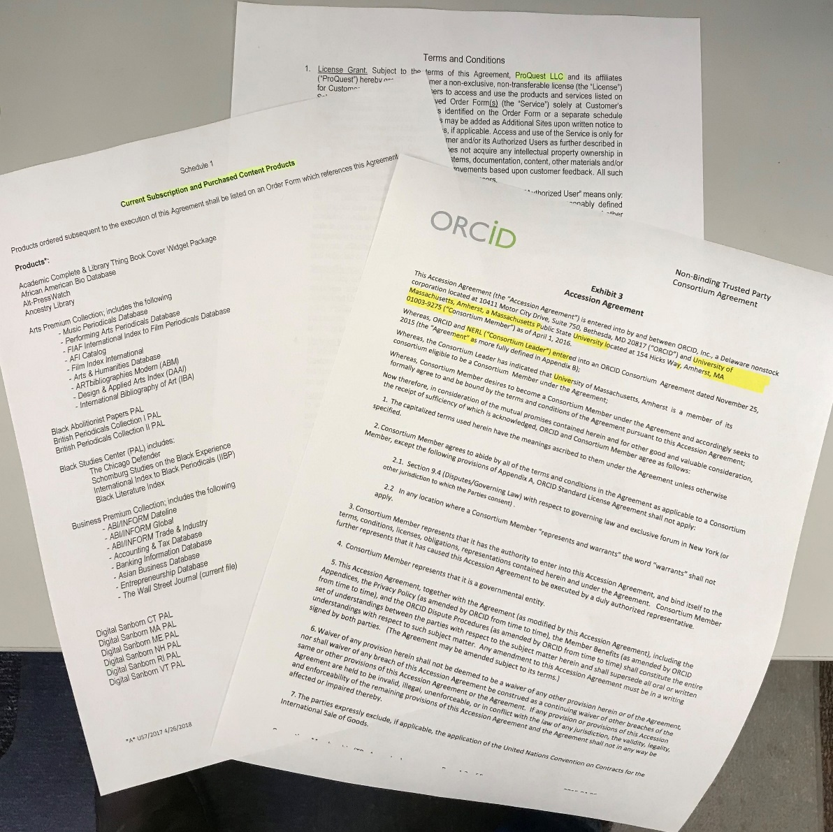


License negotiations in a nutshell

Slide 6







ERM and the gap between CORAL 1.0 & 2.0
Talk…Talk ERM
Gap Year

Slide 7


To the ends of the Earth – Global Marketplace

Slide 8
The End!
Acquisitions - IRM Showcase 2018

