Slide 1
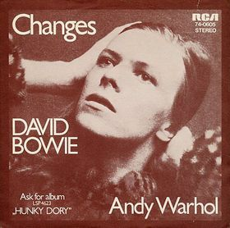
Re-Turn and Face the Strange:
A Technology Implementation, Change Management,
and a Pandemic
Aaron Neslin, Library System Coordinator for the Five Colleges
Ann Kardos, Metadata Librarian at University of Massachusetts Amherst
Michelle Paquette, Metadata & Technical Services Archivist at Smith College
Colin Van Alstine, Metadata Technologies Librarian at Smith College
Notes:
Thank you for that introduction.
{introduction of roles at institutions and FOLIO}
In this presentation, we’ll be talking about our experiences and reflections of change management during our multi-year implementation of the FOLIO LSP. For those that are unfamiliar, FOLIO is an open source library management platform, being developed by an international community of developers and institutions.
And how a global pandemic can throw you off.

Slide 2
Introduction
Approaching change with a methodical process will help the process proceed and increase likelihood it will permanently anchor in the institution
Change Management provides a systematic approach to dealing with organizational change
Change is hard
Many Models and Frameworks
Notes:
https://www.pmi.org/learning/library/integrated-change-management-5954
{Aaron}
Change management is a way of being methodical and intentioned with the process of instituting a major change initiative. In using a methodical approach, it’s more likely that you organizational change will be successfully completed, and take root in the organization.
However it’s important to remember- change is hard. Using an analytical approach may make the process smoother, it is still going to make people feels stressed and anxious, it’s still going to require hard work, a certain amount of sacrifices.
We originally prepared this presentation over a year ago- back when we thought things might be back to normal in a few months, max, and we were much earlier in the library system migration. The challenges we’ve faced during this time have clarified both how important many of the principles of change management are, and how hard it is to integrate them into your project.

Slide 3
Kotter’s 8 Steps
Establish a Sense of Urgency
Create a Guiding Coalition
Develop a Vision and Strategy
Communicate the Change Vision
Empower Broad-Based Action
Generate Short Term Wins
Consolidate Gains and Produce More Change
Anchor New Approaches in the Culture
Notes:
{Aaron}
In this presentation, we’ll be looking at our change (and encouraging you to look at changes in your own institutions) through the lens of John Kotter’s 8 steps, from his Book “Leading Change”. It is absolutely not the only framework for change- there are others including models from the PMI, Detta Jones, Bridges .
we’ll be sharing own experiences with library system migrations, through the Kotter’s steps

Slide 4
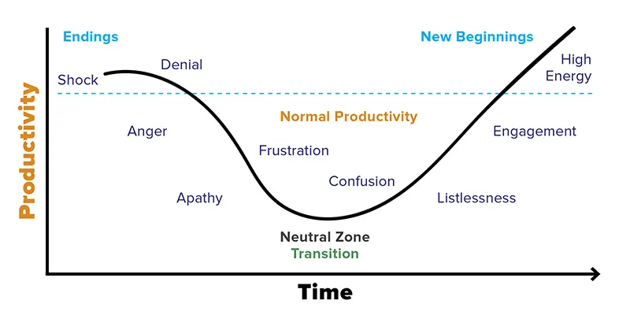
Let’s think about our emotions and change...
https://PollEv.com/acrlne
Notes:
[Colin]
The chart that we see here is another model that is often used to help frame change management. This is a riff on the Transition Model by William Bridges and it represents a spectrum of emotions that are found between three main phases; Endings, a Neutral zone and New Beginnings. One of the things that I like about this model is that acknowledges that everyone has a personal and emotional reaction to change, and you can move back and forth along a continuum as you go experience change.
You’ve heard from Aaron that we initially created this presentation a year ago, and that in the meantime, we went live with some parts of FOLIO and pushed back our timelines for others. The shape of the graph for our FOLIO project really depends on what part of the tool you are interacting with and these changes caused all of us to have to reevaluate how we feel about the project and determine what our engagement should look like going forward.
We would like everyone to take a moment and visit the link that is on the slide, which has also been posted to the chat, and think of a major change initiative that you have experienced. How did you feel during the process and where do you think you are now?
Keep this change initiative in mind during the presentation. The four of us will be talking about our experiences with the FOLIO library service platform, but we are hoping that you can find your own personal ways to connect to the change management concepts that we are going to talk about. We just posted a second link to chat that will show how all of today’s participants are responding; it will be interesting to see where we all are.
As you finish selecting a point on the Transition Model, we will hear from Ann about the need to establish a sense of urgency.
Tiny url:
https://PollEv.com/acrlne
Live results:
https://www.polleverywhere.com/clickable_images/SH7JHl4vcX1fy8gPgLAGF?preview=true&controls=none

Slide 5
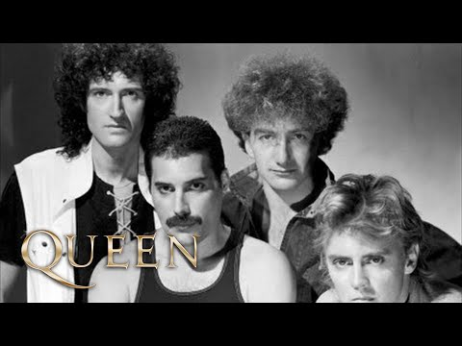
Establish a sense of urgency
Urgency does not mean panic, but to make people feel “Under Pressure”
Urgency is about preparedness and timelines
This can be a difficult step!
Notes:
When you establish a sense of urgency, this doesn’t mean to panic but it does mean to make your colleagues feel like they are under pressure.
Urgency is about getting you, your colleagues, or your organization prepared for whatever big change that is coming--you’ll all be working on a brand new project that is going to change people’s work and their daily lives
It’s important to communicate your timelines clearly and make sure people understand what will be asked of them at all stages of the project
This is a hard task--the work is done up front before you might know everything that your migration will entail, and of course you don’t know about whatever pitfalls you will encounter. I will admit that I think we’ve struggled with this step during our migration process to FOLIO, mostly because the product is open source and some of the milestones have slipped and we’ve also changed our timeline several times now. Additionally, there have been times when we’ve struggled to effectively communicate very specific workflow changes that need to happen now, in our current system--things that need to stop or it will cause big problems with the actual data migration. As a result, I think we still have a number of colleagues at UMass in particular who still feel like FOLIO is something far away that will be happening to them, but they are not really a part of.

Slide 6
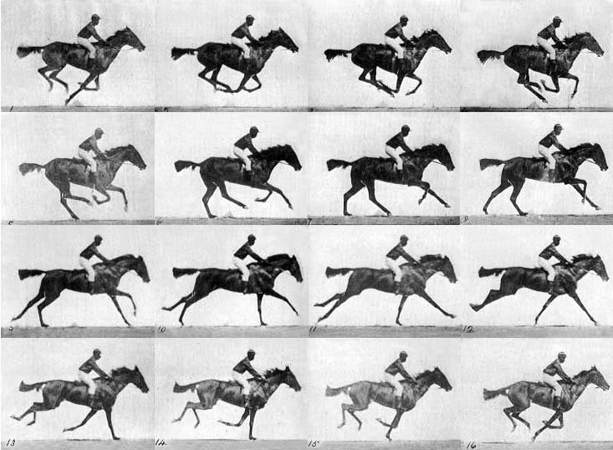
Some steps to establish urgency
Make sure to identify the problem
  WHY are we making this change?
Identify a major opportunity
  WHAT is great about what we’re doing now?
Reach out to stakeholders and get people involved early on in the process
Notes:
But here are some things we can do to help communicate our urgency better. All of us working on the project should be able to identify the problem with our current database, or the problems we have with our data for migration. We should be able to discuss with them WHY we are making changes. But we should also be able to tell anyone WHY this is a major opportunity. What do we stand to gain? We should be able to talk about why FOLIO is so exciting!
It’s really important to get your stakeholders on board so that they can also talk about the change in this manner. And just so you know, everyone affected by the change should see themselves as a stakeholder. Anyone should be able to communicate why the organization is doing what it’s doing and why this change is going to be so great, and yes. I mean everyone in your department, from the lowest to the highest should have a basic understanding of what the implementation team is trying to accomplish and why.

Slide 7
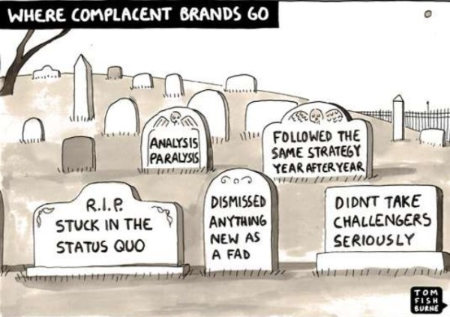
Why is urgency important?
libraries
Notes:
I thought this graphic was a funny way to illustrate why change is so important. All of us here work in libraries and I think libraries have trouble with clinging to the idea that we’ve always done something a certain way. I’ve personally seen this allegiance to historical workflows and processes in every library I’ve worked in. I think this attitude creates difficulties for metadata and systems workers whose very jobs are to innovate. We have a lot of innovative things going on in our libraries, but it can seem hard to get our colleagues on board with all the change that needs to occur.
It’s challenging to reframe our innovative changes in our libraries with urgency from the start. But in an era of shrinking technical services departments and a deprioritization of our expertise, we need to change our thinking around how we work with our data and our systems. It is, in fact, urgent that we handle our data differently, urgent that we imagine new workflows and provide innovative solutions, and the pandemic has shown that we need to be creative regarding how to provide our services to our colleagues and campuses. I think for us, the 5C adoption of FOLIO has changed how we approach taking risks with our some of our data, and we’re getting better at creating the pressure and urgency the project needs. To do this it helps if you have a strong coalition, which is what Michelle is going to talk about next.

Slide 8

Establish and maintain a strong coalition
"Kotter (1996) maintains, however, that a change process cannot be successfully planned, led, and executed by the leader alone, regardless of the amount of power that person holds; it should instead be guided by a coalition." (Carter, 2014)
Notes:
[Michelle]
In looking for examples of other libraries implementing change with Kotter’s principles in mind, I came across Toni M. Carter’s 2014 article “Assessment and change leadership in an academic library department: a case study”, which discusses a change in their library instruction program. Carter notes that “one advantage of Kotter’s (1996) method is that the leader of a change initiative does not require positional power within an organization." Positional power meaning being in a managerial role where you can literally tell the people under you what to do. There are other types of power, like personal power, which a person might have due to their expertise or their reputation.
READ QUOTE ON SLIDE
Basically, the change “leader” doesn’t necessarily need to have the power to make the changes, but needs to have people on their team that do have that power, or that have personal power to influence those that do. Going back to what Ann said about being blocked at times by the relationship with IT, that’s a case where a strong coalition in UMass might require someone from IT, or with influence over IT, to be part of the coalition.
In the specific case of FOLIO, any one person doesn’t, on their own - have the power to make Smith College implement FOLIO at a certain time or a certain way, but the leadership Coalition that individuals are a part of *does.* Similarly, I don’t necessarily have the power to influence how anyone outside of my institution does things, but I have the expertise related to Special Collections materials to inform the broader group about how different choices may impact Special Collections, making sure our voice is heard within this process. And you save yourself effort as part of a coalition - just like birds in flight share the load of migration by taking turns at the front of the V - you share the load of a change when you’re part of a strong coalition.
What this past year has shown is that it’s not enough to establish this coalition - it’s something that has to be constantly worked on to *stay* strong. Imagine if 4 of these birds just left the V, and three of them started trailing far behind. Everybody who’s left is working harder and harder to get to the same place. At Smith, we went through a lot of staff departures in the fall and are just now starting to rehire, so people were taking on more and more work within their day-to-day, making it harder to keep hold of the coalition. I myself dropped off several committees and found myself paying less attention to FOLIO development, with a constant thought of “I need to get back into looking at this”. I think it highlighted for me the importance of having formal accountability for my work on FOLIO, and the importance of having a leader to wrangle your coalition and keep them on task and engaged. [next slide please]

Slide 9
At Five Colleges
Coalition(s) formed out of necessity
  five different institutions impacted with different practices and needs
Multiple coalitions!
  FIT (FOLIO Implementation Team)
  Working Groups (5 of them)
Coalition characteristics
  position power (key players support the change, others cannot hinder)
  variety of expertise and viewpoints
  credibility
Notes:
[Michelle]
We could have done this at the Five Colleges without really thinking about it in terms of Kotter or any other formal change management strategy. We’re 5 different institutions with different practices and needs, so of course we’d need a coalition with members from all 5 colleges. I think this speaks to how important a coalition, that we tend to create them in times of great changes whether we do it with intention or not. Of course, just because we didn’t do this with Kotter in mind at the time doesn’t mean we didn’t do it with intention - the creation of FIT (the FOLIO Implementation Team) was intentional, and the formalization of other coalitions was intentional.
BUT I just want to note that the danger in creating a coalition without intention is that you might end up with a coalition that doesn’t meet the ideal characteristics - not enough power, not enough diversity, not enough credibility to influence those outside the coalition.
Again, though, a year into the pandemic, people’s priorities have shifted and at least for me personally, I had lost some of that intentionality, in part because of the lack of a sense of urgency that Ann mentioned earlier. I had left the Inventory Working Group at the direction of my supervisors and I hadn’t had the bandwidth to be intentional about continuing to pay attention to the group’s work, or to the broader FOLIO Metadata Management Special Interest Group for several months. I’m now making a renewed effort to attend meetings when they relate to my work. And at a broader level, the 5C as a whole realized we were due for a renewed examination of our coalitions to confirm whether they’re still hitting the desired balance of characteristics. My colleagues recently reviewed the roles of our different coalitions and how they work together, and this is an example of change management being an ongoing process. All this to say that while the shifting of our working during the pandemic has led to some shifting priorities, I still think these steps for change management are useful tools for thinking about and planning change. These reinvigorated coalitions are ideally getting us closer to our shared vision, which Ann will discuss next. [next slide please]

Slide 10

Create a vision
Communicate early and often
Show appreciation
Allow participation at all levels
Build skills together
Understand that transitions are emotional
Create shared values
Notes:
A vision can help build resilience and change acceptance among the staff. Communicating this vision is key, particularly if you have multiple teams managing the project, as in the case of the Five College. You can never really communicate too much. It keeps your teams aligned, encourages participation, and allows you or your groups to show appreciation for the amount of work being done.
We had to learn to communicate our vision better because of the pandemic. We needed to build extra resilience and help people build new skills for the remote environment. Those of us that were already a part of the FOLIO community were used to Zoom meetings, Slack conversations and more. We spun our experience as a positive to help our colleagues learn new tools and get them more involved in the project in ways that made sense for their skill level and expertise. And now it’s part of the way that we talk about FOLIO--people are seeing more value in working with a database that’s different than what they were used to.
Also remember that any change is emotional, and the pandemic has created extra stress around transitions of any kind. People want to feel like they are a part of the change, not just on the receiving end of it. Creating shared values can help. I’ve linked to our Five College Shared Principles here for you to look at later. This is a big step, helping everyone understand that we’re not just implementing a new system and it’s over. In the Five Colleges, we are aligning our practices as a consortium, working across libraries for some functions, and we are moving to an open source system still under development. All of this is part of our shared principles and our vision.

Slide 11

Some tips!
Identify what you are working towards!
Use positive framing and avoid dismissive language
Create a strategy to execute the vision
  We attend the relevant community special interest groups (SIGs)
  We are empowered as subject matter experts to specify our needs and work in the SIGs to develop Five College implementation requirements
According to DeEtta Jones, “Change is a process, not an event!”
Notes:
First, don’t be afraid to name it. Identify what you are all doing and why! If you are one of the people leading the initiative, keeping a positive attitude is really key to its success. Reiterating that this will be new for everyone, and that everyone will be making mistakes together is a great way to create a shared learning environment. Model behaviors and let your team know that mistakes are natural when learning something new. Try to avoid using dismissive language. Words like “just” or “only” or phrases like “Look, it’s easy” can make people feel like they are not a part of the vision and team.
Create a strategy to execute your vision. Empower your colleagues to be a part of the process. We encourage colleagues to tell us what they need to do their work and to attend relevant sig meetings to learn as much as they can about the product.
I love this quote from DeEtta Jones because it illustrates that a team of people going through exactly the same change event at the same time will all experience it differently. We need to keep our vision in mind as we work on large projects and check in with our teams to see how things are going to keep ourselves on track.

Slide 12
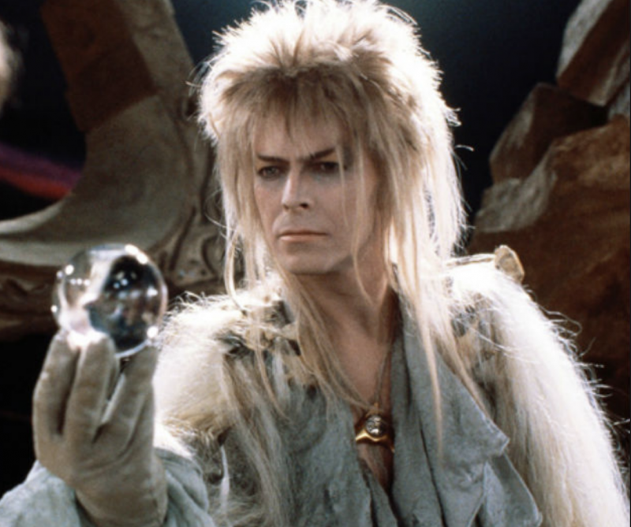
Why is a vision important?
Notes:
If new behaviors don’t become part of the culture or the shared values, they don’t stick. It really takes time and team-building to accomplish large projects like implementations. In order to create new behaviors we have to model what we want to see. Understanding where people are emotionally during and after change help people persevere and value their accomplishments!
If someone is struggling with the vision, ask questions! Even saying something as simple as “thank you” can completely change how someone perceives a challenge and can improve performance and outlook on a project.
So in all the reading that I do about change leadership, I want to share this sentiment with you because it resonated so much with me. I’m paraphrasing this here, but it’s from a site called “Management is a Journey”: your change vision and strategy pull things together and give the organization a picture of what the future looks like after the change is implemented. It tells your organizational stakeholders why they should let go of the past, why they should sacrifice and work hard in the present, and why they should follow leadership into the future. A vision creates a sensible and appealing picture of the future, and it provides guidance for organizational decision-making.

Slide 13
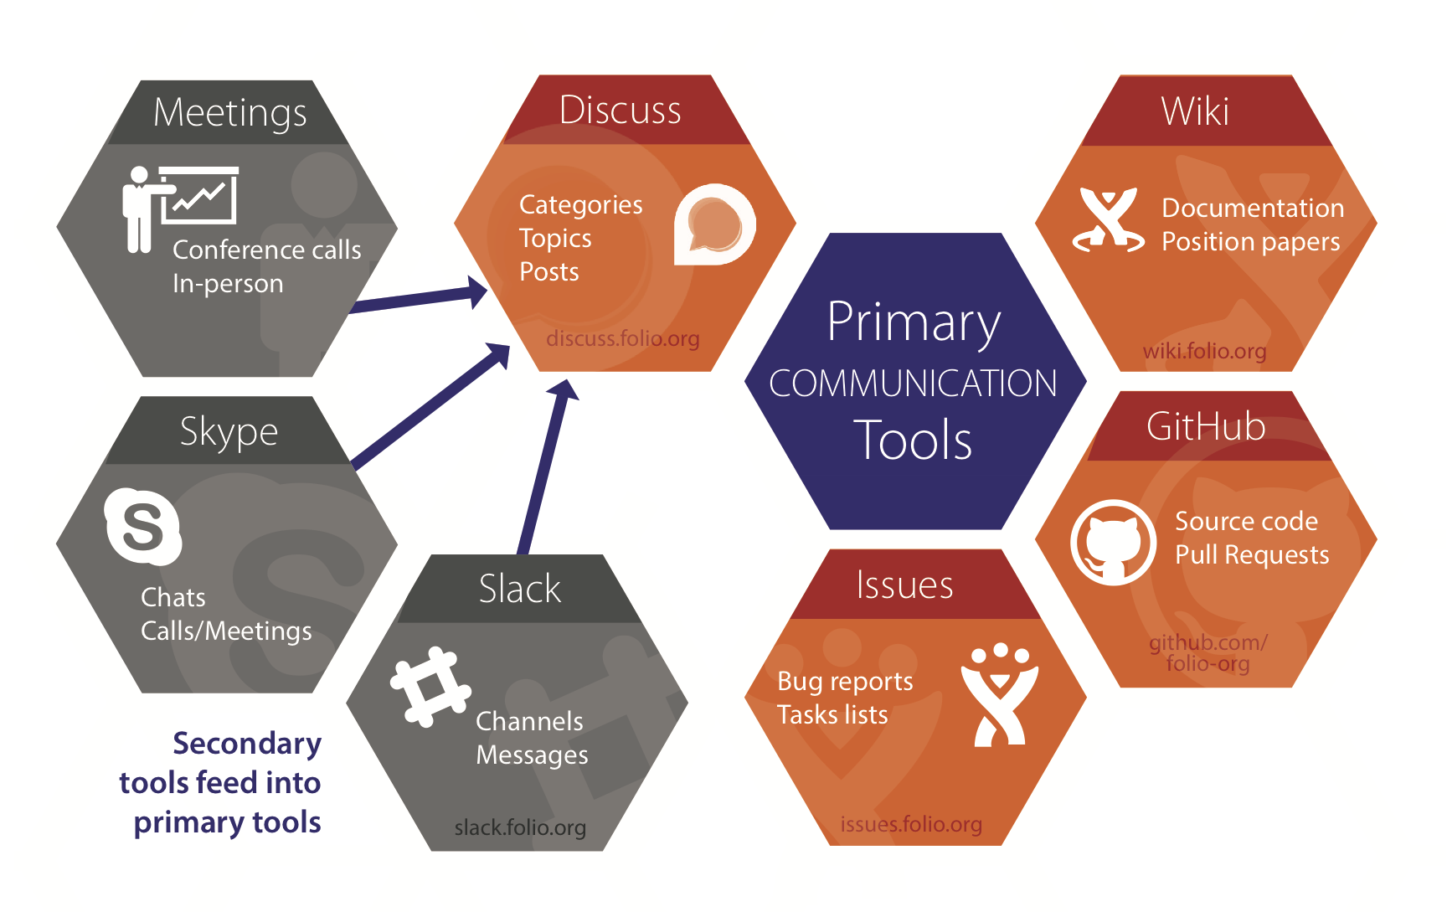
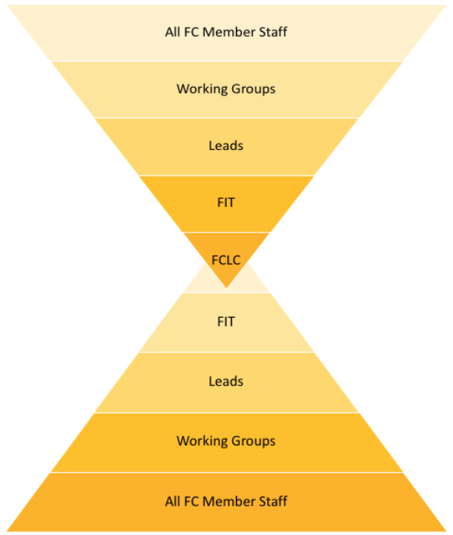
Communication - what do we talk about?
Vision, first and foremost
Notes:
[Colin]
Kotter frames communication as a bridge between kick-off and implementation, with a focus on using vision to inspire others to action.
As Ann said, this vision can be established at multiple levels, from upper management down to individual group leads. It provides everyone with a shared understanding of the future state that you want to achieve and helps make decision making and prioritization of tasks easier.
You’ve heard Michelle talk about coalitions within the wider FOLIO community as well as our Five College implementation. The visuals on this slide are representations of how information is supposed to flow, in each case.
FOLIO has built a community between its member librarians, developers and vendors. At a high level, it values open source development and international participation and uses social media to share project updates. In the day to day, distributed work is facilitated by Slack, JIRA tickets and wiki documentation. These are used to coordinate work between SIGs, who represent specific functions within the library platform, keeping everyone focused on the overall goals of the project.
The Five Colleges implementation is organized in a similar fashion. We have a central decision-making body, FIT, who distributes tasks to the Working Groups. The Working Groups are responsible for engaging staff who support certain types of library services. One of the outcomes of our decision to postpone implementation is to look at these layers and make sure that they are working well for us and make sense to continue in their current form. Communication is a lot of work, and with another year ahead of us, we want to make sure that the staff in these roles are supported and aren’t burning out.
By its nature, communicating a vision of the future will also include discussing the things you will stop doing. Ann mentioned this before, about changes we’re making to workflows right now, anticipating how we will be using FOLIO differently.
You need to share all possibilities at the outset, positive and negative, so you can begin to have productive conversation on these topics. In the absence of clear communication, speculation and uncertainty appear, which chips away at the buy-in that you need from staff who are going to be impacted by the project.
Communicating vision is important at the start, and people will need reminders throughout the project, but it is not the only thing you need to talk about. Next slide please.

Slide 14

Communication - what else do we talk about?
Incremental updates
Training and learning
Accomplishments
Notes:
[Colin]
Jones describes other elements of a project that are important to share.
The staff implementing a new system are going to be doing an enormous amount of work and there is value in talking about what they are up to. It can reinforce buy-in from staff already working on the project, when they see the impact of their work, and it can help involve colleagues who are on the periphery of the project.
Sometimes this is only intended to be a broadcast, where recent decisions and activity are shared with stakeholders. Locally, this can be your Dean of Libraries talking to trustees at an annual meeting or it could be a Working Group member sharing highlights to staff at their institution.
Other times the members of the project need to get feedback from the community in order to proceed. The FOLIO project uses Slack heavily, for quick responses to minor questions. Locally we use online surveys and open houses to get deep into a topic.
Training and learning can be a formal process or it can be skill sharing between colleagues. Multiple forms of outreach should be explored.
A lack of sufficient training can be a sore spot that lingers for years. To head this off, my first system implementation developed a successful train-the-trainer model. Everyone went through a comprehensive training prior to go-live and had access to advanced training for the six months that followed.
FOLIO is not mature enough for this level of effort, but staff are still coming together to learn the system. The project has organized several bug-testing events which is a good way to look at a system that is under development. Our colleagues in e-resources are live in some parts of FOLIO and their work helps inform apps that are still being worked on. Learning from your peers humanizes the process and makes the new system more accessible.
Aaron will talk about intentionally developing short-term wins in a few minutes, but I wanted to mention it briefly here. It is important to acknowledge when something goes well. It validates all the effort that goes into these projects. And once you are up and running, it is a way to help entrench the new way of working into your workplace culture. Next slide please.

Slide 15





Communication - how do we talk about it?
1. Frequent ✔
2. Only broadcast
3. Multiple forms of outreach ✔
4. Jargon and tech-speak
5. Lead by example ✔
Notes:
[Colin]
I’ve spoken a bit about the kinds of things that you should be communicating about during your implementation, but how do you go about it? Conrad has three communication tenets that are helpful in all areas of life. Communication needs to be honest, transparent and frequent.
Frequency in particular is brought up by all the resources we consulted on change management. You need to think about the context in which your message is being received. Library staff are taking calls, answering emails, and maybe are back to interacting in person. If you feel that the information about the project should be important to your recipients, you need to make sure it is represented in their inbox accordingly. Jones says it simply - there is no such thing as over-communication.
Kotter makes a point to say that communication is not a one-way street. Providing avenues for feedback helps increase buy-in, but it is an investment of time. We hold open houses and have back and forth conversations on Slack to make sure we’re heading in the right direction. Ultimately, it is better to have an iterative and participatory process that you can be confident in, rather than wasting time going down dead ends.
Just as you need to be communicating frequently, you need to use all the methods available to you. People are going to respond differently to different kinds of outreach. This can include participatory methods like trainings and social activities as well as traditional broadcast methods like email and presentations (like this one).
When you are reaching out to people, you need to make sure that they will understand what you are trying to share with them. When dealing with a system migration, it is very easy for those of us who are close to the project to slip into using jargon. We’ve probably used a ton of unexplained acronyms in this presentation - we’re all guilty of this! If your outreach ends up focusing on just the technology, you are only talking about the “how” of the project and missing the “why” which means you will only be reaching a subset of the people in the room. Instead, you need to focus on the impact of the project on the individual, which will help make it real for everyone.
Last, Kotter urges us to lead by example. If you are involved in a project, people are going to look to you for direction when they start to learn the system and change their workflows. All of us on this panel are using personal power instead of positional power to lead, and that is largely derived from our experience and involvement in FOLIO.
Now let’s hear from Aaron about empowering employees and removing structural barriers.

Slide 16
Empowering employees
Empower employees to enact the vision
Managers must be agents of change
Structures present barriers to change
Staff need help removing themselves as
a barrier
Notes:
[Aaron]
An institutional change will not happen without the participation of the staff. They are the functional experts on the ground who understand how services are provided, and they will be bearing the brunt of the changes. By Empowering employees to take action during the change process, we enable them to enact the vision (Kotter 102)
Kotter identifies a number of barriers including structures, systems , managers and training. During the Folio implementation at the Five Colleges we have had to tackle barriers mostly related to structures and training
When Kotter mentions the idea of training, he’s specifically referring to the need to provide skills for people to deal with the post-change environment. While this is something we are preparing to tackle at the Five Colleges I want to add that a continuing challenge that we deal with is providing the soft skills to deal with the change process and deal with the emotional impact of the change. These soft skills might include training in leading meetings so you could serve on a cross functional working group.
Joffe, M., & Glynn, S. (2001). Facilitating change and empowering employees. Journal of Change Management, 2(4), 369. https://doi-org.silk.library.umass.edu/10.1080/714042517
Image: Woolman, Roger . “David Bowie” 2003 https://commons.wikimedia.org/wiki/File:David_Bowie_(135687113).jpeg

Slide 17

Structural barriers
“A formal structure makes it difficult to act”
What is required by the vision -> the obstacle
Notes:
[Aaron]
Formal or traditional structures in an organization can made it difficult to act
In many cases, old structures at an organization can block the staff from enacting the vision. There can be any number of structural barriers - for example old workflows that people can’t quite let go of or departments that don’t communicate
As part of a change process, we must look at the outcomes demanded by the vision and find to ways to remove the structural barriers that are preventing us from achieving the vision.
One of the biggest challenges we have to deal with in the folio project is barriers that arise from distinct silos. This comes from the fact that we are Five..Colleges. Even within libraries, normally relatively distinct groups are now being called to work together in a way they are unaccustomed. While we have a strong history of collaboration, the part of the vision of the Folio project is to create a single shared library resource. This is still a challenge.
We’ve take a few steps to remove this barrier The first and foremost is that we have cross college working groups working on normalizing practices and procedures to the extent that we can
Some areas will require a greater deal of integration. We will be combining five distinct catalogs into a single resource ,as well as converting loan rules and individual schools into a single set of loan rules system-wide
Greyling, L. View of remnants of walls of a fort in ruin. https://www.publicdomainpictures.net/en/view-image.php?image=309184&picture=view-of-remnants-of-walls-of-a-fort

Slide 18
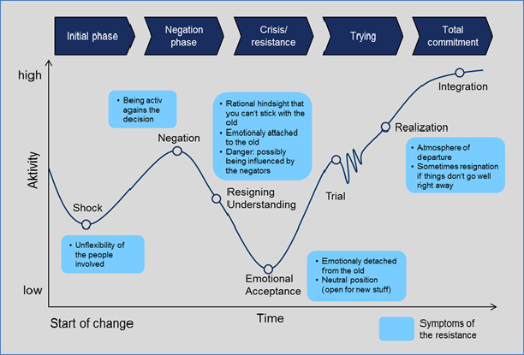
Employees as their own barrier
Loss of identity
  Kübler-Ross Model
  Change management as a dying process(D. Zell)
New skill required
  Requires an investment of time and money
  Brief trainings can build a foundation but are not enough
Notes:
[Aaron]
Employees may also serve as their own impediment to enacting the vision.
Remember how we talked about the emotions involved with change in the beginning?
A study interviewed professionals dealing with a change process over a period of two years. In her analysis of the interviews, she was able to map the emotional states of those affected by the change to the Kubler-Ross Model of grief (Denial -> Acceptance).
Change is traumatic. It requires you let go of things that you may have viewed as accomplishments, with roles that defined your identity. This grief, or fear of losing the work that defines identity, can manifest as an opposition to the change. There is unfortunately not an easy way to help someone move through these feelings.
In managing the the change, we are required to help those affected move out of their own way and participate in the change effort. Zoll offers two suggestions- one is to confront resistance with facts, as advocated by Rosenthal in. Another is to talk with people (either individual or in groups) and discuss how change (like death) is not undiscussable but a part of life.
In both my experience and Kotter’s suggestion, is to remember that these aren’t bad people. They may have had a bad experience in the past with a change, or fear that they are becoming irrelevant. Rosenthal proposes that a major change in an organization, because of how people may derive their identity from their work, accomplishments at work etc may go through a morning process (Rosenthal 203). Kotter recommends honest dialog. I’ve also found in the migrations that I’ve done, a powerful coalition will help. If you coalition implementing the change has both positional power, and power derived from expertise and influence, the ability to help a reluctant employee is easier
Supplying employees with the skills to perform the role in the changed environment is also clearly important, as if you’re going to operate in the new environnement you need to know how things work. However, the perception that they don’t have the skills or knowledge will cause them anxiety about the outcome of the change as well as limit their willingness to participate.
When I went live with Alma at one of my sites, we got a two day training workshop from a trainer from Ex Libris. She was very good, but the two day training wasn’t enough for people to build the skills. Allowing them to develop skill required that we build in time for trial and error in workflows and producing new documentation collaboratively.
Image courtesy of Wanner, M. F. (2013). Integrated change management. Paper presented at PMI® Global Congress 2013—North America, New Orleans, LA. Newtown Square, PA: Project Management Institute.
Zell, D. (2003). Organizational Change as a Process of Death, Dying, and Rebirth. The Journal of Applied Behavioral Science, 39(1), 73–96. https://doi.org/10.1177/0021886303039001004

Slide 19
Generating Short Term Wins
A short term win is highly visible, related to the change and unambiguous
Short term wins serve a variety of purposes:
  Justify the time investment
  Reward the change agents
  Reduce resistance
  Refine the vision
You cannot hope for wins, you must plan for them in the change process
Notes:
[Aaron]
Kotter states that one of the reason a change process fails is a failure to create short term wins (kotter 123). This gives people something to celebrate, justify the time investment, and demonstrate the project is headed in the right direction. (kotter 125)
My biggest takeaway from the last year is that it is impossible overstate the importance of having victories to celebrate during the course of your project.
We’ve had a lot of victories over the last year:
we brought part of Folio into production,
we’re getting close to our target data migration quality, and we’ve advocated for a lot of important features to be added to the Folio software. These are big things. And they’ve been hard to celebrated. The pandemic without a doubt was a major factor. We’ve also had many failures and disappointments. It seems like the losses stick ,while the successes are forgotten- particularly when people seem to only see the flaws.
Given the pandemic, I’m not sure how we would celebrate our wins.
They go in the meeting notes, and maybe we have a zoom party, then we get back to work.
And even if we were in person, it feels like the victories have been few and far between, even if this is not the case.
Which is why I think it’s important to to understand that you must engineer short term wins as part of your change management process.
Easier said than done.
What we’ve tried to do is define achievable milestones- goals that aren’t too ambitious that we can point to a success.

Slide 20

Build on the Change
(Consolidate Gains and Produce More Change
Anchor New Approaches in the Culture)
Both there and not there yet with FOLIO implementation.
Notes:
[Michelle]
You’ve built a house, it’s “done” now, and you don’t have to ever think about it again, right? Ann already quoted that D’Etta Jones webinar we attended that emphasized “Change is a process, not an event”. And I want to highlight that it’s not just the process leading UP to change. It’s a process on both sides. Just like any home will always require maintenance if you want it to remain functional.
As part of the Five College FOLIO implementation we’ve already had many discussions about what features are absolutely necessary for go-live. One might consider go-live the “end” of the change, but we have many, many features that we’ve noted can wait for a quarter after go-live, a year after go-live, etc. We already know there’s no one “end date” to this change, and maybe no such thing as an “end date” at all. And in our case, as Colin mentioned, we are live with the Electronic Resources Management (ERM) module, so some folks at the 5C are already in the go-live stage and are working on improvements. Again, it’s a case of something that would be true regardless of whether you really thought about it in the context of change management. But if you can be intentional about continuing to build on and reassess your change once you’ve hit your “end date” you ensure you don’t end up complacent with a situation that doesn’t really work. So now I’ll hand it over to Colin to wrap all of this up. [next slide please]

Slide 21
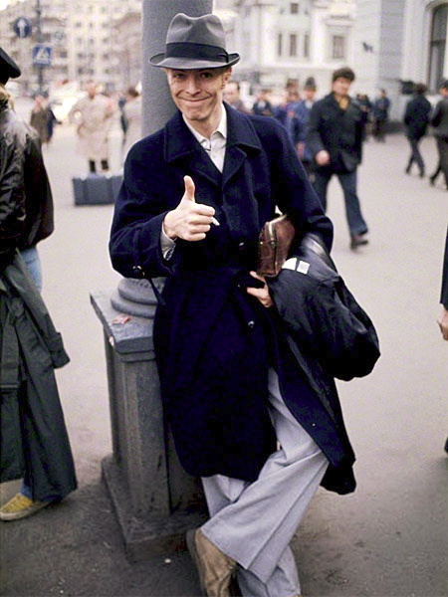
Conclusion
Making change is hard, but necessary for a modern organization to thrive and problem-solve in modern times
Approach change methodically
Change is process
You’ll be fine!
Notes:
[Colin]
Organizational change is necessary if libraries want to stay relevant and avoid getting locked into stasis. Sometimes this will require a system migration in order to support new work and services. If you spend some time at the outset, act with intention, and have a little self-management, you will have the resilience necessary for a successful project.
Your staff and community members have to be refreshed consistently with communication, feedback, and intermediate victories to maintain buy-in during an extended change process. Also, don’t underestimate the self-regulation needed to be an effective change agent, as well as someone who needs to consider emotional regulation of others. All stakeholders need consistent support to match the challenges they meet along the way.
Implementation is merely ignition of a new stage of change management. Assessment and incremental change need to be baked in your organizational culture after “go-live,” to help you prepare for the next project looming on the horizon.
We’re going to move to Q/A for the remainder of our time. If you find our presentation on the ACRL website, the last slides contain our sources and image credits. Please feel free to ask questions in chat. Ann will be keeping an eye on it and she might read your question aloud or ask you to restate it. If we don’t get to all of your questions, please reach out to us through email afterwards.

Slide 22
Sources
Carter, Toni M. “Assessment and change leadership in an academic library department: a case study.” Reference Services Review, 42(1). 148–164, 2014. Available: https://doi.org/10.1108/RSR-05-2013-0028
Connor, Daryl. “Change is easy when people like it, right?” Connor Partners, 2012. Available: http://www.connerpartners.com/frameworks-and-processes/change-is-easy-when-people-like-it-right
Conrad, Suzanna. “Spinning communication to get people excited about technological change.” Code4Lib Journal, 2018. Available: https://journal.code4lib.org/articles/13641

Slide 23
Sources
“From skeptic to champion: How to guide staff through change.” OCLC webinar, 22 January 2020. Available: https://www.oclc.org/en/events/2019/TransformativeLeaders_Change.html
Jones, DeEtta. “The magic is in the how.” webinar by DeEtta Jones Associates, 23 January 2020. Available: https://www.youtube.com/watch?v=x4epjWkaUeg&list=UUsH7QRNghJKKXfX6i7o37VQ&index=9&t=0s
Kotter, J.P. “Leading change.” Harvard Business Review Press, 2012.
Kotter, John P. “Leading change: Why transformation efforts fail.” Harvard Business Review, 1995. Available: https://hbr.org/1995/05/leading-change-why-transformation-efforts-fail-2

Slide 24
Sources
“Leading change (step 3): Develop a change vision and strategy.” Management is a Journey. Available: https://managementisajourney.com/leading-change-step-3-develop-a-change-vision-and-strategy/
Rosenthal, S. “Mourning and Depression in Organizations,” Depressive states and their treatment (pp. 201). Northvale, N.J.: Aronson, 1985.
Wanner, M. F. “Integrated change management.” Paper presented at PMI® Global Congress 2013—North America, New Orleans, LA. Newtown Square, PA: Project Management Institute.
Zell, D. Organizational Change as a Process of Death, Dying, and Rebirth. The Journal of Applied Behavioral Science, 39(1), 73–96, 2003. Available: https://doi.org/10.1177/0021886303039001004

Slide 25
Image & Video Credits
Bowie, David. “1976 Moscow Thumb” pin-up on davidbowie.com. Available: https://www.davidbowie.com/pinups#/1976-moscow-thumb/
Bowie, David. “Changes” single alternative cover. RCA, 1972.
Di Somma, Mark. “6 signs your brand is in a complacency loop.” Accessed 13 March 2020. Available: https://www.brandingstrategyinsider.com/signs-brand-complacency/#.Xmvv0pNKg_U
Greyling, L. View of remnants of walls of a fort in ruin. https://www.publicdomainpictures.net/en/view-image.php?image=309184&picture=view-of-remnants-of-walls-of-a-fort
Henson, Jim. Movie poster graphic from “The Labyrinth.” 1986.
Labin, Jenn. “JennLabinProductivity.png” January 19, 2018. Available: https://www.productiveflourishing.com/overcome-thrash/

Slide 26
Image & Video Credits
Murray, Peter. “FOLIO Communication Channels Infographic_Simplified_v4.pdf” October 25, 2016. Available: https://wiki.folio.org/x/dgAB
Muybridge, Eadweard. “The horse in motion.” 1878.
Noun Project icons:
  road sign by Alfredo @ IconsAlfredo.com from the thenounproject.com.
  Hose by KonKapp from the thenounproject.com.
  input data by dDara from the thenounproject.com.
  leader by Oksana Latysheva from the thenounproject.com.
  nerd by AomAm from the thenounproject.com.
Varios public domain images from avopix.com

Slide 27
Image & Video Credits
Queen feat. David Bowie. “Under Pressure.” Hot Space, EMI Records, 1981.
Shen, R. Nike+ Human Race in Taipei Men's Winner, 2008. https://commons.wikimedia.org/wiki/File:2008_Nike%2B_Human_Race_in_Taipei_Men%27s_Winner.jpg
SOLIDAR Foundation. “Ground control to Major Tom” image from SOLIDAR weekly round-up, 5 October 2018. Available: https://twitter.com/solidar_eu/status/1048217345863417856
Woolman, Roger. “David Bowie.” 2003. https://commons.wikimedia.org/wiki/File:David_Bowie_(135687113).jpeg

