Slide 1
My library has a new residency program, now what? Planning and implementing a successful residency program
Quetzalli Barrientos
American University
Qlbarri@gmail.com

Slide 2
About me
American University (AU)
Resident librarian for reference and instruction
ACRL Diversity Alliance
1st Resident librarian at AU
Three year contract

Slide 3
Blueprint
Of a successful and effective residency structure for universities

Slide 4
Our outline for today
What does a successful residency look like?
Why should institutions care?
Challenges
Residency benchmarks (3,12,18 months)
Importance of mentorship

Slide 5
A successful residency includes:
Pre-hire conversations
Same page
Why you are hiring a (diversity) resident
Clear mission and purpose
AU: Competitive for a tenure-track
What are your goals?
Are they feasible?
Can you realistically support these goals?
What resources do you already have in place?

Slide 6
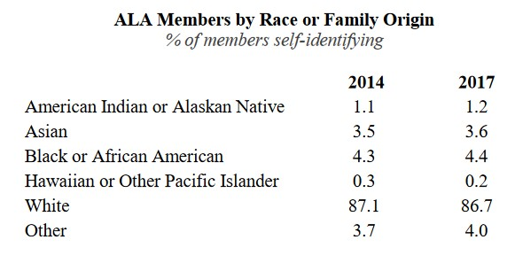
Why should insitutions care?
When asked “How do you describe your ethnicity?” in 2014, 3.9% responded “Hispanic or Latino.” In 2017, 4.7% responded “Hispanic or Latino.”
2017 ALA Demographic Study. “ALA Members by Race or Family Origin” http://www.ala.org/tools/sites/ala.org.tools/files/content/Draft%20of%20Member%20Demographics%20Survey%2001-11-2017.pdf

Slide 7
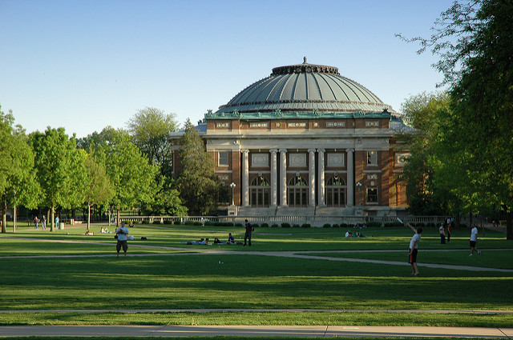
“Increasing numbers and percentages of Black and Hispanic students are attending college. Between 2000 and 2015, the percentage of college students who were Black rose from 11.7 to 14.1 percent, and the percentage of students who were Hispanic rose from 9.9 to 17.3 percent”
Table 306.10
Total fall enrollment in degree-granting postsecondary institutions, by level of enrollment, sex, attendance status, and race/ethnicity of student: Selected years, 1976 through 2015
https://nces.ed.gov/fastfacts/display.asp?id=372
“Foellinger Auditorium, University of Illinois” by Vince Smith, used under Attribution 2.0 Generic (CC BY 2.0)

Slide 8
Why should institutions care?
Recruitment & Retention
Institutional Culture
When the resident librarian succeeds, you succeed!

Slide 9
Administrative considerations prior to residency job being posted
Pre-hire
Position description input
Clear job parameters and flexibility
Professional growth
Documentation
Documentation
Responsibilities
Expectations of research
Service (within university and nationally)
Professional development

Slide 10
Challenges

Slide 11

Structure of the residency
What are your organizational needs?
What are your gaps?
How can a resident librarian gain experience from this new skilled labor?
What can your organization gain from new skilled labor?
Will it be rotational?
.
Where will the professional growth be?

Slide 12
Mentor and coordinator roles
Mentor
Acquainted with institutional memory
Knowledge of organizational culture
Advises on professional trajectory
Research & Scholarship
Service
Confidentiality!
Coordinator
Long & Short term plans for residency
Identify needs of organization(and how resident librarian can gain experience)
Identify gaps in organization
Identify possible projects

Slide 13
Importance of mentor figures
Build strong rapport
Mutual trust
Instills confidence in new librarian
Peer mentoring

Slide 14
If I was a coordinator…
Post hire (goals and support)
Choose one or two areas to emphasize throughout residency
Set priorities with resident librarian and follow them
Take your role seriously!

Slide 15
Being proactive as a resident
Ask for opportunities
Professional Development
Advocate for yourself

Slide 16
Residency benchmark highlights
3 months
Orientation
Institutional memory
Identify short & long term goals
12 months
Near solid identification of research agenda
Identify university service work
18 months
Draft research and teaching philosophy statements
Update CV

Slide 17
Thanks!
Any questions?
You can find me at:
Qlbarri@gmail.com

