Slide 1
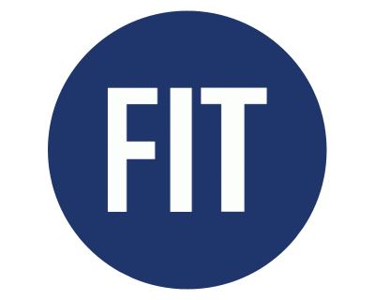
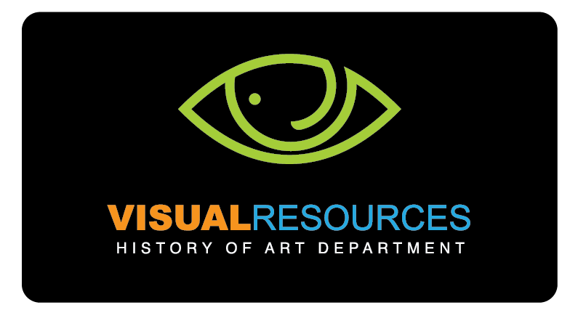
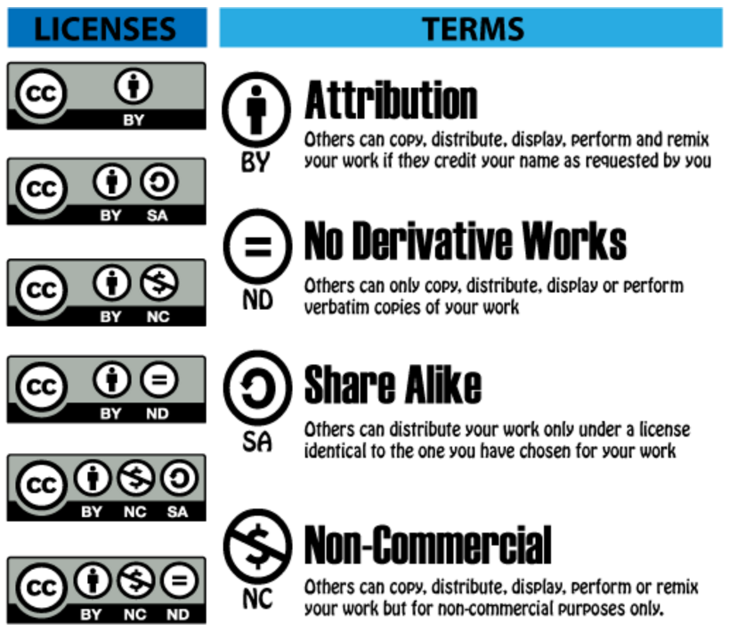
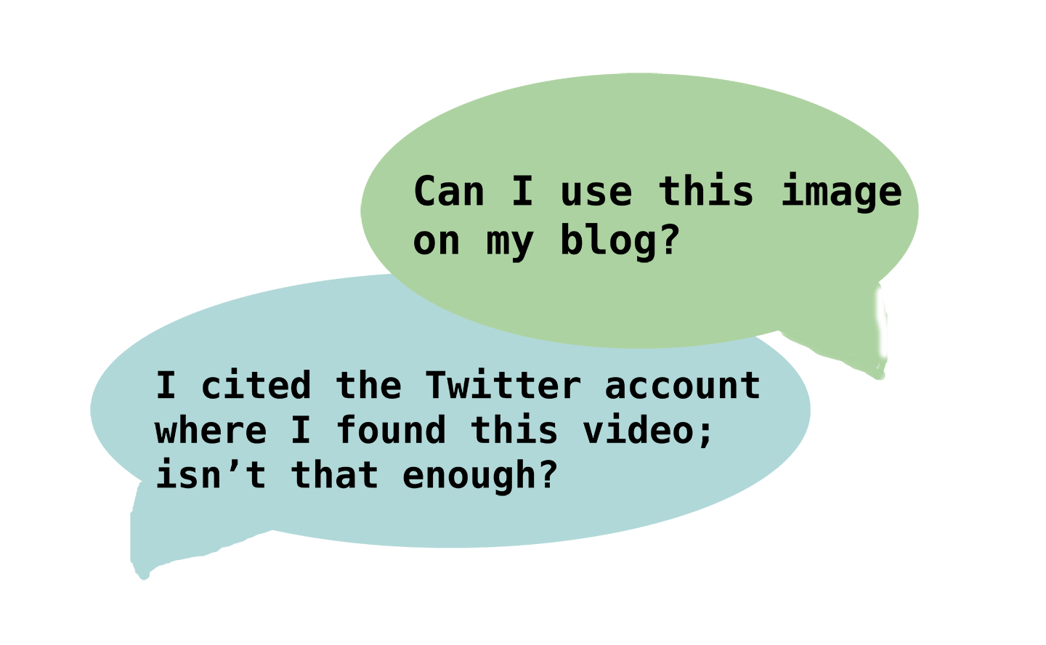
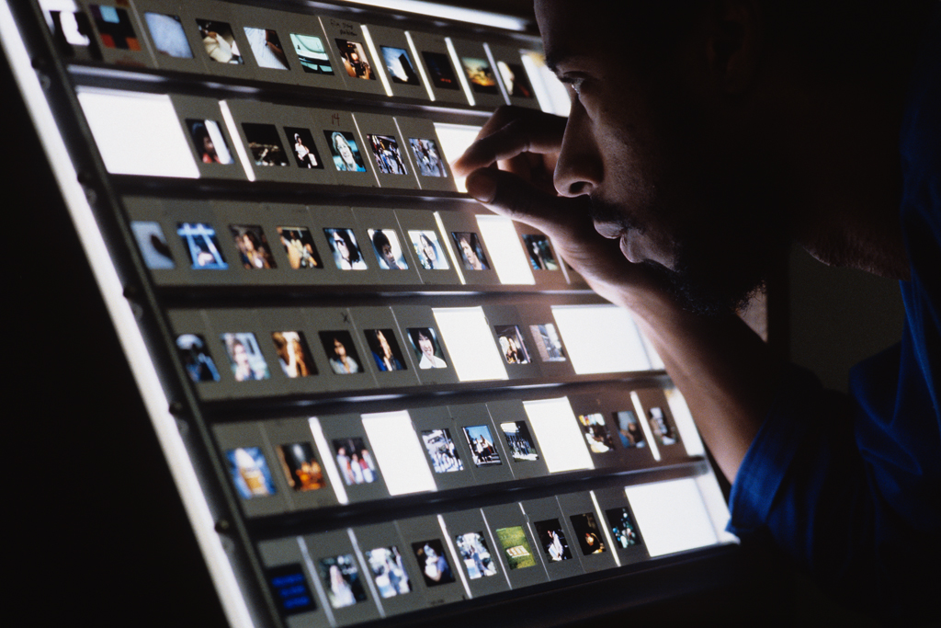
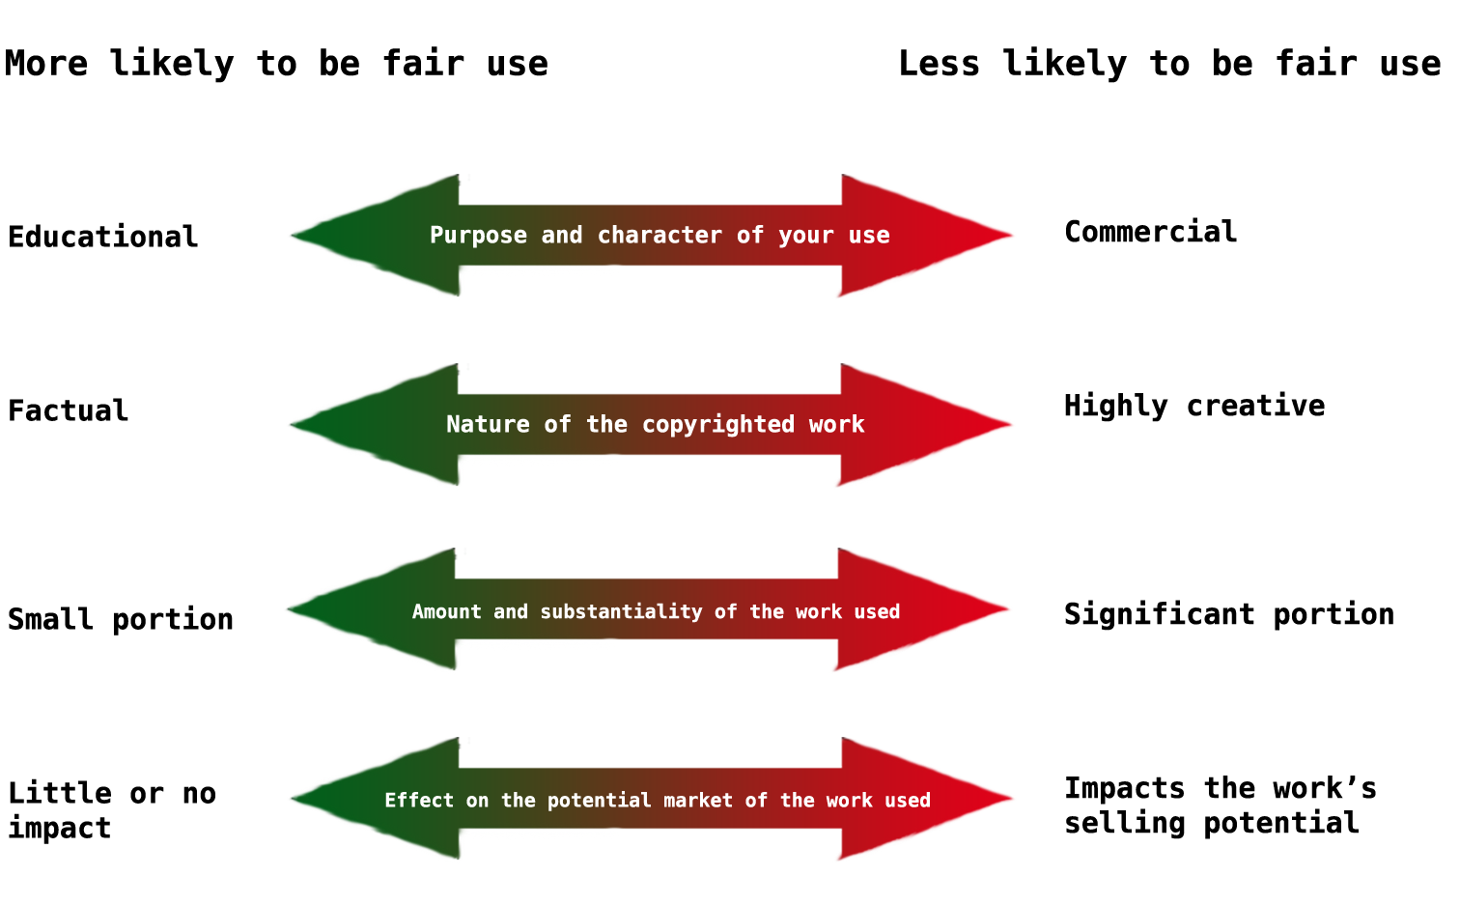
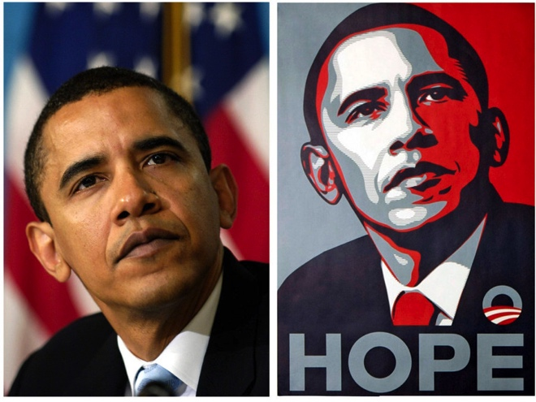
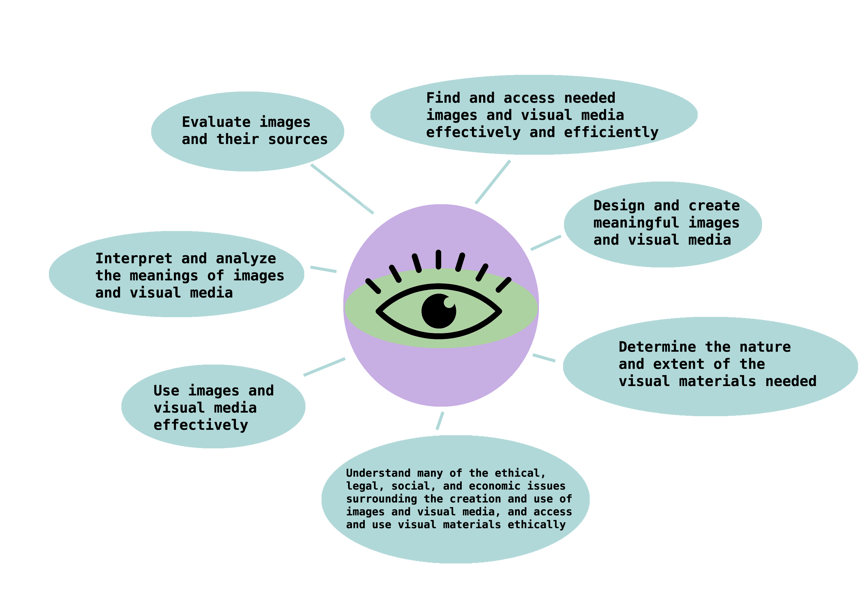
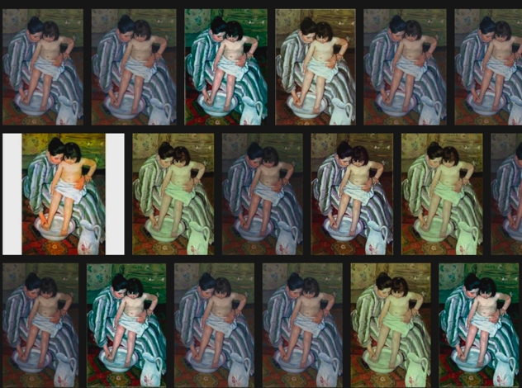
Expanding Library Services from a Visual Perspective
Molly Schoen, Visual Resources Curator
Fashion Institute of Technology, State University of New York
Background
Introduction
Strategies
What are Visual Resource Centers?
Visual resource centers, or VRCs, fulfill the image-related needs of faculty and students. They are often located within studio art, art history, and architecture departments, or they may be part of a larger academic library. VRCs often have unique digital collections that support their departments. Visual resources staff regularly digitize slides, negatives, print photographs, book images, and more. Materials are cataloged to ensure accuracy and accessibility.
Students and faculty are using, creating, and interacting with visual media more than ever before. Yet many are not aware of the implications of using these materials in their academic lives, as they are with citing text and avoiding plagiairism.
How do libraries accommodate the research needs of patrons when they are dealing with non-text resources?
Copyright Consulting:
— Advise on fair use
— Explain types of Creative Commons licenses
— Provide examples of copyright permission letters
— Resources to use:
  CAA Code of Best Practices on Fair Use in the Visual Arts
  Stanford Copyright and Fair Use Center
  Fair Use at Columbia University
  Center for the Study of the Public Domain,
  Visual Resources Association’s Digital Image Rights Calculator.
Visual Resources at FIT
At the Fashion Institute of Technology, Visual Resources operates within the History of Art department. Like many other VRCs, we had our beginnings as a 35mm slide library, which has since gone digital. We have been able to expand our services as the need for scans has decreased, since more and more museums are hosting their collections online.
Strategies
Objectives
Education:
One-shot sessions and one-on-one tutoring
— Show different images of the same artwork
  Which are the truest representations?
  Which have been altered or faked?
— Teach importance of copyright from case studies
  - ex: did Shepherd Fairey plagiarize an Associated Press photo of Obama for his “Hope” poster?
Increasing the visual literacy skills of patrons is our main goal.
What makes somebody visually literate?
Visual Literacy Competency Standards for Higher Education. Association of College & Research Libraries, 2011.
http://www.ala.org/acrl/standards/visualliteracy.
Our objective at FIT: patrons will learn how to…
- find high quality visual materials
- evaluate the accuracy and authority of images and videos (have they been photoshopped or are they true to the original?)
- know when and how to cite multimedia sources
- determine what constitutes fair use vs. plagiarism or copyright infringement
- understand the differences between different types of visual media (ie, JPEG vs TIFF) and what is most suitable for their needs.
Findings: we don’t need to know everything about copyright to assist faculty and students, we just need to know where to look.
Expanding Digital Media Services
— High quality PDF creation
    searchable text
  high resolution images in color
— Graphic design
    in tune with FIT’s style guides
    uses only cleared images, not ones “lifted” from the internet
—Digitizing video and film clip creation
    files are hosted on a password-protected site, so faculty don’t have to worry about copyright
    students can access videos 24/7
Findings: faculty are appreciative that we can digitize items with a quick turnaround time. Because we have high grade equipment and professional expertise, our scans are better than ones faculty make for themselves. Students appreciate doing readings from our highlight-able, copy and paste-able PDFs instead of relying on crooked, low-res scans done by copy machines.
Collaborations:
We have collaborated with the Library, the IT department, the Writing Center, and the College of Liberal Arts to increase the understanding of visual literacy across campus.
Findings: In part because FIT is a school of art and design, and in part because smartphones and other technologies have increased image use and creation, people from all over campus—not just in History of Art—are interested in learning how to better work with visual materials.
— Show advanced search options for Google Images, Wikimedia, etc.
  filter by size
  filter by domain (.edu, .org)
  filter by Creative Commons license
— Reverse image searching
  - identify unknown or unlabeled images or objects
  - track down the creator of an image
  see if anyone else is using your artwork without your permission
Findings: students are not generally aware of how to use images ethically. They do not know how or when to cite other people’s work, or how to find the original creator of an image that’s been shared and reposted. A one-shot session can encourage them to consider research strategies for visual materials just as seriously as they do for text-based items.
See corresponding handout for image citations and references, or email mollyjschoen@gmail.com. Poster made for the 2017 ACRL-NEC conference.

