Slide 1


ACRL/NEC & NELIG Joint Annual (Virtual) Conference
Connection, Disconnection, Reconnection:
How Are We Building Community Now?
June 1-3, 2022
Link to a complete list of sponsors:
https://whova.com/portal/webapp/aneac_202206/Sponsors
https://acrlnec.org/annual-conference/

Slide 2
ACRL/NELIG/NEC
June 2nd, 2022
Public Service Loan Forgiveness and what recent changes mean for you

Slide 3
Who am I anyway?
I’m a Public Librarian and Union activist and also an Admin of the Public Service Loan Forgiveness Program Support (PSLF) group on Facebook, now supporting ~110,000 borrowers
https://www.facebook.com/groups/pslfprogramsupport

Slide 4
What’s PSLF?: A primer and a reminder
PSLF forgives a borrower’s entire Direct Loan balance (principal and interest) with no tax consequences (unless you pay Mississippi taxes)
To earn PSLF, you must make 120 monthly loan payments, and certify those 120 months of qualifying employment
  Payments do not need to be consecutive
Rather than paying down balances and avoiding interest, which is a good strategy with every other kind of debt, PSLF is all about making the minimum payment which will qualify
https://studentaid.gov/manage-loans/forgiveness-cancellation/public-service

Slide 5
For a month to qualify for PSLF, you must:
Have had Direct Loan(s)
Have worked Full Time in Public Service
Have been enrolled in a qualifying repayment plan
Have paid on time and in full
https://studentaid.gov/manage-loans/forgiveness-cancellation/public-service

Slide 6
Remember this phrase!
Under
Normal Conditions

Slide 7
Which loans are eligible (qualify)?
Loans owned by the Department of Education
  Direct loans - Subsidized or Unsubsidized
  Direct Consolidation loans
  PLUS loans
    Grad PLUS loans
    *Parent PLUS loans, but only for Parents and:
      PPL must be consolidated to become eligible and:
      Consolidated PPL are eligible for Income Contingent Repayment only, not other IDR plans
https://studentaid.gov/manage-loans/forgiveness-cancellation/public-service#eligible-loans

Slide 8
Which loans are ineligible (do not qualify)?
FFEL loans (pre-2010)
      Owned by banks, not the Department of Education
But can be consolidated into Direct Consolidation loans and become qualifying
Perkins loans
      Owned by colleges, not the Department of Education
But can be consolidated into Direct Consolidation loans and become qualifying
Private loans
      Owned by banks, not the Department of Education
Cannot be forgiven under PSLF. Period
https://studentaid.gov/manage-loans/forgiveness-cancellation/public-service#eligible-loans

Slide 9
Which employers qualify?
Government
  Federal, State, Tribal, County or Municipal Government (EVERY SINGLE community college, state college and university)
501(c)(3) non-profits (THE VAST MAJORITY OF private colleges, universities and independent schools)
And a statistically insignificant number of other non-profits
https://studentaid.gov/manage-loans/forgiveness-cancellation/public-service#qualifying-employer

Slide 10
Which employers do not qualify?
For Profit Corporations and Colleges
Partnerships
Sole Proprietorships
Self-employment
Independent Contractors
  Any work which is reported on a 1099 rather than a W2
Your own 501(c)(3) before you can pay yourself a full time salary on a W2
https://studentaid.gov/manage-loans/forgiveness-cancellation/public-service#qualifying-employer

Slide 11
What constitutes qualifying full time employment?
If you work for ONE qualifying employer:
  Full-time designation by your employer
  Working at least 30 hours per week
    Whichever is MORE, so BOTH
If you work for MORE THAN ONE qualifying employer:
  At least 30 hours per week total at more than one qualifying employer
https://studentaid.gov/manage-loans/forgiveness-cancellation/public-service#full-time-employment

Slide 12
What does not constitute qualifying
full time employment?
Classification by a single qualifying employer as <1.0 FTE, regardless of whether you work more than 30 hours/week
Classification by a single qualifying employer as <1.0 FTE, regardless of whether you receive any other “Full Time” workplace benefits
Part time work for multiple qualifying employers that does not add up to >30 hours/week
https://studentaid.gov/manage-loans/forgiveness-cancellation/public-service#full-time-employment

Slide 13
Which repayment plans qualify?
IDR (Income Driven Repayment) Plans
  Each of the IDR plans has different eligibility requirements and a different way of calculating your payment (which I don’t have nearly enough time to discuss now)
    IBR (Income Based Repayment)
    ICR (Income Contingent Repayment)
    PAYE (Pay As You Earn)
    REPAYE (Revised Pay As You Earn)
    & a new IDR plan is in development, but details have not been released yet
The 10-Year Standard Repayment Plan (The default plan for new loans)
https://studentaid.gov/manage-loans/forgiveness-cancellation/public-service#qualifying-repayment-plans

Slide 14
Which repayment plans do not qualify?
Standard Repayment with a term longer than 10 years (The default for new consolidation loans)*
Extended Fixed Repayment*
Graduated Repayment*
Extended Graduated Repayment*
Alternative Repayment
*But these plans do qualify for Temporary Expanded PSLF, which we will discuss later if time allows
https://studentaid.gov/manage-loans/forgiveness-cancellation/public-service#qualifying-repayment-plans
https://studentaid.gov/manage-loans/forgiveness-cancellation/public-service/temporary-expanded-public-service-loan-forgiveness

Slide 15
And yes, there are a few additional requirements for payments to qualify…
Loans must be in repayment i.e NOT paid off, in grace period, in-school, in deferment*, in forbearance*, in default and not covered under a bankruptcy repayment agreement
Payment must be made on time (within 15 days of due date)
Payment must be made for the full amount billed
*certain deferment and forbearance months now qualify, but the rules are evolving*
https://studentaid.gov/manage-loans/forgiveness-cancellation/public-service#qualifying-payments

Slide 16
Again, remember this phrase!
Under
Normal Conditions

Slide 17
Because these are NOT
Normal Conditions
The CARES Act/COVID forbearance has frozen payments since March 2020 and will continue through August 2022 (if it isn’t extended further)
https://studentaid.gov/announcements-events/covid-19#covid-info
And the Limited PSLF Waiver has made huge changes since October 2021 and will continue through October 2022
https://studentaid.gov/announcements-events/pslf-limited-waiver

Slide 18
Changes under the
CARES Act / COVID forbearance for borrowers already in repayment
No payments due on qualifying loans
Zero interest charged on qualifying loans
Any and all payments you may have made on qualifying loans are refundable in full
Could well be extended past August 31st, 2022
https://studentaid.gov/announcements-events/covid-19#covid-info

Slide 19
Changes under the Limited Waiver between 10/6/2021 and 10/31/2022
Arbitrary rules which disqualified significant numbers payments in the past have been waived, specifically:
Payments made prior to consolidation
  So, it is now possible to consolidate ineligible loans without restarting the payment count at ZERO until 10/31/2022
Payments made while enrolled in a non-qualifying repayment plan and/or not made on time or in full
https://studentaid.gov/announcements-events/pslf-limited-waiver

Slide 20
And more good news for those who lost credit for months in forbearance or deferment
12 consecutive and 36 or more cumulative months of forbearance will now qualify
Any months of deferment (except for in-school deferment) from prior to 2013 will qualify
More changes may be announced
https://studentaid.gov/announcements-events/idr-account-adjustment

Slide 21
But what does all that even mean?
And where do I fit in?

Slide 22
Good News Everybody!
Regardless of the (profound) lack of transparency right now about who will service loans, when and what periods of employment will eventually qualify…
There are still only:
3 sets of borrowers and
3 ways to start

Slide 23
1 - Borrowers with any ineligible FFEL or Perkins loans must consolidate those loans
2 - Direct Loan borrowers who have never certified employment must certify their employment
3 - Direct Loan borrowers who have already certified their employment can continue to do so
https://studentaid.gov/announcements-events/pslf-limited-waiver#loan-types-next-steps

Slide 24
Answer Question 1:
Do you have Federal Student Loans in repayment, and have you worked full-time in Public Service (or are you planning to)?
YES
NO
PSLF and the Limited Waiver might help you!
Skip to Question 2
You are not eligible. Even under the Limited Waiver, PSLF requires loans in repayment and full-time work in Public Service (More Info)

Slide 25
Answer Question 2:
Do you know what TYPE of loan(s) you have?
There’s more than one kind of loan
YES
NO
PSLF might help you!
Skip to Question 3
PSLF might help you!
Your loan type(s) determine what you need to do
Go to Action 1

Slide 26
Answer Question 3:
Do you know, or did your Aid Summary show,
that you have FFEL or Perkins Loan(s)?
Those loans are NOT eligible for PSLF
YES
NO
PSLF might help you! Go to Action 2
PSLF might help you! Skip to Question 4

Slide 27
Answer Question 4:
Have you ever certified your employment by submitting an Employment Certification Form
(or PSLF Application Form)?
YES
NO
PSLF will continue to help you and you may gain additional payments in the near future! Go to Action 4
PSLF will help you when you certify employment.
Go to Action 3

Slide 28
Answer Question 5:
Of interest for folks already in the process:
Has the Department of Education said they would add retroactive qualifying payments for you, OR are you entitled to qualifying payments from before a consolidation, OR are you waiting for months during forbearance/deferment to be added?
YES
NO
If qualifying payments haven’t been added yet, you are not alone! They will be added later on (Though you may receive no forewarning)
Go to Question 6
If you are indeed entitled to additional qualifying payments, they will be added later on
Go to Question 6

Slide 29
Answer Question 6:
Does this all make more sense now?
YES
NO
This “choose your own PSLF adventure” deck is an expanded version of https://studentaid.gov/announcements-events/pslf-limited-waiver#do-you-qualify
There is more general help at https://studentaid.gov/manage-loans/forgiveness-cancellation/public-service

Slide 30
Action 1:
Determine Your Loan Type(s)
Check your Aid Summary at studentaid.gov That page displays the loan type of each of your individual loans. Many borrowers have many loans of different types
Direct Loans include the word DIRECT in their title
    ALL Federal Loans since July 2010
FFEL Loans include the word FFEL in their title
    Many/Most Federal Loans from before July 2010
Perkins Loans include the word Perkins in their title
You need to know your loan types to know what to do next!
Go to Question 3

Slide 31
Action 2.1:
Consolidation Basics
In the past, Loan Consolidation “reset the clock” and payment counts on the new loan started again at zero, but under the Limited Waiver (until 10/31/2022) this is no longer the case
Consolidating FFEL, Perkins, PLUS and Direct Loans under the limited waiver (before 10/31/2022) will create a new Direct Consolidation Loan with the highest number of payments of ANY of your loans!
Go to Plan your Consolidation

Slide 32
Action 2.2:
Plan your Consolidation
When you consolidate, whether online or on paper, you should select ALL Loans (FFEL, Perkins and Direct)
Select MOHELA as your new servicer (but be aware that AidVantage may process your consolidation)
Select a qualifying IDR plan (unless you have already made 120 payments)
Consolidate before 10/31/2022 or you will miss out on all of these benefits
Go to Consolidate

Slide 33
Action 2.3:
Consolidate!
To reiterate, FFEL and Perkins Loans are ineligible for PSLF and must be consolidated to become eligible
  PLUS loans (including Parent Plus Loans*)can be consolidated any time after full disbursement
  All other loans can be consolidated immediately upon graduation
  Any Direct Loans should also be consolidated if they have separate payment timelines
Fill out the online form at https://studentaid.gov/app/launchConsolidation.action
Or fill out and mail in the paper form from https://studentaid.gov/app-static/images/ApplicationAndPromissoryNote.pdf
Go to After Consolidation

Slide 34
Action 2.4:
After Consolidation
After you consolidate, whether online or with the paper form, you will need to:
Wait as much as 30-60 days for your consolidation to be finalized (this message had come from FedLoan in the past, but will be likely to come from AidVantage)
Wait for the PSLF Servicer to give you instructions to set up an online account (this will likely be MOHELA, and you are likely to wait a long time you are only now embarking on this)
Once you have a working online account, check your progress to see how many payments you have made, and how many payments remain
Go to Question 4

Slide 35
Action 3.1:
Employment Certification Basics
Each month that you have made a payment must correspond with a month that you worked in Public Service in order to qualify
To receive qualifying credit, the PSLF Servicer must receive proper Employment Certification on a PSLF Application Form signed by you and your employer(s) for every period you work
Only the PSLF Servicer can qualify your payments, and no other servicer will or can track your count of qualifying payments (no matter what they may tell you)
Go to How to Certify Employment

Slide 36
Action 3.2:
How to Certify Employment
The easiest way to get a PSLF Application Form is to generate it with the PSLF Help Tool at studentaid.gov/pslf
A paper form is also available at https://studentaid.gov/sites/default/files/public-service-application-for-forgiveness.pdf but paper forms are not processed as quickly as forms generated electronically and paper forms are more error-prone
Even if you work for a legitimate Public Service Employer, the Help Tool may report them to be “Likely ineligible”- Don’t Panic! (but prepare for a very long wait before resolution)
HR is the most common source of employment certification, but anyone in your organization can sign
Go To Submit Employment Certification

Slide 37
Action 3.3:
Submit Employment Certification
If you already have an online account with the PSLF Servicer you will be able to upload a scanned image of your form directly
If not, you will need to Fax or Mail the form to the number/address on the form itself
You can’t certify your employment with your old servicer
Again, you must certify every period of employment from every employer to get credit for every qualifying payment
Go To After Submitting Employment Certification

Slide 38
Action 3.4:
After Submitting Employment Certification
After you submit Employment Certification for the first time, whether online or with the paper form, you will need to:
Wait 90-120 days for your employment certification to be processed
Wait for the PSLF Servicer to contact you about setting up an online account
Once you have online access to your account you should be able to see how many payments you have made, and how many payments remain
Go to Rinse and Repeat

Slide 39
Action 4:
Rinse and Repeat
Keep current with certifying your employment so you know where you stand
Subsequent Employment Certifications after your initial one are processed more quickly than initial certification
While not required, annual employment certification is recommended
Go to Question 5

Slide 40
Again!
There are the 3 sets of borrowers and 3 paths forward
1 - Borrowers with any ineligible FFEL or Perkins loans must consolidate those loans
2 - Direct Loan borrowers who have never certified employment must certify their employment
3 - Direct Loan borrowers who have already certified their employment should continue to do so
https://studentaid.gov/announcements-events/pslf-limited-waiver#loan-types-next-steps

Slide 41


Slide 42
More Resources
This presentation is online at https://docs.google.com/presentation/d/1aqJEzXVKp3u5B9E2nVVlnj2ZSvmb7-4ulohCER-ooe0
This presentation is an expanded version of https://studentaid.gov/announcements-events/pslf-limited-waiver#loan-types-next-steps
If you do not believe any of these cases and plans of action apply to you, you will discover that you are mistaken. Please don’t wait too long!
More general information on PSLF is available at https://studentaid.gov/manage-loans/forgiveness-cancellation/public-service
More specific information about the Limited Temporary Waiver is available at https://studentaid.gov/announcements-events/pslf-limited-waiver

Slide 43
More Resources 2.0!
  Public Service Loan Forgiveness Program Support (Facebook group with more than 110,000 members moderated by insufferable know-it-alls like me)
  r/PSLF (Subreddit with close to 20,000 member also moderated by insufferable know-it-alls like me and a bona-fide, albeit opinionated, Student Loan Professional)
  Unfortunately, escalation strategies for problems are unclear at present because of the transition between PSLF Servicers, but until they stop answering, DMs to the FedLoan page on Facebook are pretty effective (unless you are with another servicer)
  Read first, ask questions later (don’t be that guy!)

Slide 44
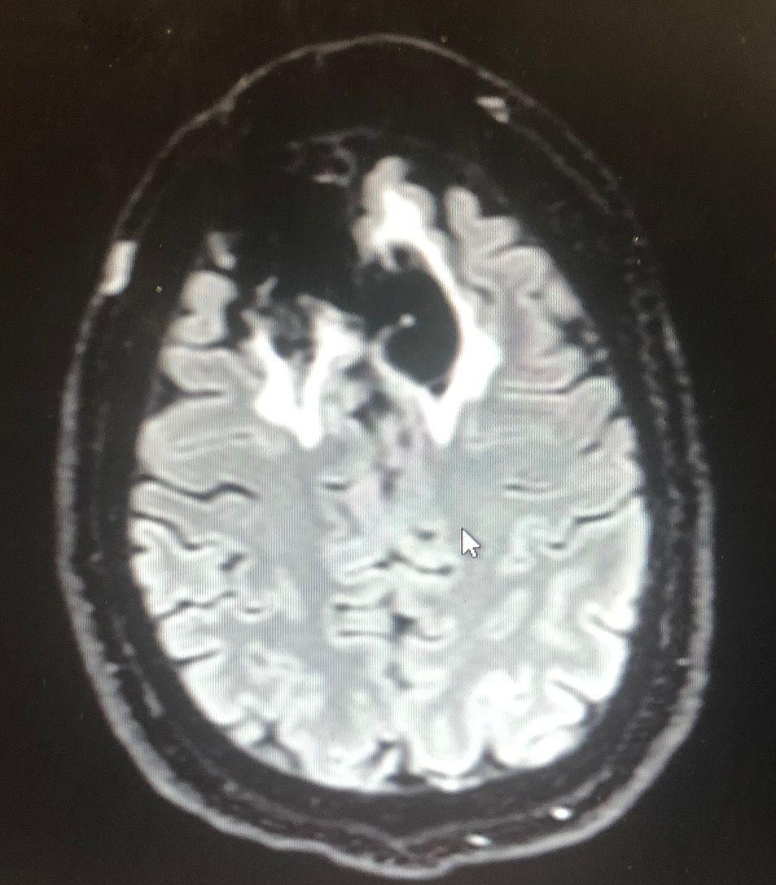
If I can do this, you can do this!

Slide 45
Matt Amory
Librarian for Information and Technology
Canton Public Library
786 Washington St.
Canton, MA 02021
matt.amory@gmail.com

