Slide 1

Discovery, Evaluation, Creation: The role of librarians in supporting open educational practice
NE OER Summit 2019
Melinda Boland, ISKME
Donna Maturi, Middlesex Community College
ISKME 2019:
Notes:
Presentation Abstract: This seminar focuses on discovery, evaluation, and creation. We'll look at how information architecture of a digital library promotes discovery; how evaluation rubrics can further use of high quality materials; and how content creation can fill curricular gaps and be designed to meet specific course goals.

Slide 2
Session Goals
Create a shared understanding of OER, OEP, and the role of the librarian in Open Educational Practice
Understand how to use the tools for search and discovery of Open Educational Resource
Explore library-driven OER initiatives
Share the MASS CC OER Commons Hub experience
Share best practices for digital curation by librarians of OER materials

Slide 3
High Level View of ISKME’s OER Work
Professional learning program to support OER adoption and use
Extensive body of empirical research on OER practice, and the supports needed to enable that practice
Field-tested tools, rubrics, and guides to support OER adoption across classrooms, districts, and states
Notes:
perhaps add a photo of our professional learning program here?

Slide 4
Massachusetts CC Hub Background
2016-2017 MASS Go Open initiative funded by the
DOL TAACCCT 4--GPSTEM grant
1 year grant program underwriting 121 OER development projects across 14 community colleges in the Commonwealth. Savings to students over 1 million dollars. Over 800 OER items created.
2017 Startup costs for the OER Commons Massachusetts CC hub funded by TAACCCT. 15 Community Colleges share yearly maintenance fee.
Massachusetts CC hub is a custom resource center where OER collections can be shared within the Commonwealth and beyond..
Notes:
perhaps add a photo of our professional learning program here?

Slide 5
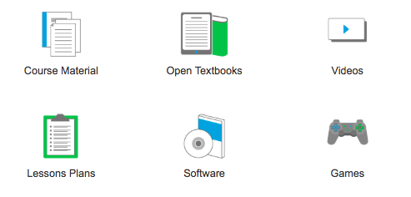
Guiding Definition: Open Educational Resources (OER)
OER refer to any teaching and learning materials that reside in the public domain or have been released under a license that permits no-cost access, use, adaptation and redistribution.
OER Can Be:
OER Can Be and the associated images are a derivative of the BCOER Poster by BCcampus, licensed under CC BY 4.0

Slide 6
Guiding Definition: Open Educational Practice (OEP)
OEP refers to collaborative teaching and learning practices that help educators to advance a culture of sharing and active learning through OER.
Examples Include:
Educators collaborating on the creation or curation of OER
with peers and with learners
Peer review of OER
Sharing of OER implementation experiences
Iterative curriculum improvement through localizing
and remixing of OER

Slide 7
What Libraries can do to support Open Educational Practice
Help faculty identify existing OER materials, including alternatives to textbooks
Use advanced search skills to find exactly what faculty need
Give options for ways that students can access resources
Advise on how to make resources more accessible
Advise on issues of copyright and fair dealing
Advise on use of Creative Commons licences
Attribution: Text a derivative of “How Libraries can Help”, in CCCOER: Faculty and Librarians Selecting High Quality OER, by Tina Ulrich, licensed under CC BY 4.0
Notes:
Inc Mass experience

Slide 8
Massachusetts CC Experience
OER Commons Advanced Search
Other tools- Google advanced search- OER Metafinders
Our Brain on print
Accessibility for all- less retrofitting
Just ask! (copyright and fair dealing)
Explain the benefits of CC BY to faculty
Advise on ways to insure created materials are not just licensed but also shared( Open repositories such as Massachusetts CC Hub)
Notes:
Inc Mass experience

Slide 9
What Libraries (likely) cannot do to support Open Educational Practice
Be completely knowledgeable of your subject area
Make the final call on the quality of a resource
Choose your textbook or course material
Interfere with your academic freedom
Attribution: Text a derivative of “How Libraries can Help”, in CCCOER: Faculty and Librarians Selecting High Quality OER, by Tina Ulrich, licensed under CC BY 4.0

Slide 10
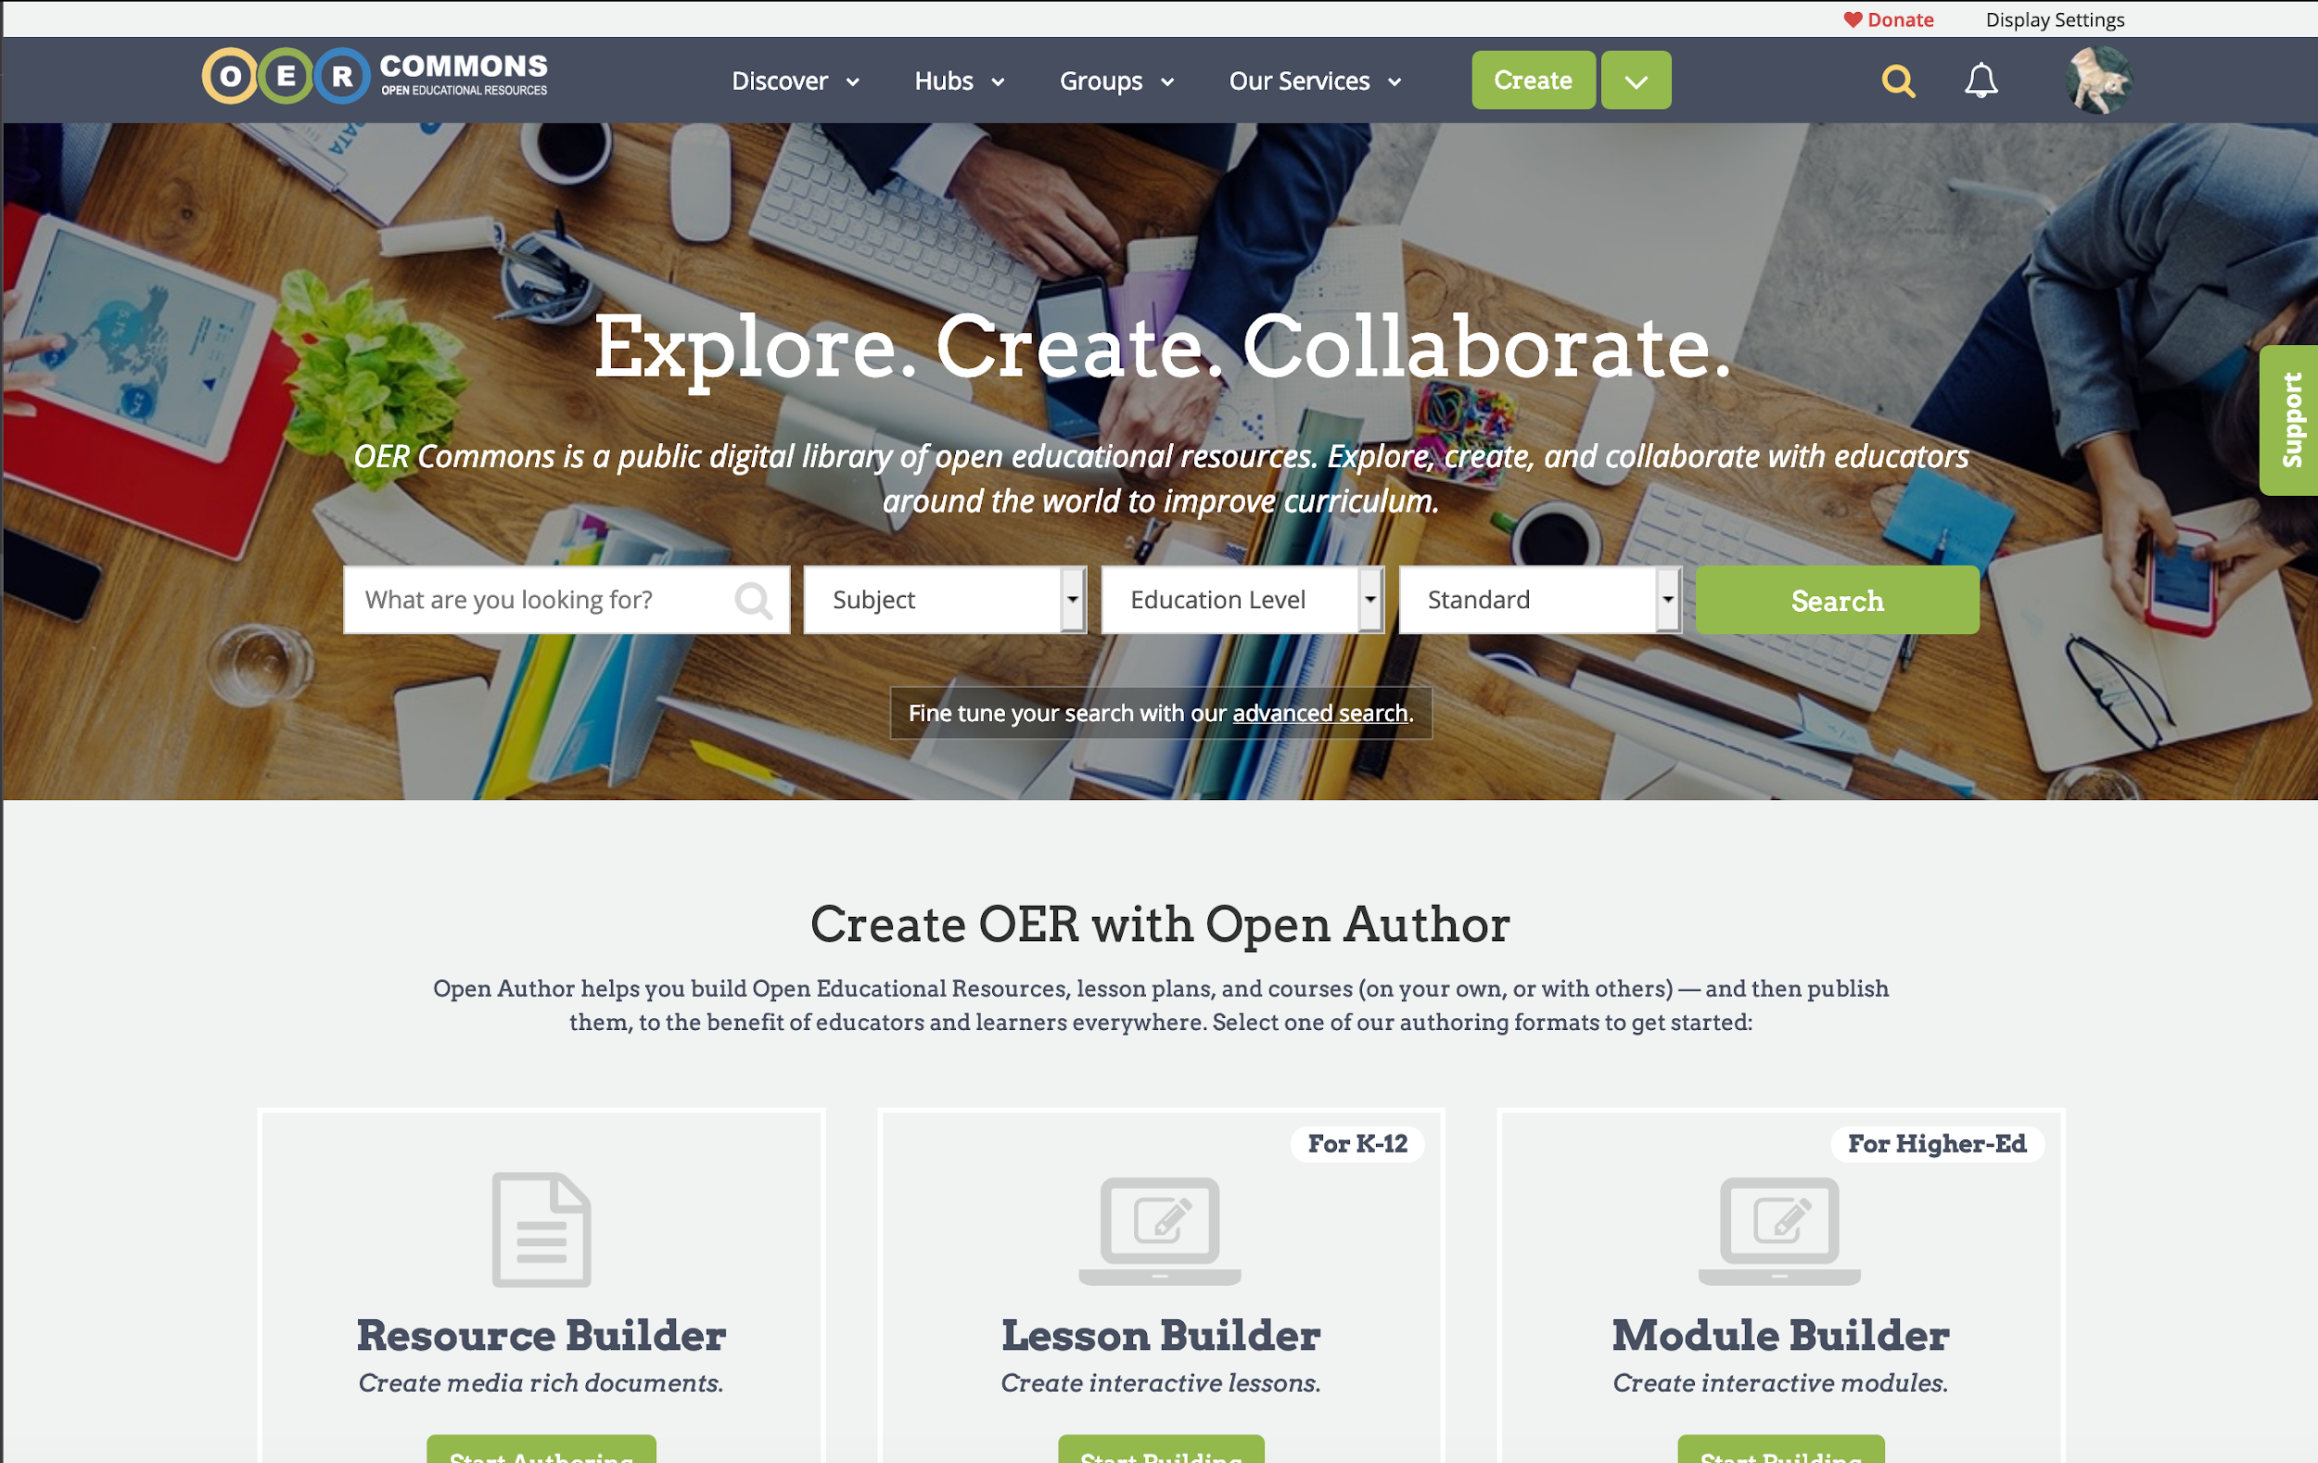
Using OER Commons for Search and Discovery
Search
Keyword search
Refine your search
Advanced search
Discover
Browse
Collections
Providers
Hubs
Groups
Notes:
Donna - Best practices for librarians, IMLS work with school librarians, curation framework

Slide 11
Approaches to Cross-Institutional OER Initiatives
Faculty Grants (VIVA, OhioLINK, CUNY)
Adopt: Those who "adopt" a resource will be using existing resource(s) as-is or with minimal editorial changes.
Adapt: Those who "adapt" will be modifying resource(s), combining several existing resources with changes, or creating ancillaries for an existing resource.
Create: Those who "create" an OER resource will be creating it all or largely from scratch.
https://vivalib.org/c.php?g=836990&p=6425615

Slide 12
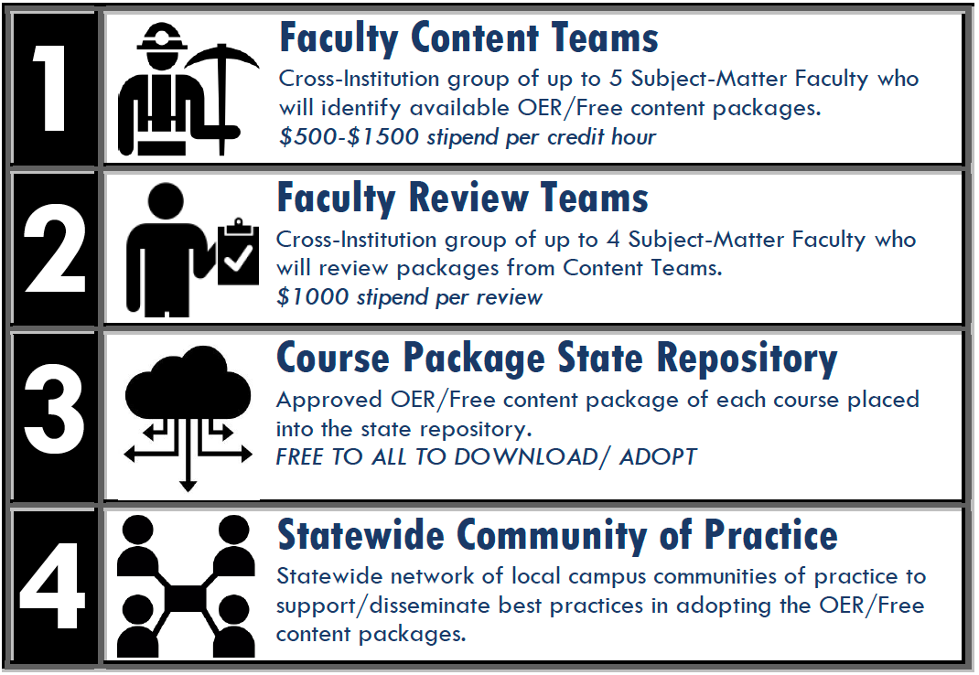
OER Faculty Grants: OhioLINK Affordable Learning Ohio

Slide 13
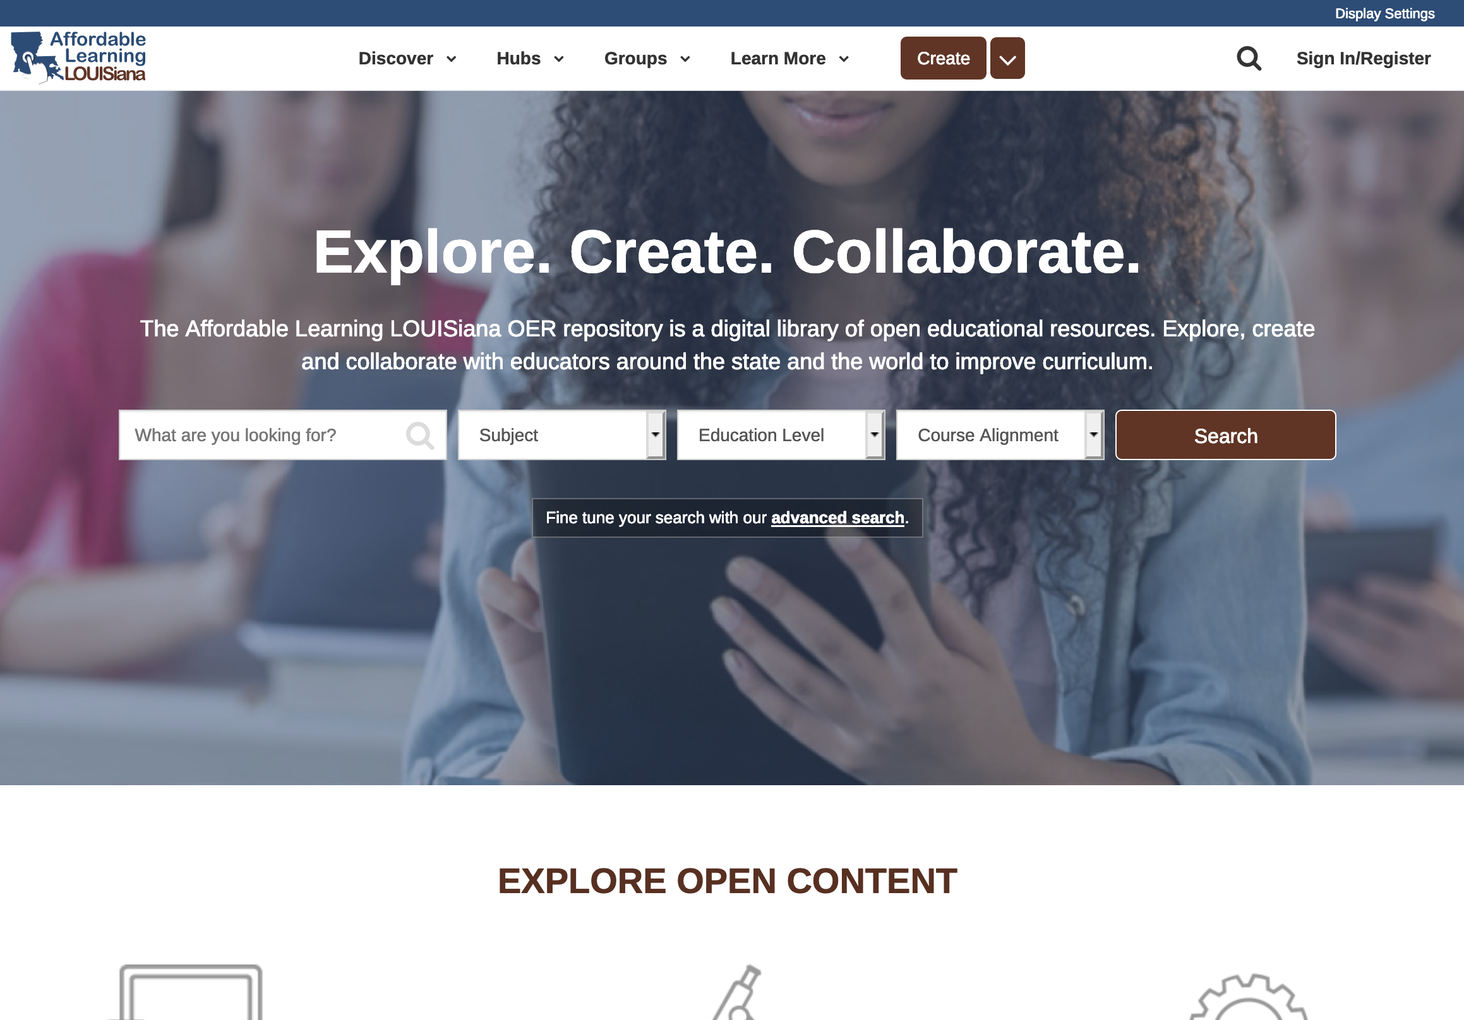
Approaches to Cross-Institutional OER Initiatives: Curation

Slide 14
Massachusetts CC
MA Open Education collaborative project focused on building capacity for OER across all Public HE institutions in the Commonwealth
Course Development Day
focus on MASS Transfer Block courses materials to be uploaded to the Hub
MASS DHE OER Working Group convene, study, evaluate & recommend to DHE/BHE

Slide 15
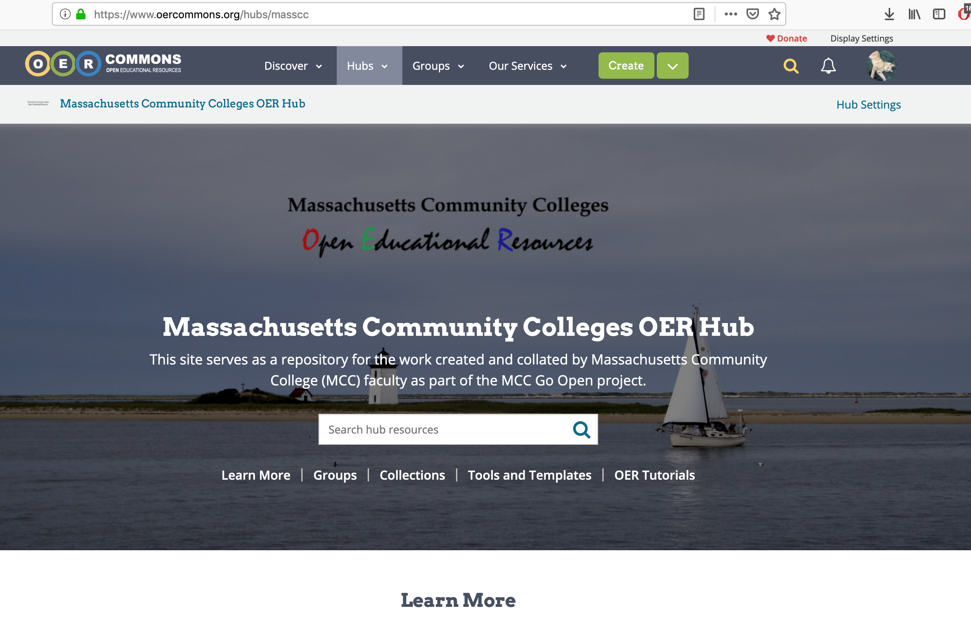
Mass CC Hub
Notes:
Mindy Hub Demo

Slide 16
Project Challenges - Massachusetts CC
Cross institutional partnerships
Need for dedicated staff
Sharing helps sustain momentum
Informed Advocacy

Slide 17
Additional Readings
OER: A Field Guide for Academic Librarians: https://commons.pacificu.edu/pup/3/
OCLS OER Toolkit: https://tlp-lpa.ca/oer-toolkit/home
The Role of School Librarians in OER Curation
A Framework to Guide Practice: https://docs.google.com/document/d/1wTzE7rKg9Kbzm3t24TIxIJy_bEA81sDqVvwIXPC7OYA/edit

Slide 18
Thank you!
Melinda Boland
Director, OER Services
mindy@iskme.org
@oer_maven

