Slide 1
We're all about the space: Taking inclusive library spaces to another level
Catherine Fahey, MLIS, MA
Tara Fitzpatrick, MLIS
Elizabeth McKeigue, MSLIS
Rukmal Ryder, MLIS, M.Ed.
Dawn Stahura, MLS
Salem State University

Slide 2
Objectives
Determine cost-conscious budget ideas
Discover four approaches to using library space to advance diversity, equity, inclusion and wellness
Learn about successful proposal development and execution of approved space plans
Identify potential space ideas and action items for your own library

Slide 3
Impetus & Process

Slide 4
Opportunity: Underutilized space and empty offices
Budget: <$5,000 from gift funds
Proposals: ideas that promote community and inclusion, minimal costs, reuse of existing materials, and involvement from campus partners
Notes:
Opportunity: Underutilized space and empty offices -- upside (if there is one) of unfilled positions…
Mention the sizes of the spaces --
Budget: annual income from a couple of unrestricted endowments = $5,000
Request for proposals:
Asked for ideas that promote community and inclusion,
“Points for” minimal costs, creative reuse of existing materials, achievable over the summer, and involvement from campus partners.
Discussion with teams and/or individuals to combine similar ideas into one proposal
4 PROJECTS approved to proceed… “the IDEA Den, Family Study Room, Meditation Room, and Community Meeting Room” --
FIRST -- about the IDEA DEN (turn over to Dawn)

Slide 5
IDEA Den

Slide 6
About
Offer a starting point in cultural competency.
Acknowledgement that libraries have historically failed in appreciating the diversity that makes our communities strong.
Commitment to working beyond these shortcomings.
Rotation of resources and student-created works.
Partnerships across campus for displays.
Accompanying LibGuide expands reach beyond physical space & allows for virtual/distance participation and for showcasing digital content. https://libguides.salemstate.edu/IDEA-Den

Slide 7

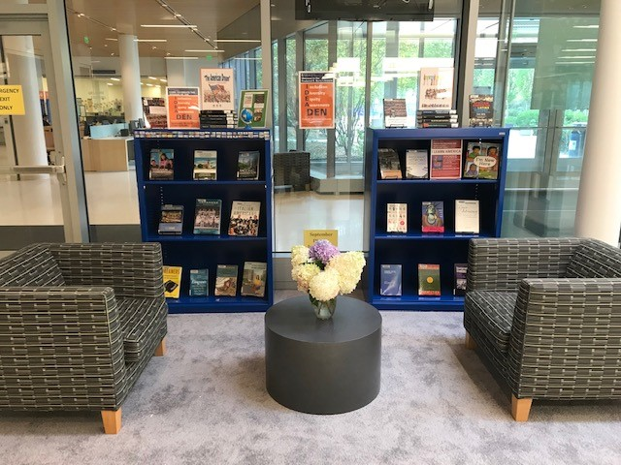

Slide 8
Impact
Past Displays:
Activism and Social Justice
Immigration
Black Excellence
Latinx Creatives
Collaborations
IDS 333A Explorations of Identity
SOC 306 The Black Woman
World Languages & Cultures Department
Office of Inclusive Excellence
Center for Creative and Performing Arts (postponed)
Counseling and Health Services (postponed)
Cozy seating nook in previously under-utilized space

Slide 9
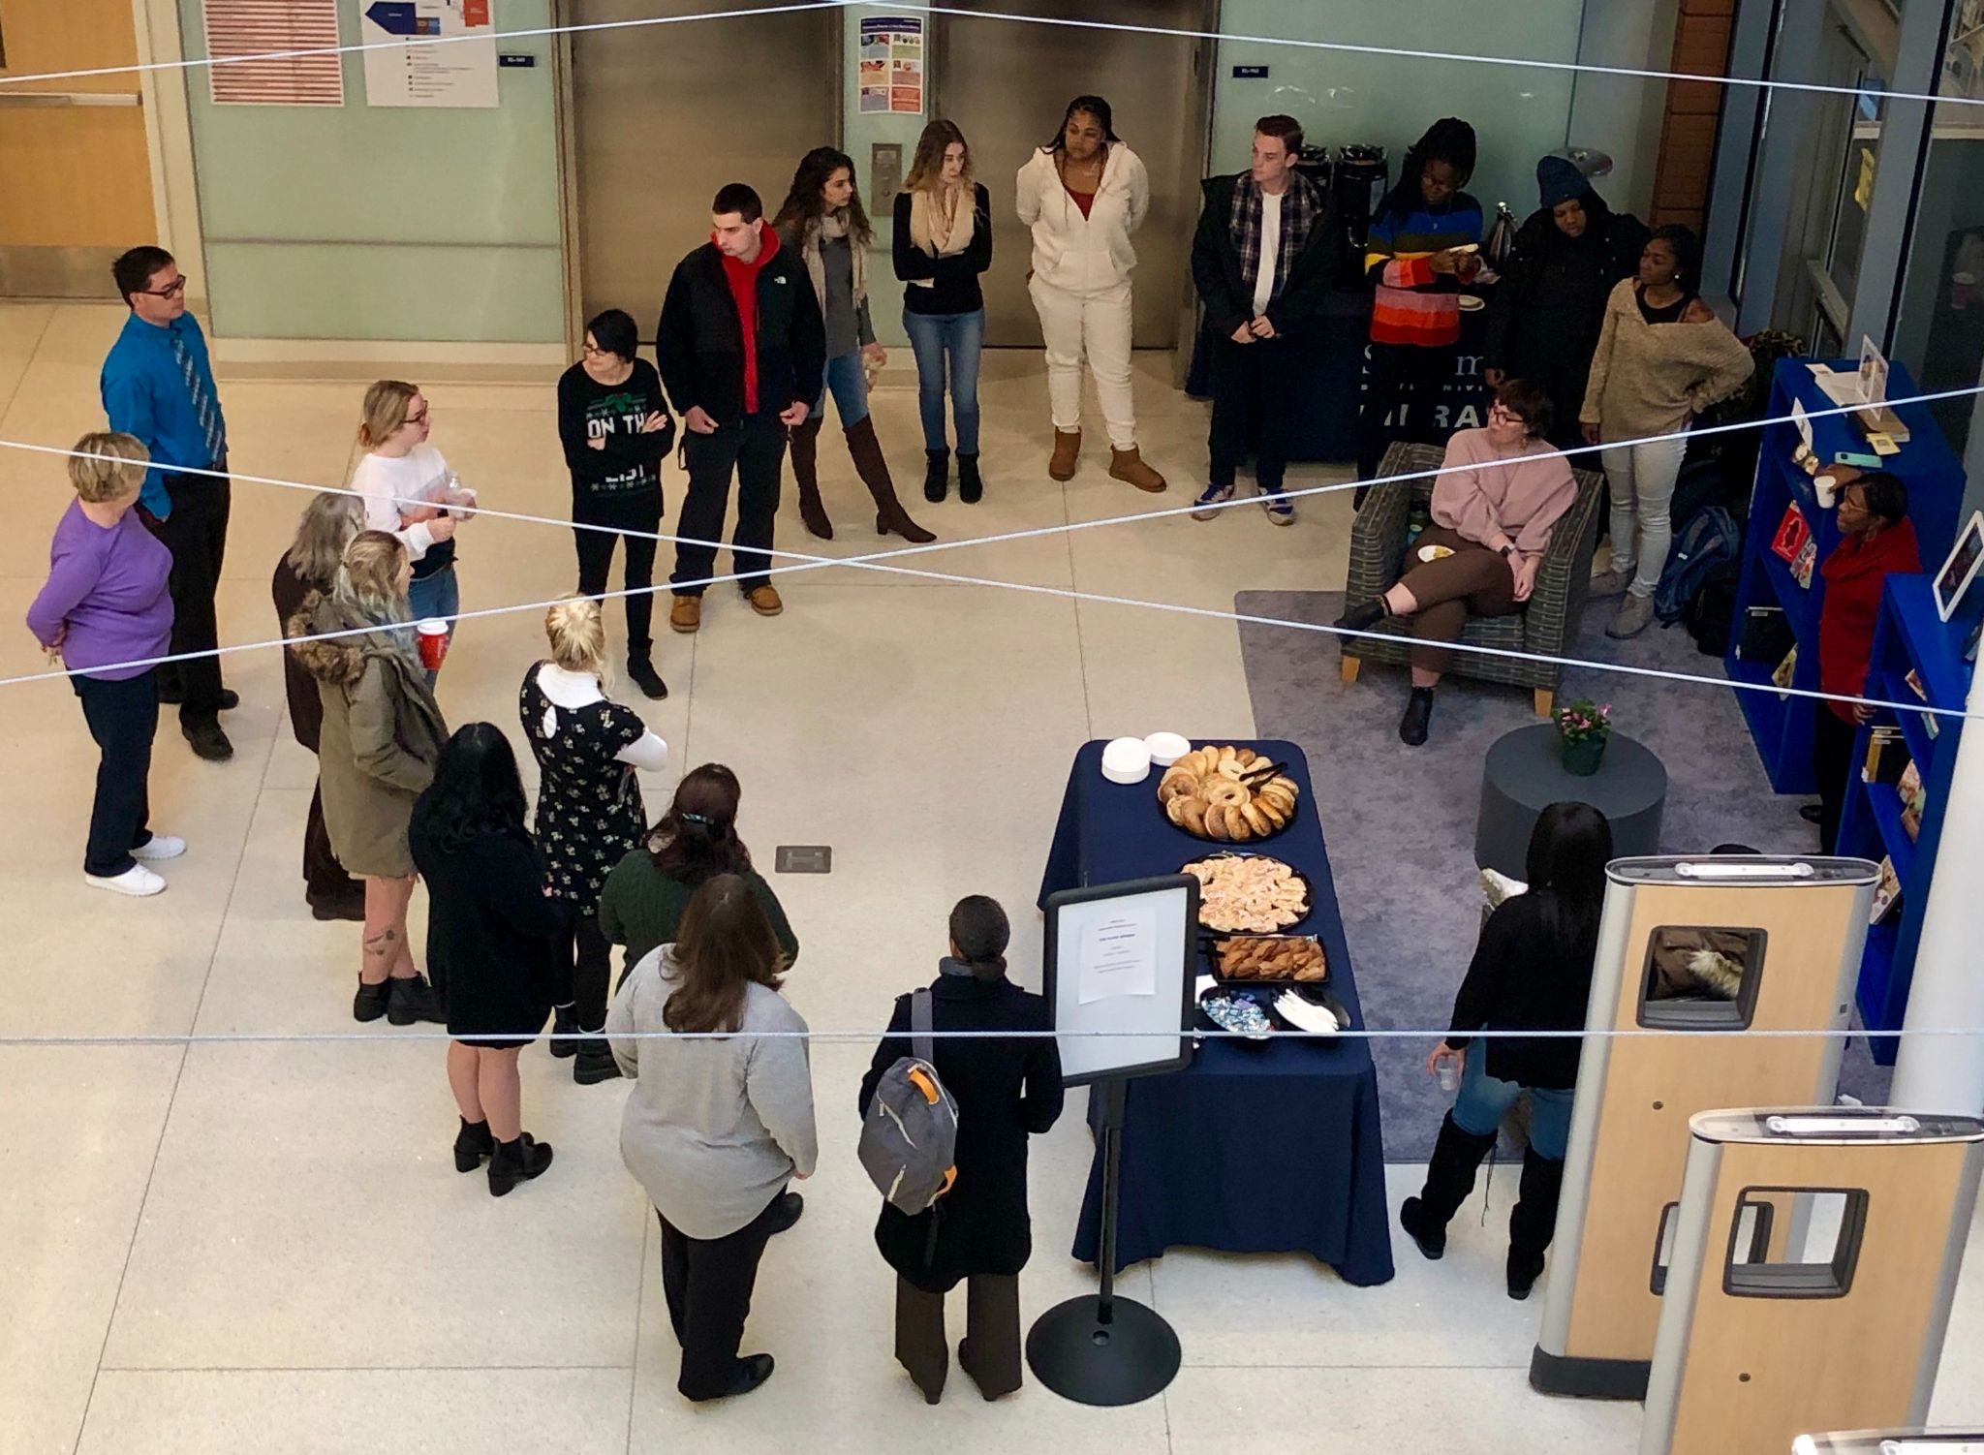
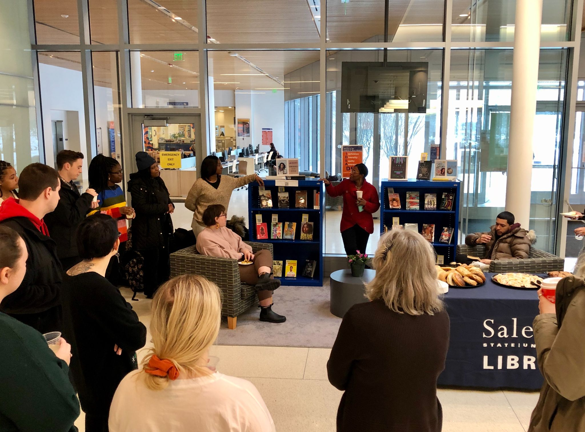

Slide 10
Family Study Room

Slide 11
About
Purpose to provide a more inclusive space for SSU students who are parents/caregivers by offering a safe & secure library space with amenities more conducive to studying with a child present
Observed evidence
2018 data 20.66% of undergrad respondents with dependents; largest group First Years
Graduate students (61 programs)
Link: https://libguides.salemstate.edu/home/spaces/directory#s-lg-box-wrapper-25990411
Notes:
Data from MapWorks via office of student retention services

Slide 12
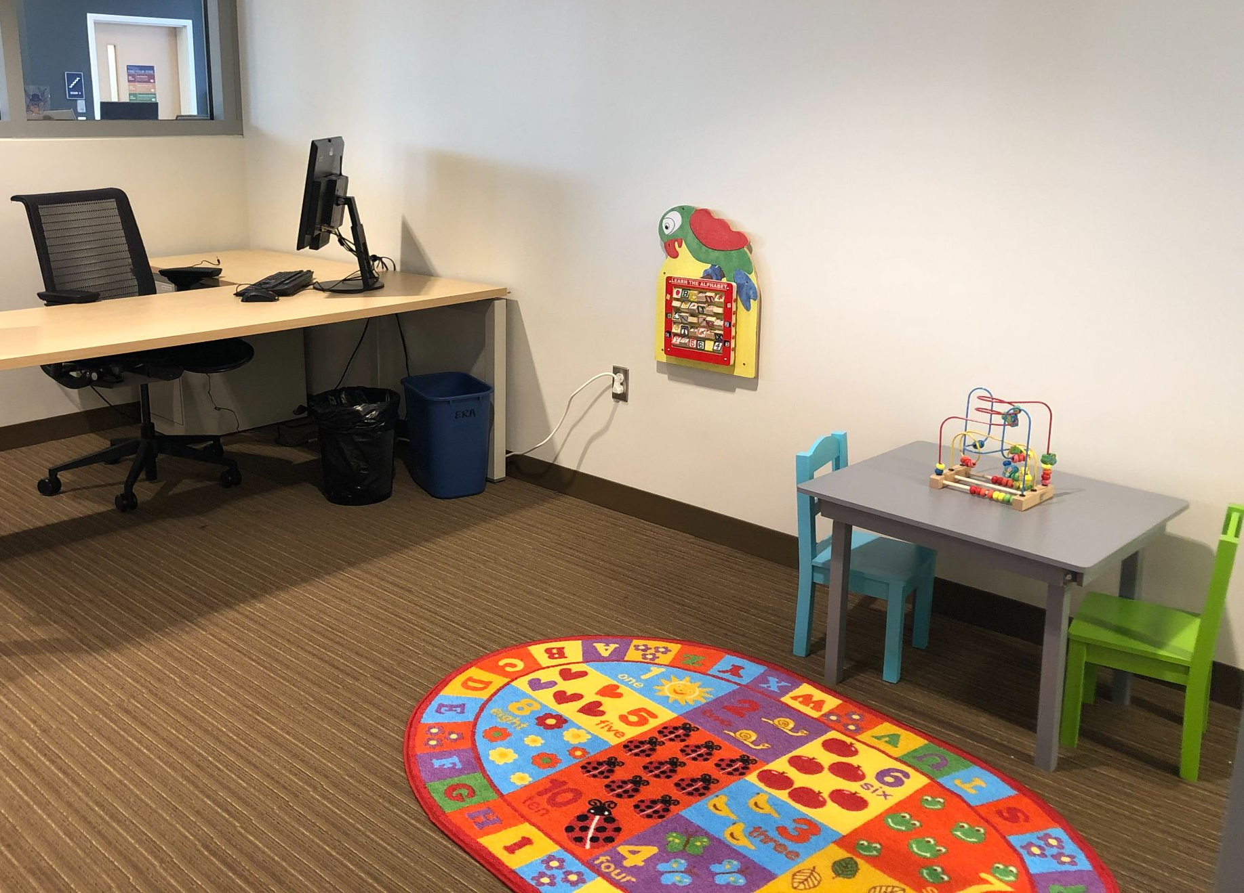
Proposal
Summary/rationale
Room features
Usage
Action Items
Potential costs
Potential revenue
Academic library examples
Notes:
Action items:
Check out procedure established
Online booking worked out
Room usage policy created
Costs: furniture, equipment Revenue: donor naming

Slide 13
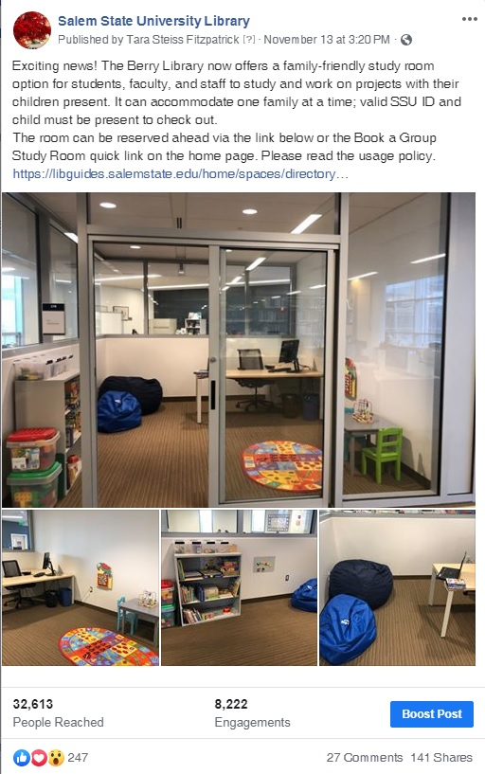
Impact
Unexpected collaboration - donations from School of Education
Positive publicity
18 checkouts in abbreviated AY 19-20
Expanded to faculty and staff
Notes:
SLIDE turner note go to next slide after speaker mentions “Positive publicity”

Slide 14
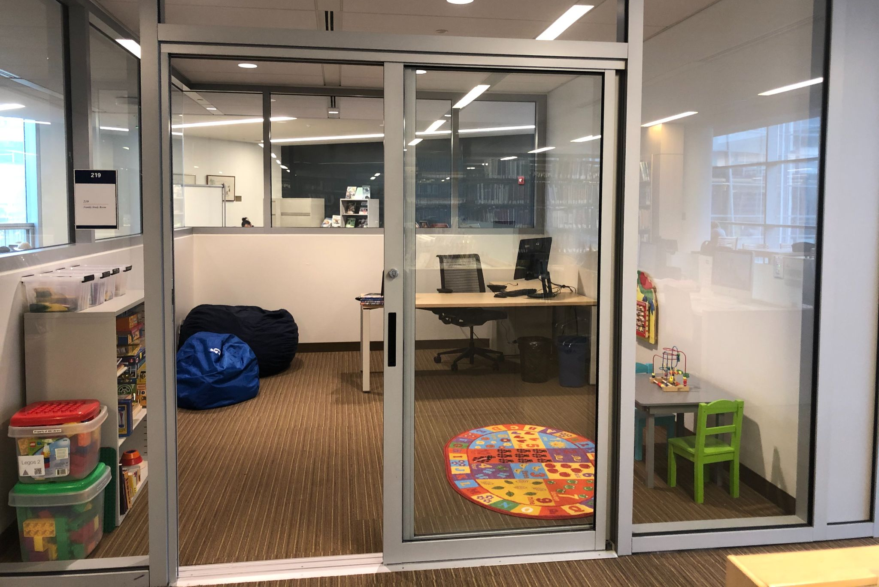
Adriana shared a post via Facebook (Nov. 2019).
I remember going to school at Salem State and having to take my 3 yr old with me to the library for sometimes late night study sessions. I’d make a little bed next to me for him while I finished my homework or bring some toys to distract him while I worked on my papers. Having something like this would have provided me with such peace of mind.
I was so wrapped up in guilt that I couldn’t tend to him nor afford childcare while I finished school, doubting it was worth it.
Salem State University thank you – as an Alumni, it warms my heart to see that you are thinking about all your students. This will provide parents with the perfect environment to pursue their dreams.
Notes:
Speaker note: I apologize for the amount of text on the screen but I think it is worth it ; ) It shows the meaningful impact a space like this can have

Slide 15
Meditation Room

Slide 16
About
A truly quiet space in the library for SSU students, faculty and staff, with books on mindfulness from a variety of sacred and secular traditions, comfortable chairs, prayer rugs and meditation cushions.
2019 student survey skiing for a quiet place
Muslim students using offices for prayer
Closing of prayer room in another campus building
Link: https://libguides.salemstate.edu/home/spaces/directory#s-lg-box-wrapper-25973530
Notes:
At time of proposal, did not know about planned closure/repurposing of prayer room.

Slide 17
Proposal
Summary/rationale
Room features
Usage
Costs
Appendices:
Library Events Survey Report 2/1/19
Examples in other academic libraries
select bibliography
Notes:
Action items:
Check out procedure established

Slide 18
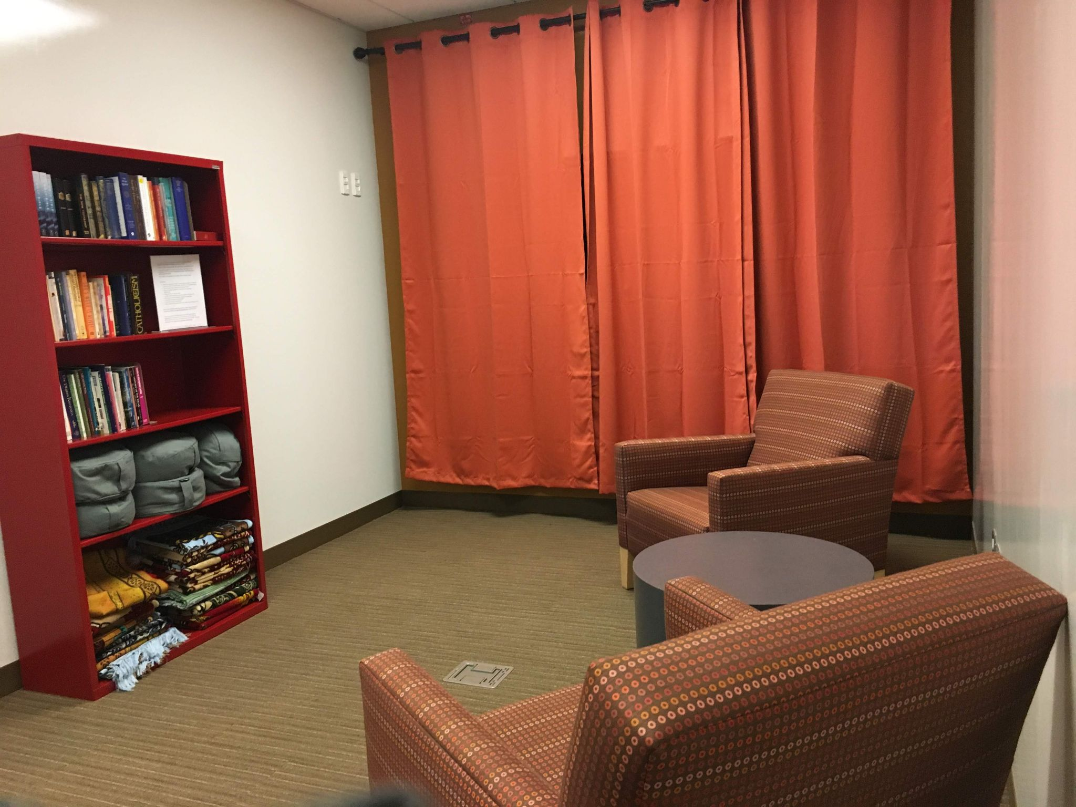
Notes:
TV/AV still behind the curtain

Slide 19
Impact
Collaboration with Chaplain’s office, Dean of Students office
Graduate student mediation group
10 persons requested individual access, 99 key checkouts
Notes:
Checkout: key at circ desk or patrons can request individual access via ID card.

Slide 20
Community
Meeting Room

Slide 21
About
A private space open to all library users, including non-SSU local community patrons, for up to two hours per day
Accommodates up to 4 people
Usage is first come first served
Link: https://libguides.salemstate.edu/home/spaces/directory#s-lg-box-wrapper-25973453
.

Slide 22
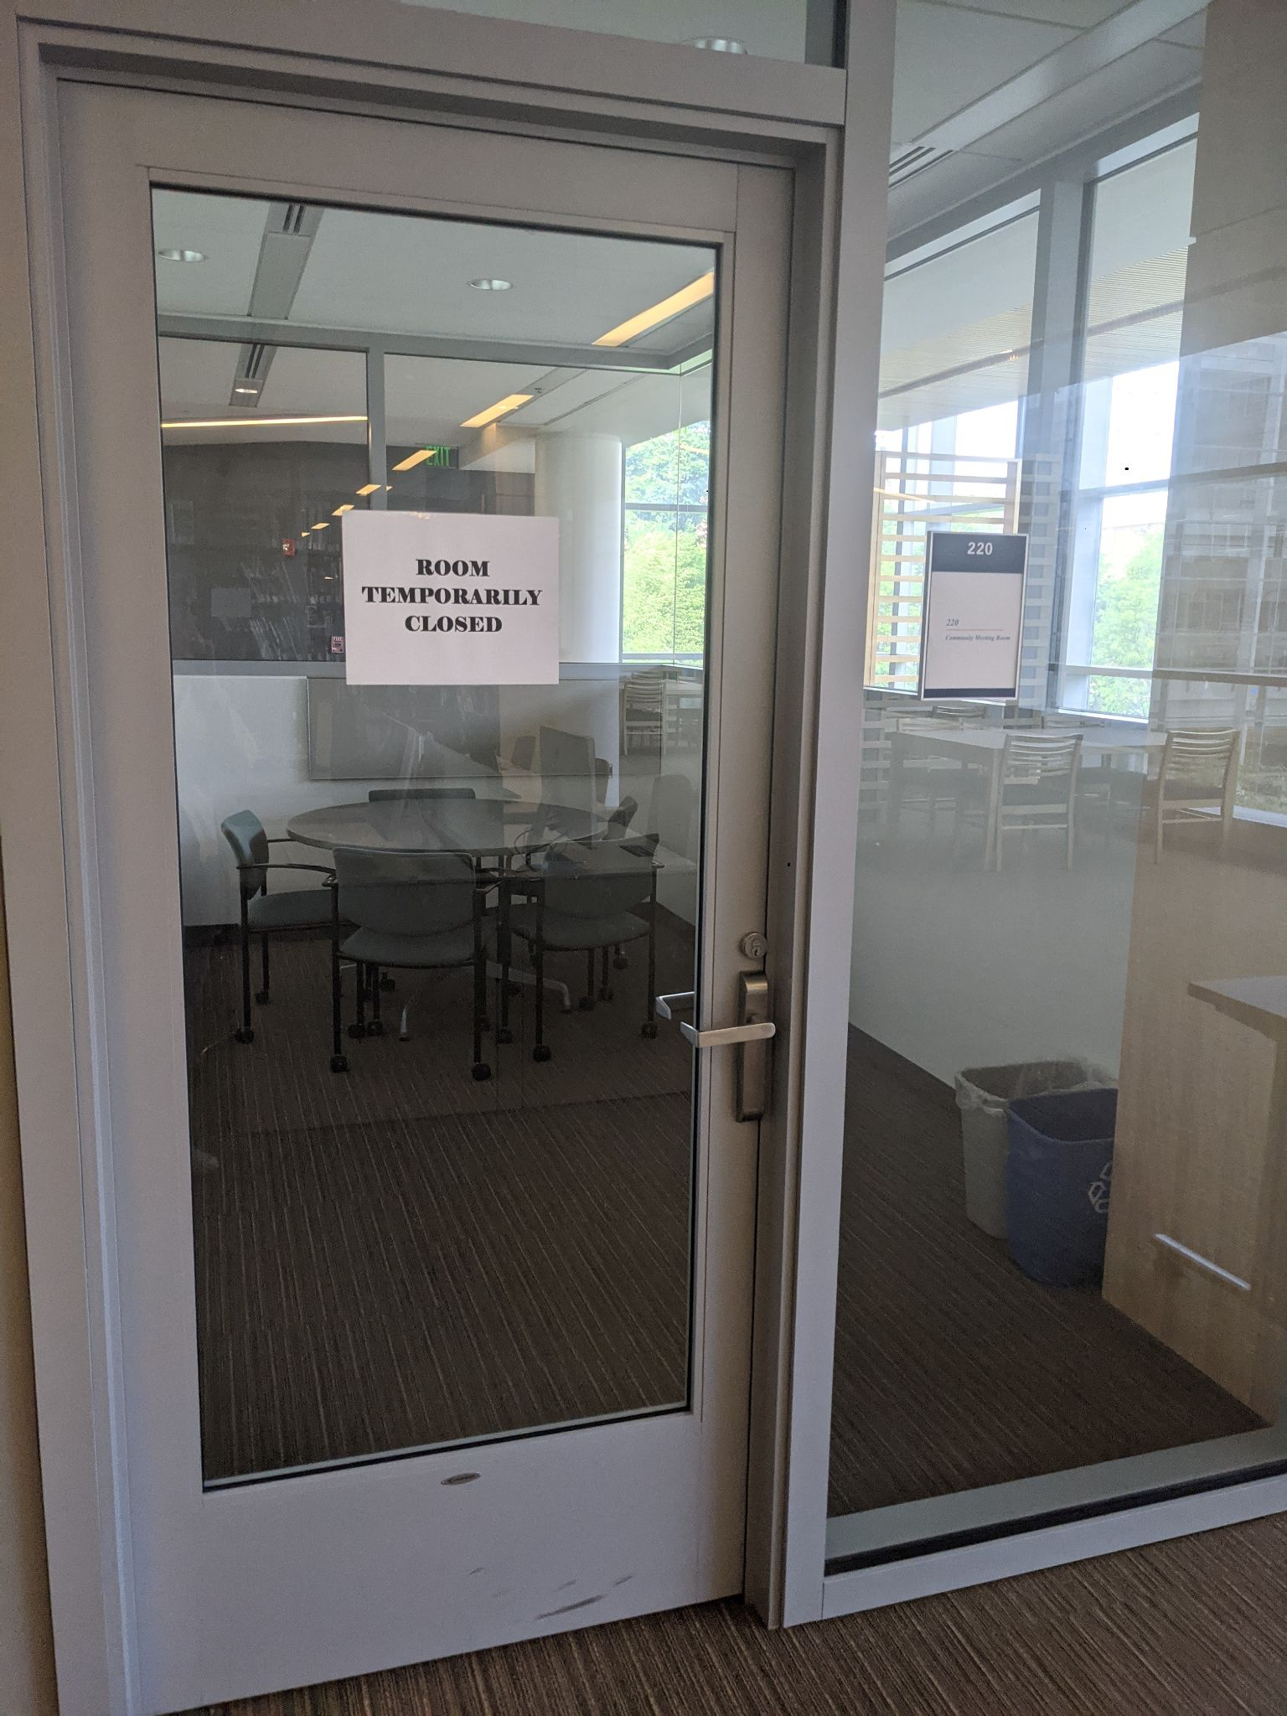
Requests from faculty and community for group study or for a collaborative work space.
Meeting space for community to plan events (student organizations, campus staff, or public patrons)
No cost for the library as we used furniture that we had in the library.

Slide 23
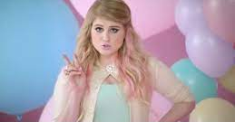
Unprecedented times
Two points!
Adapt even if that means pause
Bring that space online with virtual exhibitions (for example IDEA Den)
Asian Pacific Islander Heritage Month Virtual Displays and Events
SOC 403 & the SSU Archive: Campus activism
Image from: https://www.flickr.com/photos/zennie62/15524209516
Notes:
Speaker notes: That brings us to what is going on with these rooms today...

Slide 24
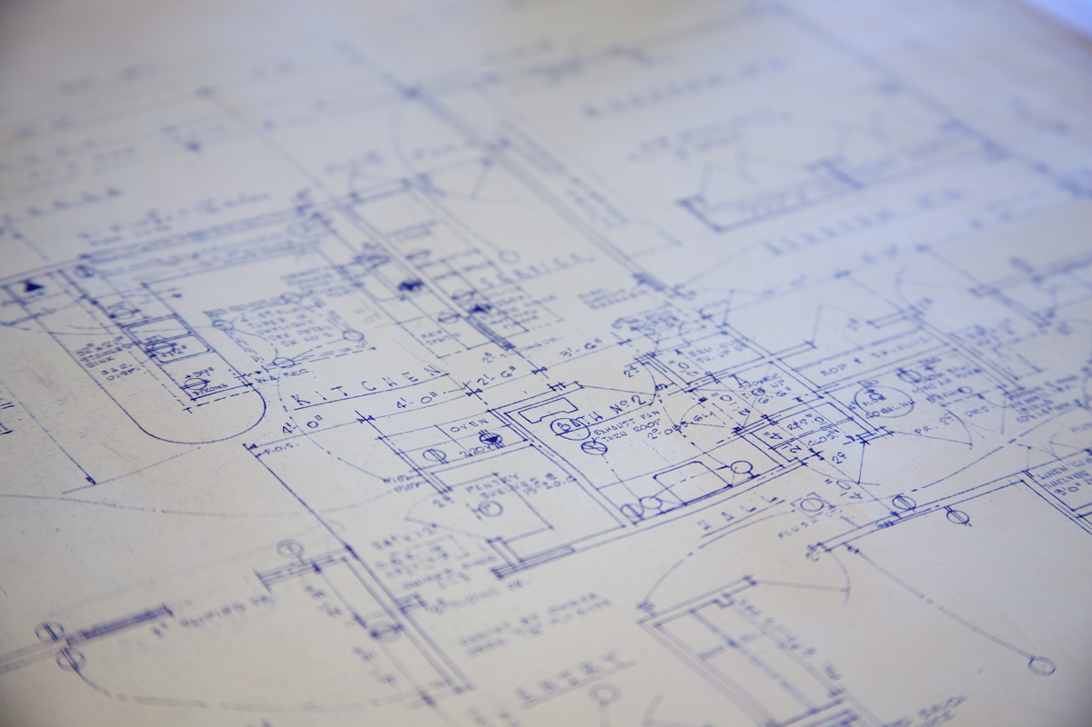
All About YOUR Space
"Blueprint" by Will Scullin is licensed under CC BY 2.0
Notes:
Share following link and instructions in chat:
Click on this link:
https://padlet.com/tkfitzpatrick2/j92jiog6vg7fkajk
Click on the pink plus icon on lower right to create a post. Be anonymous or include your library or your name in the title field. Brainstorm your space ideas in the text field.

Slide 25
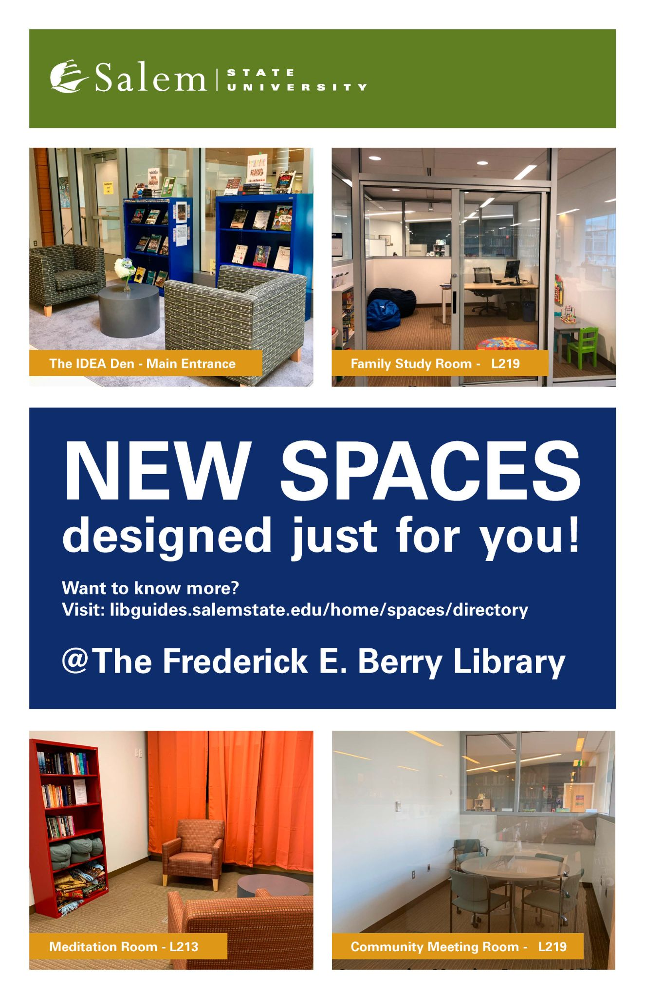
Thanks!
Contact:
cfahey@salemstate.edu
tfitzpatrick@salemstate.edu
emckeigue@salemstate.edu
rryder@salemstate.edu
dstahura@salemstate.edu
For more info on these spaces:
https://libguides.salemstate.edu/home/spaces/directory

Slide 26
Please keep this slide for attribution

