Slide 1

Lightning talk
Economics of cataloging
How serials holdings management can affect interlibrary loan
Daniel Saulean| Cataloging Management Librarian
ACRL-NEC Conference, May 28, 2021
Notes:
In the next minutes I will focus on basic library economics, precisely on how certain cataloging actions can generate efficiency across departments. It is about how reporting serials holding descriptions to OCLC affects ILL in an academic library with large legacy collection of periodicals. Despite its broad course-like title, no worries, there is no final exam to take!

Slide 2
Start: OCLC Data Sync
Compares library’s bibliographic database against records in OCLC and manages the local holdings (LHR) on the matching records
- institutional symbol is either confirmed, added or removed from records in WorldCat
Prior to Data Sync, local serials holdings in WorldCat
- represented solely at title level
- pervasive format misrepresentation
OCLC scans and deletes all the existing library holdings set over time in WorldCat, and reinstates them correctly
Notes:
This is a talk about an outcome of a Data Sync project (also known as Reclamation) at University of Vermont Libraries in 2018.
What is Data Sync? It is a tool that compares library’s bibliographic records against master records in OCLC and manages the local holdings on the matching records in WorldCat. As a result, the institutional symbol is confirmed, added or removed from records in WorldCat.
Why Data Sync? My institution never did such a comprehensive tune-up of its holdings in WorldCat; it was necessary and long overdue. Among reasons to do Data Sync: our serials holdings in WorldCat represented solely at title level, and there was a pervasive format misrepresentation.
Through processing, OCLC scans and deletes all the existing library holdings set over time in WorldCat, and reinstates them correctly.

Slide 3
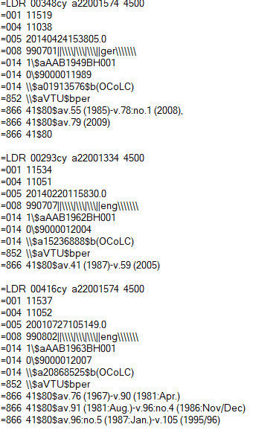
Library Holdings Records (LHRs)
Set up as a separate collection in OCLC WorldShare Management Services (WMS)
Local holdings statements are attached to the serials records in WorldCat
Importance of ANSI/NISO Z39.71/2006 compliance
Notes:
The upload of LHRs is run as a separate Data Sync collection in OCLC WorldShare Management Services.
LHR statements are attached to the corresponding serials bibliographic records in WorldCat, and provide users with information on volumes/issues of a serial held.
In order for OCLC to upload LHRs, these have to be compliant with the ANSI/NISO protocols.

Slide 4
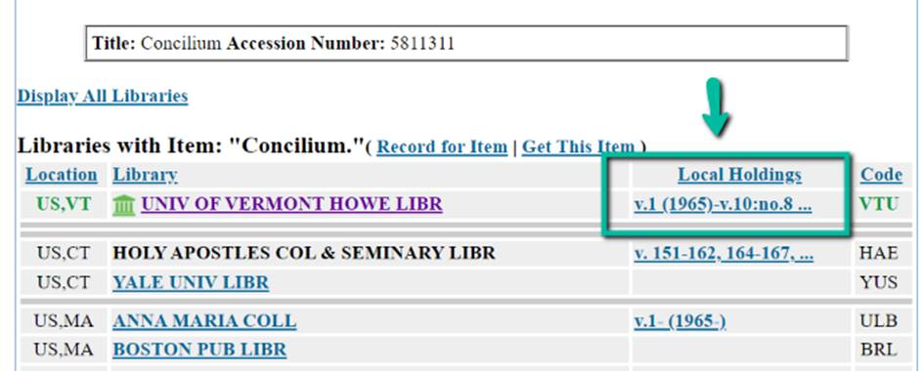
Implementation steps
Uploading of LHRs for serials in print & microfilm
Deletion of e-journals holdings from WorldCat
May 2018:
- 16,835 serials titles in tangible formats reported to OCLC
Notes:
We uploaded to OCLC of all LHRs for print and microfilm serials (everything encoded as serial in the local catalog, i.e., journals, magazines, newspapers, monographic series).
The deletion of e-journals holdings from WorldCat was necessary as they became vastly inaccurate over time. Why inaccurate? Because electronic format was many times misleadingly reported as print. SFX KnowledgeBase and MARCIt! service, used for the local e-journals holdings management and digital access, frequently linked e-journals to the best CONSER record available in OCLC, which often times was the one for print.
A number of 16,835 serials titles in tangible formats, print or microform, were reported to OCLC in May 2018. The display of LHRs in WorldCat went into effect immediately, and the results were visible starting with June statistics.
This is how the local holdings display in WorldCat.

Slide 5
Impact of LHRs update on lender activity
Requests for lending via OCLC coming from other libraries decreased dramatically
Notes:
The impact was instantly noticed in the lender’s side of ILL.
Here is the graphic evolution of lending volume over a period that includes the Data Sync reference point, that is, May/June 2018. The biggest drop happened around the date of the LHR upload, followed by a stabilization of lending volume at a much lower level than before. Why did this happen? Primarily because the borrowers were now able to submit their requests by checking first our description statements, instead of just guessing whether or not we might have the issue they were looking for.

Slide 6
Evolution of lending requests for serials: electronic vs. print
Notes:
And here is the evolution of lending requests for serials over the same period. There are two lines in the graphic, the electronic format, in green, respectively print, in blue.
While the requests for e-serials in OCLC ceased entirely after June 2018 (the green color line) because of their removal from WorldCat, the blue line tells a different story. Firstly, the borrowers looking for print prefer using OCLC resource sharing, because they already have other more efficient pathways to borrow exclusively e-serials, such as RapidILL. Secondly, the dramatic drop of print serials requests accounts for how much a difference the detailed description of holdings can make when it comes to selecting lenders to borrow articles from.

Slide 7
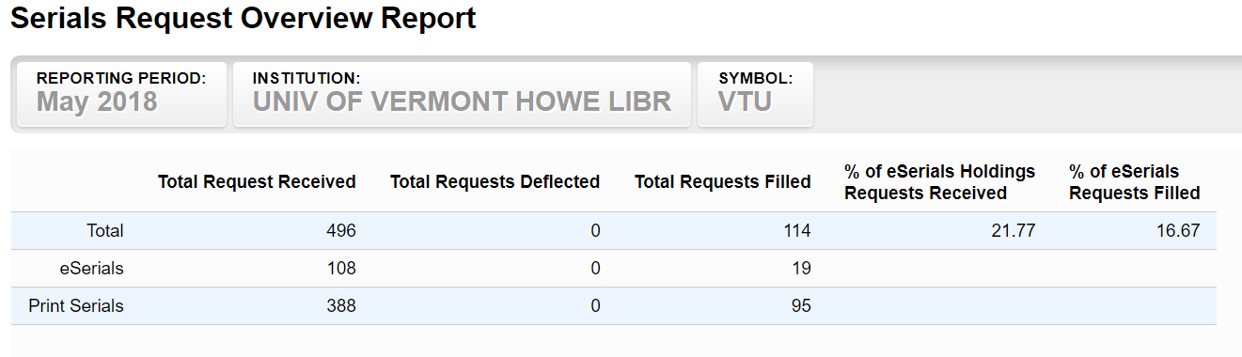
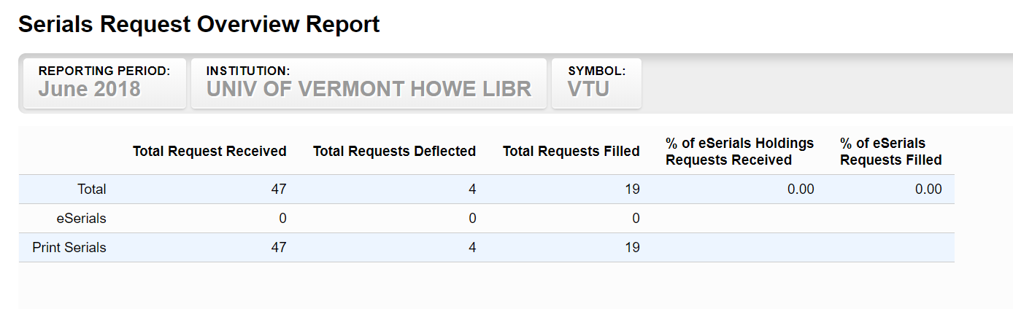
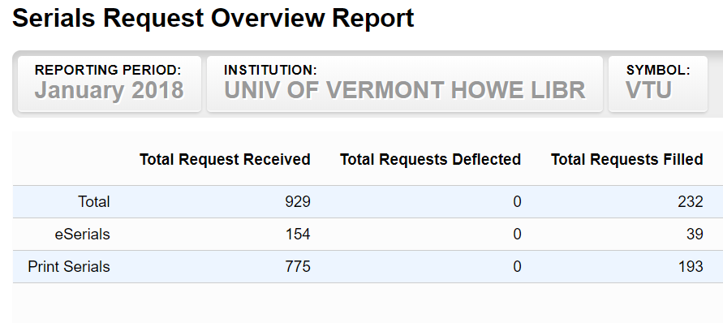
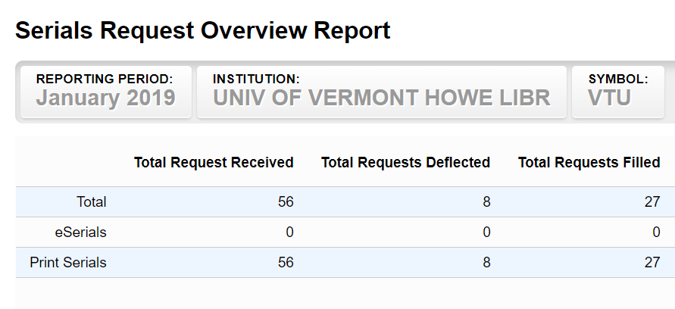
Before vs. after LHRs update
Notes:
These tables present the serials requests numbers in the month prior to implementing LHRs, respectively after. The average decrease of the volume is more than 8 times.
In the lower side of the slide is the downward pattern of serials requests, confirmed by a comparison between a specific month before Data Sync and the same month a year later, in which the decrease is about 14 times.

Slide 8
Fill rate for print serials
Significant change in the fill rate for print serials requests received via OCLC
Notes:
Another effect: the doubling of the ILL fill rate. This went from under 25%, in the period preceding May 2018, to over 55% immediately after and going higher (the maximum 75% was reached in October 2018). Here is represented a period of 18 months. Much of the unfilled rate before Data Sync was mainly due to actual unavailability of the requested resource (“lacking” issue/volume or “title not owned”). The statistics for 2019 and 2020 show a steady average fill rate of 75%.
[To mention that aside from the lending requests received via OCLC, a much higher number is coming through a separate channel, RapidILL, for which holdings are reported separately. The difference between the two is not only by scope, but the fill rate as well. RapidILL had a traditionally fill rate between 75-85%, in fact the same as in OCLC in the period following Data Sync.]

Slide 9
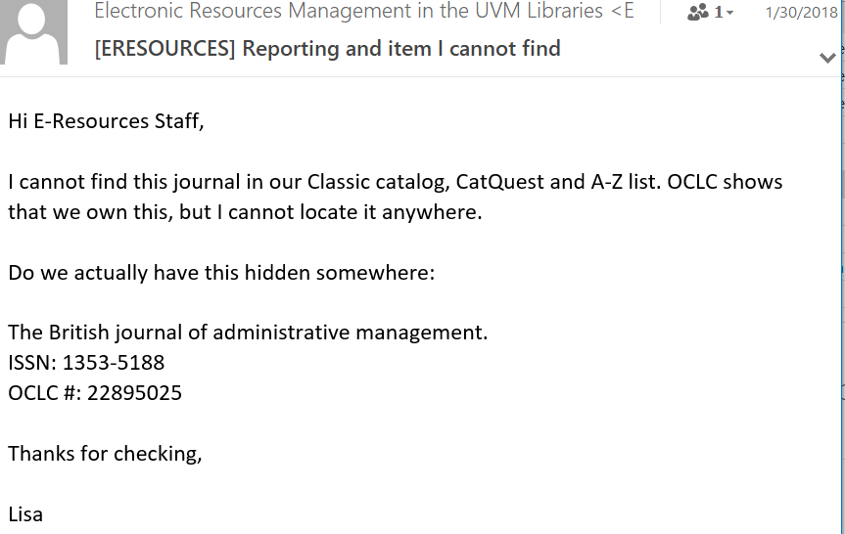
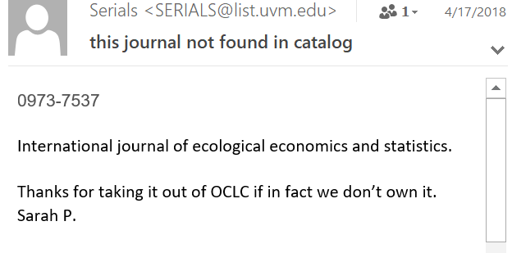
Added benefit: staff time saving
Error-reporting procedure by ILL staff for holdings troubleshooting ceased
Significant time saving for both ILL and Cataloging staff
Notes:
An added benefit of the LHRs is the staff time saving, very important aspect if productivity matters in an organization. The error-reporting procedure for troubleshooting holdings of both print and e-journals, initiated by ILL staff, completely died out. The time-consuming procedure of reporting errors to Acquisition and Cataloging department, checking subscriptions status, coverages, and fixing the problem on a piecemeal-basis is gone.
Ultimately, this resulted in a significant time saving for both ILL and cataloging staff.

Slide 10
Later development: Big Deal cancellations
Elsevier’s Freedom Collection cancelled in December 2020
- lost access to issues after 2020 for 2237 e-journals titles
Cancellation
- immediate increase of the demand for borrowing articles from other libraries (+ pay-per-view, tokens)
Conclusion
- timeliness of LHRs implementation, repurposing staff time to deal with Big Deal cancellations
Notes:
Now a later development, if we have time.
It is widely accepted that unsustainable price increase models and changes in usage patterns will lead to the breakup of Big Deal e-journals packages as we know them for two decades.
UVM successfully cancelled the Elsevier Freedom Collection at the end of 2020, which means lost access to issues starting Jan 2021 for 2237 academic research titles, and need to find alternatives.
The Elsevier cancellation brought about an immediate increase of the demand for borrowing articles from other libraries, and increased reliance in ILL.
In conclusion, the implementation of LHRs for print serials, paired with a full deletion of holdings for e-journals from WorldCat proved to be cataloging actions that reduced the volume of incoming lending requests and created conditions for repurposing staff time to deal with Big Deal cancellations.

Slide 11
Credits
My thanks for input to
Lisa Brooks
Interlibrary Loan Coordinator
UVM Libraries

