Slide 1

The COVID-19 Misinformation Challenge
Asynchronous Learning About (and During!) a Pandemic
Jen Bonnet
University of Maine
Senta Sellers
Miami University

Slide 2

Poll question 1: Have you ever participated in an email challenge?
Poll question 2: Have you ever created an email challenge?
Go to menti.com
Enter 55 33 99 7
Photo by fauxels from Pexels

Slide 3
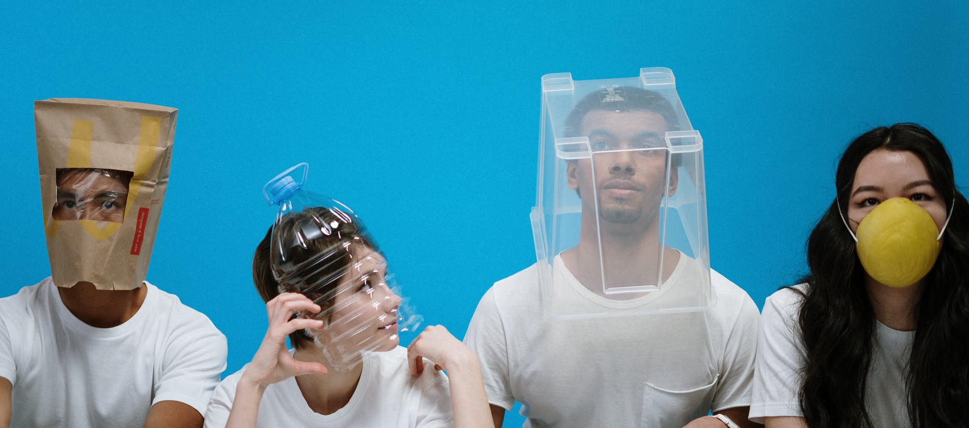
COVID-19 Misinformation Challenge
https://libguides.library.umaine.edu/covid19
Photo by cottonbro from Pexels

Slide 4
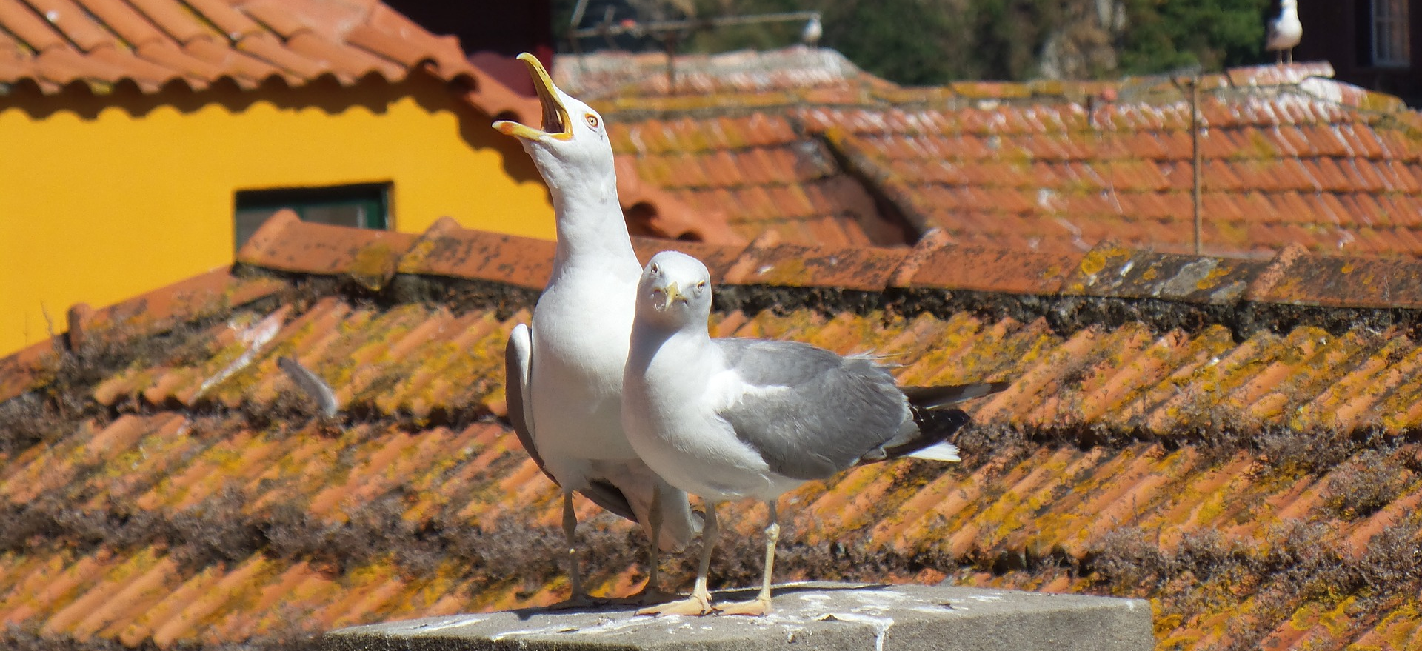
Getting the Word Out

Slide 5
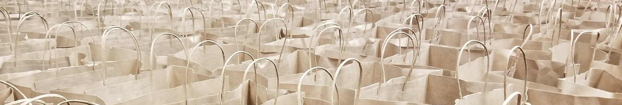
Takeaways
Asynchronous = Advantage
Concise = Contentment
Pilot, pilot, pilot

Slide 6
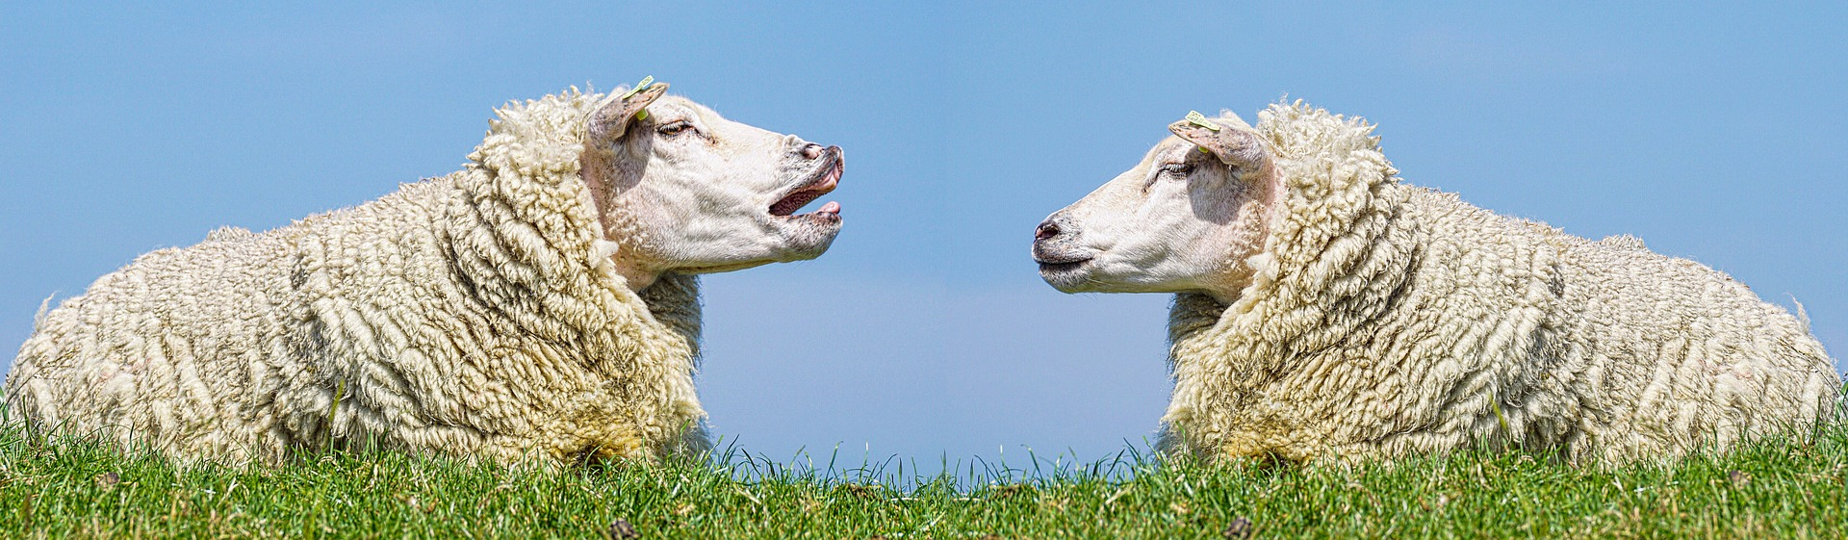
Discussion
How could an email challenge work in your area(s)?
What other topics/content would benefit from this approach?

Slide 7
Thank You!
Questions/Comments?
Jen Bonnet
jenbonnet@
maine.edu
Senta Sellers
senta.sellers@gmail.com

