Slide 1



Marketing and Encouraging OER
Photo by Gilles Lambert on Unsplash
Nicole Finkbeiner, Associate Director, Institutional Relations
nicolef@rice.edu, @nfinkbeiner, @openstax

Slide 2


Clearly define your goal
Strategic
Measurable
Actionable
Relevant
Time Limited
Notes:
David

Slide 3
Measure Outcomes,
Not Actions
Outcomes. Measure success by these:
  # of faculty using OER
  # of students impacted by OER
  $ amount of savings to students ($98.57)
  Student success (grades, completion, etc.)
Actions, that contribute to, but don’t equal success:
  Holding a meeting
  Having a workshop
  # of people who attended meeting/workshop
  Having a display
Notes:
David

Slide 4
Quality goal?
We want people to stop smoking.
Notes:
David

Slide 5
Quality goal?
90% of the Harris County population will be a non-smokers by January 1, 2020.
Notes:
David

Slide 6
Quality goal?
We want people to know about our event.
Notes:
David

Slide 7

Quality goal?
We want people to know about our event.
Photo by Arwan Sutanto on Unsplash
Notes:
David

Slide 8
Quality goal?
We want a minimum of 50 faculty to attend our workshop on September 1, 2018.
Notes:
David

Slide 9
Quality goal?
We want to increase OER on our campus.
Notes:
David

Slide 10
Quality goal?
Save our students $5 million in
5 years with OER
- Maricopa Millions
Notes:
David

Slide 11
But I don’t know who is using OER at my institution?
Ways to find out:
  Send-out an email
  Send-out a survey
  Ask your bookstore
  Email Nicole (nicolef@rice.edu) and ask for a list of adoptions for your institution from OpenStax
Notes:
David

Slide 12

But I don’t know who is using OER at my institution?
Ways to find out:
  # of faculty using OER
  # of students impacted by OER
  $ amount of savings to students ($98.57)
  Student success (grades, completion, etc.)
Photo by Oscar Sutton on Unsplash
Notes:
David

Slide 13
But I don’t know who is using OER at my institution?
Ways to find out:
  Send-out an email
  Send-out a survey
  Ask your bookstore
  Email Nicole (nicolef@rice.edu) and ask for a list of adoptions for your institution from OpenStax
Caution!
  Don’t get stuck at this step. Some schools get stuck here for more than a year!
  Do the best you can in 2 weeks and then move on.
  Increasing the accuracy of OER reporting is something you can do slowly.
Notes:
David

Slide 14

Exercise:
Take 10 minutes and write-out your goal(s). Share with those around you
Notes:
David

Slide 15
Identify your main target markets
Notes:
David

Slide 16
Identify your target markets
My target market is everyone!
Notes:
David

Slide 17

Identify your target markets
My target market is everyone!
Photo by Ayo Ogunseinde on Unsplash
Notes:
David

Slide 18
Identify your target markets
80/20 rule:
80% of your business comes from 20% of your clients
Notes:
David

Slide 19
Identify your target markets: Which faculty?
ROI with faculty advocacy steps:
  Find out your top 25 highest-enrolled courses
  Identify which of those courses have high-quality OER alternatives.
  Identify the faculty who teach full-time or teach multiple sections for the list of courses from #2.
  Focus on the faculty from #3.
  Other faculty groups to consider:
  “Early adopters” of new ideas
  New faculty
  Faculty who are influencers for other faculty
Notes:
David

Slide 20
Identify your other target markets:
Who do you need on the advocacy bus?
  Administrators
  Librarians
  Instructional Support
  At least one Senior Administrator who is willing to regularly promote the initiative
  Bookstore
  Disability Services
  Students
Notes:
David

Slide 21

Pick only a few target markets at a time, otherwise you’ll stretch yourself too thin!
Prioritize your target markets: Focus on those that have the most influence to the least influence.
Photo by Sharon Garcia on Unsplash
Notes:
David

Slide 22
Exercise:
Take 5 minutes and write-out your top 5 target markets
Notes:
David

Slide 23
Goals are different for each target market
(with some exceptions, but start with this assumption)
Notes:
David

Slide 24
Question: What do you ultimately want them to do?
Notes:
David

Slide 25
Clearly define your goal
Smart
Measurable
Actionable
Relevant
Time Limited
Notes:
David

Slide 26
Quality goal?
We want people to know about our event.
No!
Notes:
David

Slide 27
Exercise:
Take 5 minutes and write-out your ultimate goal for each target market
Notes:
David

Slide 28
Features vs. benefits
Features are something about your product or service
Benefits are what your target market gains from your product or service
Notes:
David

Slide 29
Features vs. benefits
Start by naming something about your product or service.
Now, pretend that you are talking to your target market and finish the sentence by saying “so you can…” and adding an ending
Notes:
David

Slide 30
Features vs. benefits
Imagine your target market saying to you:
Why should I care?
Notes:
David

Slide 31
Feature or benefit?
You’ll have $100 per month on your healthcare costs.
Notes:
David

Slide 32
Feature or benefit?
Our department’s mission statement is...
Notes:
David

Slide 33
Feature or benefit?
Dr. Jane Doe has her degree from Michigan State University.
Go Green!
Notes:
David

Slide 34
Feature or benefit?
You’ll be able to move forward on day-one of your course with your learning objects, because there’s no excuse for the student to not have the book.
Notes:
David

Slide 35

Feature or benefit?
Photo by Alexandr Podvalny on Unsplash
Notes:
David

Slide 36

Feature or benefit?
Photo by Arnaud Jaegers on Unsplash
Notes:
David

Slide 37
Academic Freedom and OER
Every student has immediate & unlimited access
Standard scope & sequence makes it easy to adopt
Variety of technology partners allow choice
Permission free use, editing & adaptation
Variety of formats/partners eliminates one size fits all
Ownership of the content. Forever
Moving to a new edition is optional
Notes:
David

Slide 38
Exercise:
Take 10 minutes and identify the top 4 benefits for each of your target markets. Share with those around you.
Notes:
David

Slide 39
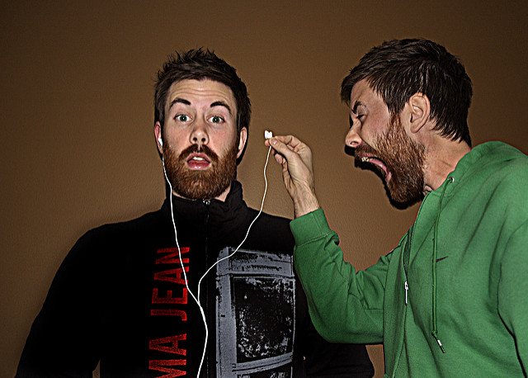
Identify when/how your target markets are mostly likely to listen
"listen to ME!" by Jonathan Powell, via
Flickr Creative Commons is licensed under CC BY 4.0
Notes:
David

Slide 40
Identify when/how your target markets are mostly likely to listen
Consider
Messaging medium (presentation, email, posters, etc.)
Location
Timing
Who delivers the message
Notes:
David

Slide 41
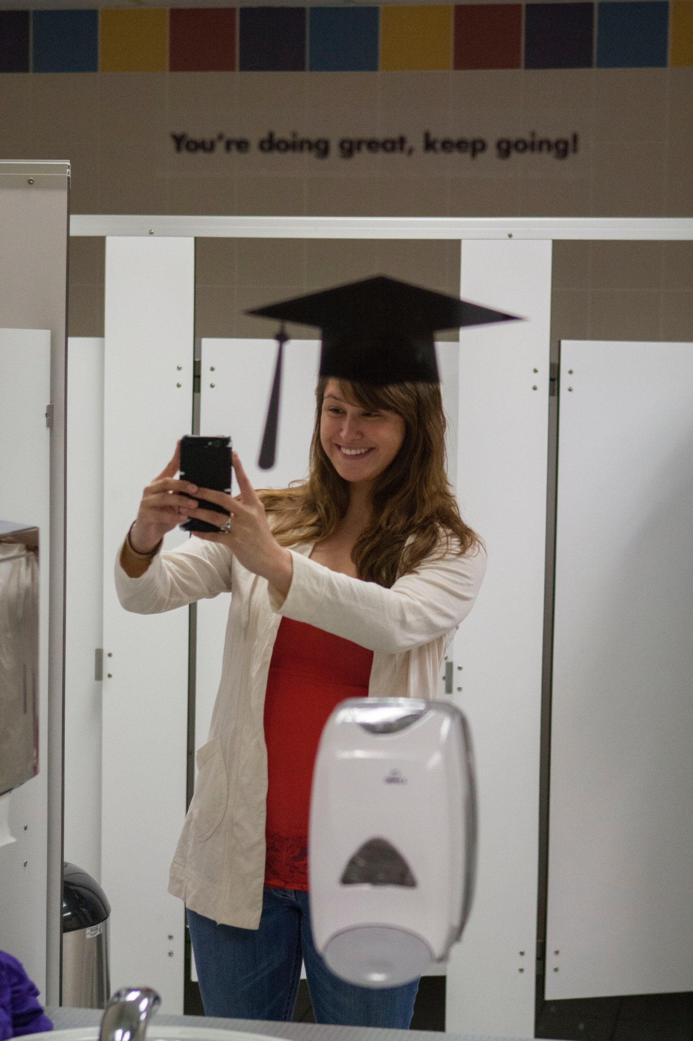
Think beyond emails!
Notes:
David

Slide 42
Exercise:
Take 5 minutes to identify when/how each target market is most likely to listen
Notes:
David

Slide 43
Putting it all together: Create a message based on the benefit and target market chosen that fits the medium
Notes:
David

Slide 44
Short-term, interim goals:
What you want them to do from a specific communication
Notes:
David

Slide 45
One goal per communication
Notes:
David

Slide 46
One goal per communication:
Attend our OER workshop on September 19, 2018
Notes:
David

Slide 47
One goal per communication:
Attend our OER workshop on September 19, 2018
Joe will feel left out if I don’t include his stuff too
Notes:
David

Slide 48
One goal per communication:
Attend our OER workshop on September 19, 2018
Joe will feel left out if I don’t include his stuff too
But I also want to tell them about my other programs
Notes:
David

Slide 49
One goal per communication:
Attend our OER workshop on September 19, 2018
Joe will feel left out if I don’t include his stuff too
But I also want to talk to another target market
But I also want to tell them about my other programs
Notes:
David

Slide 50
One goal per communication:
Attend our OER workshop on September 19, 2018
Joe will feel left out if I don’t include his stuff too
But I also want to talk to another target market
Oh, also, we’re holding webinars
But I also want to tell them about my other programs
Notes:
David

Slide 51
One goal per communication:
Attend our OER workshop on September 19, 2018
Joe will feel left out if I don’t include his stuff too
But I also want to talk to another target market
Oh, also, we’re holding webinars
I know you said not to put your mission statement in here but…
But I also want to tell them about my other programs
Notes:
David

Slide 52
One goal per communication:
Attend our OER workshop on September 19, 2018
Joe will feel left out if I don’t include his stuff too
But I also want to talk to another target market
Our center is also doing some other cool stuff I want them to know about
Oh, also, we’re holding webinars
I know you said not to put your mission statement in here but…
But I also want to tell them about my other programs
Notes:
David

Slide 53
One contact (preferably direct) per communication
Please email Nicole at nicolef@rice.edu if you’re interested in exploring OER for your courses
Notes:
David

Slide 54
One contact (preferably direct) per communication
Please email Nicole at nicolef@rice.edu if you’re interested in exploring OER for your courses
I want them to be able to contact any of us, so we need to list everyone
Notes:
David

Slide 55
One contact (preferably direct) per communication
Please email Nicole at nicolef@rice.edu if you’re interested in exploring OER for your courses
But I also want them to be able to check-out my LibGuide
I want them to be able to contact any of us, so we need to list everyone
Notes:
David

Slide 56
One contact (preferably direct) per communication
Please email Nicole at nicolef@rice.edu if you’re interested in exploring OER for your courses
But what if they prefer the phone? Shouldn’t I also list my phone number?
But I also want them to be able to check-out my LibGuide
I want them to be able to contact any of us, so we need to list everyone
Notes:
David

Slide 57
One contact (preferably direct) per communication
Please email Nicole at nicolef@rice.edu if you’re interested in exploring OER for your courses
But what if I’m on vacation? Shouldn’t I list a second contact?
But what if they prefer the phone? Shouldn’t I also list my phone number?
But I also want them to be able to check-out my LibGuide
I want them to be able to contact any of us, so we need to list everyone
Notes:
David

Slide 58
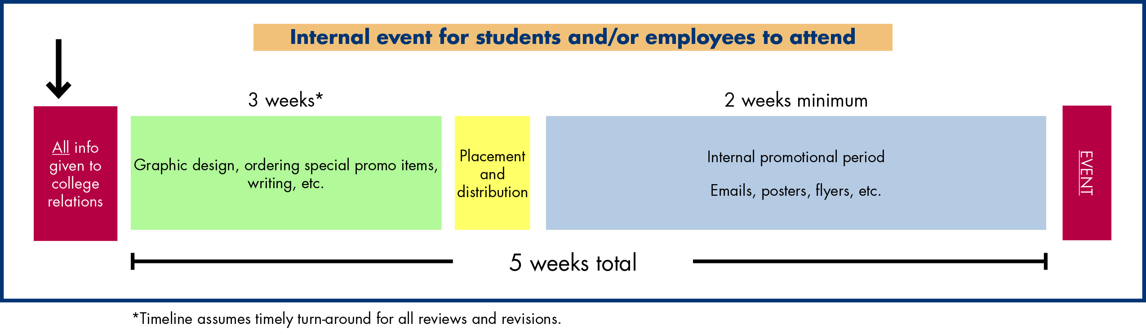
Marketing timelines
Notes:
Nicole

Slide 59
Direct vs. Indirect Tactics
Direct tactics
      Should result in one or more faculty members saying:
        Yes
        No
        I’m interested, tell me more
      You should be able to track, for each direct tactic:
      Faculty who expressed interest (aka “leads”)
      Faculty who adopted
      New students impacted
      Indirect tactics
      “If you build it, they might find it”
      Does not result in you getting a yes, no, or I’m interested from faculty
      Helpful, but should not be your main focus
Notes:
David

Slide 60
Exercise:
Put it all together! Map-out some of your direct tactics and your marketing related to them.
Notes:
David

Slide 61


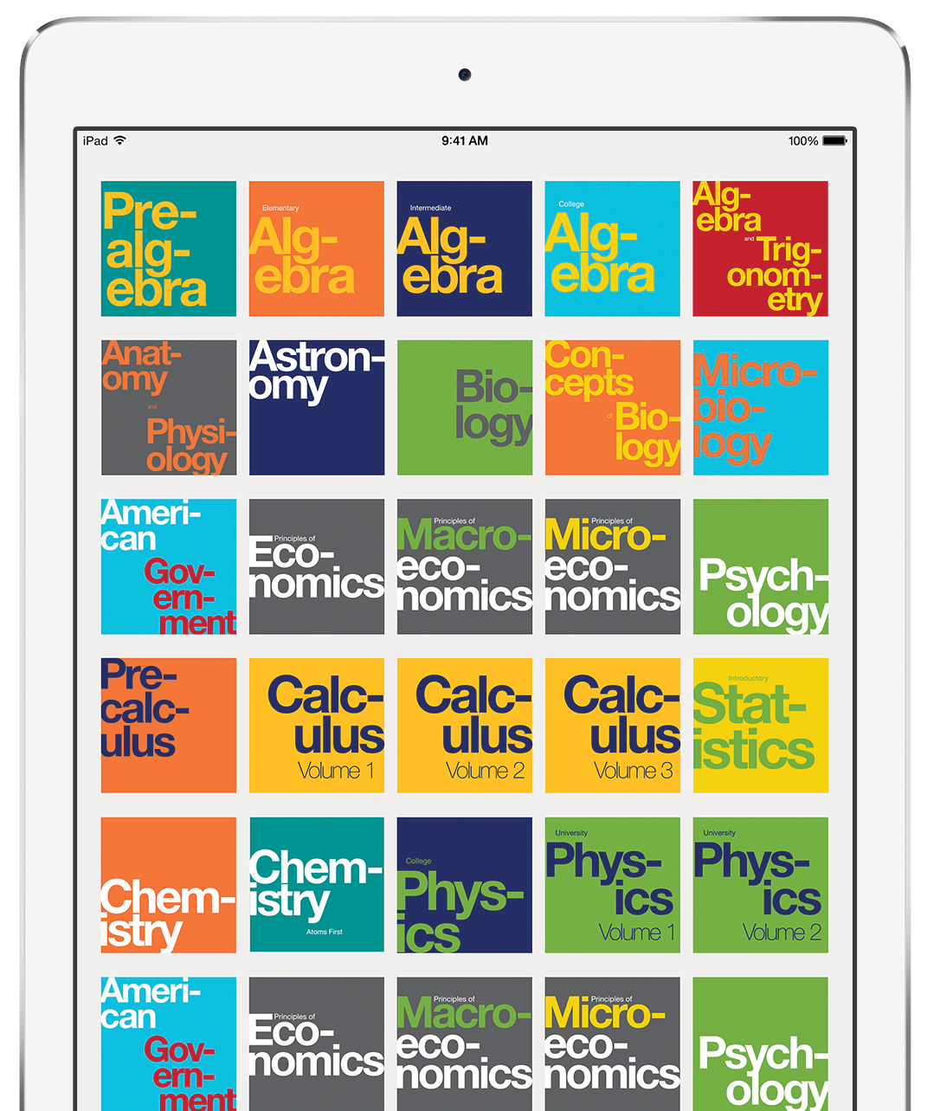
Questions?
nicolef@rice.edu

