Slide 1
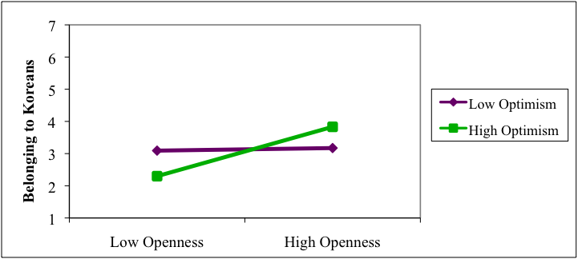
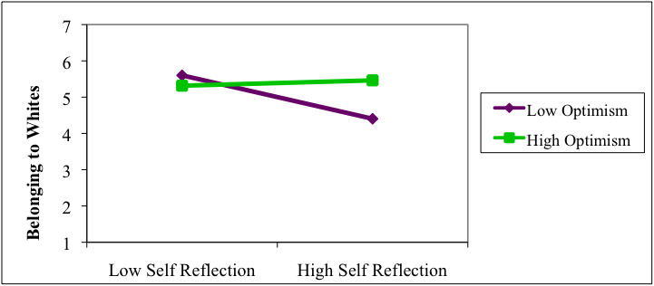

Internal Attributes and Sense of Belonging:
The Moderating Role of Optimism in Korean Transracial Adoptees
Danielle E. Godon & Patricia G. Ramsey
Background
Results
Conclusions
While some transracial adoptees (TRAs) are able to appreciate and value their birth and adoptive sides, others feel like they are perennial outsiders (Ramsey & Mika, 2011) and caught “in-between” both groups (Meier, 1999). To understand why TRAs vary so widely in these perceptions and identifications, this study, which was part of a larger investigation, explored how internal attributes (i.e., personality traits, dispositional optimism, and self-reflection) are related to Korean transracial adoptees’ (KTAs’) sense of belonging in general and specifically to their birth (Korean) and adoptive (White European) referent groups.
Simple correlations
Internal attributes are directly related to general feelings of belonging
They are not directly related to sense of belonging to Korean and White referent groups, suggesting these relationships might be influenced by a more complex interplay of internal attributes. Optimism, in particular, appears to moderate openness and self-reflection to particular groups:
    For more optimistic KTAs, greater openness is associated with a stronger sense of belonging to Koreans
  For less optimistic KTAs, higher self-reflection is related to a lower sense of belonging to Whites
Internal Attributes | Belonging to Koreans | Belonging to Whites | General Belonging
Personality traits
Extraversion | ns | ns | .48***
Agreeableness | ns | ns | .24*
Conscientiousness | ns | ns | ns
Emotional Stability | ns | ns | .32**
Openness | ns | ns | .34***
Optimism | ns | ns | .43***
Self-reflection | ns | -.21* | ns
The majority of internal attributes were linked with a general sense of belonging, but not with belonging to Koreans and Whites specifically (see table).
Research Questions
*p < .05. **p < .01. ***p < .001
How do internal attributes directly relate to belonging?
How do openness and optimism relate to feelings of belonging to Korean and White referent groups?
How do self-reflection and optimism relate to feelings of belonging to Koreans and Whites?
Moderation analyses
Does optimism moderate the relationship between openness and belonging to Koreans?
The overall model was significant, F(3, 106)= 3.284, p = .024. The interaction between openness and optimism accounted for a significant proportion of the variance in belonging to Koreans, adjusted R²= .059, b = .320, SEb = .143, t(109) = 2.24, p = .027. For more optimistic KTAs, higher openness was related to a greater sense of belonging to Koreans. However, there was no relationship between openness and belonging to Koreans for less optimistic KTAs (see figure below).
Implications
Method
This nuanced examination of internal attributes and feelings of belonging may lead to a better understanding of the dynamics of group affiliations and disaffections and tease out potential remedies for KTAs’ feelings of alienation and “in-between-ness”.
Specifically, the buffering role of optimism suggests that adoption practitioners could:
Focus on cognitive restructuring therapies that teach KTAs to challenge maladaptive thoughts by substituting pessimistic cognitions with more optimistic and adaptive ones
Be aware that, for less optimistic KTAs, self-reflection, a major component of many therapies, might be associated with decreased feelings of belonging to the White group
Participants (N = 144)
114 female, 30 male
19 to 57 yrs (M = 31.5, SD = 7.3)
People adopted from Korea by White parent(s) recruited via the Internet
Current residence:
    U.S. (n = 115)
    Europe (n = 19)
    South Korea (n = 7)
    Other/not specified (n = 3)
Materials & Procedure
Participants completed an on-line survey that included:
Ten-Item Personality Inventory (TIPI; Gosling, Rentfro, & Swann, 2003)
Revised Life Orientation Test (dispositional optimism) (LOT-R; Scheier, Carver, & Bridges, 1994)
Modified Four-Factor Self-Consciousness Scale (self-reflection subscale) (Burnkrant & Page, 1984)
Ratings of Sense of Belonging to:
  Koreans
  Whites
  People in general (no explicit referent group)
Does optimism moderate the relationship between self-reflection and belonging to Whites?
The overall model was significant, F(3, 107)= 4.821, p = .003. The interaction between openness and optimism accounted for a significant proportion of the variance in belonging to Whites, adjusted R² =.094, b = .573, SEb = .242, t(110) = 2.37, p = .020. For highly optimistic KTAs, there was no relationship between self-reflection and belonging to Whites. However, for less optimistic participants, greater self-reflection was related to a lower sense of belonging to Whites (see figure below).
References
Baron, R. M., & Kenny, D. A. (1986). The moderator-mediator variable distinction in social psychological research: Conceptual, strategic, and statistical considerations. Journal of Personality and Social Psychology, 51, 1173–1182.
Burnkrant, R. E., & Page, T. J. (1984). A modification of the Fenigstein, Scheier, and Buss self-consciousness scales. Journal of Personality Assessment, 48(6), 629-637. doi:10.1207/s15327752jpa4806_10
Gosling, S. D., Rentfrow, P. J., & Swann, W. B., Jr. (2003). A very brief measure of the big-five personality domains. Journal of Research in Personality, 37(6), 504-528. doi:10.1016/S0092-6566(03)00046-1
Meier, D. I. (1999). Cultural identity and place in adult Korean-American intercountry adoptees. Adoption Quarterly, 3(1), 15-48. doi:10.1300/J145v03n01_03
Ramsey, P.G., & Mika, K. (2011). Identity of transracial adoptees: Outsiders looking in? Anales de Psocologia, 27(2), 611-624.
Scheier, M. F., Carver, C. S., & Bridges, M. W. (1994). Distinguishing optimism from neuroticism (and trait anxiety, self-mastery, and self-esteem): A reevaluation of the life orientation test. Journal of Personality and Social Psychology, 67(6), 1063-1078. doi:10.1037/0022-3514.67.6.1063
Analysis
A preliminary simple correlation analysis explored the direct relationships between internal attributes and belonging.
We then computed moderation analyses using Barron & Kenny’s (1986) approach to capture the complex interactions between multiple internal attributes and belonging to Whites and Koreans. Specifically, we focused on optimism as a potential moderator. Simple slopes analysis was used to aid interpretation of significant findings.
Optimism did not moderate the relationship between openness and belonging to Whites; nor did it moderate the relationship between self-reflection and belonging to Koreans.

