Slide 1

Chemigation
John Mason, Slocum-Gibbs Cranberry Co.

Slide 2
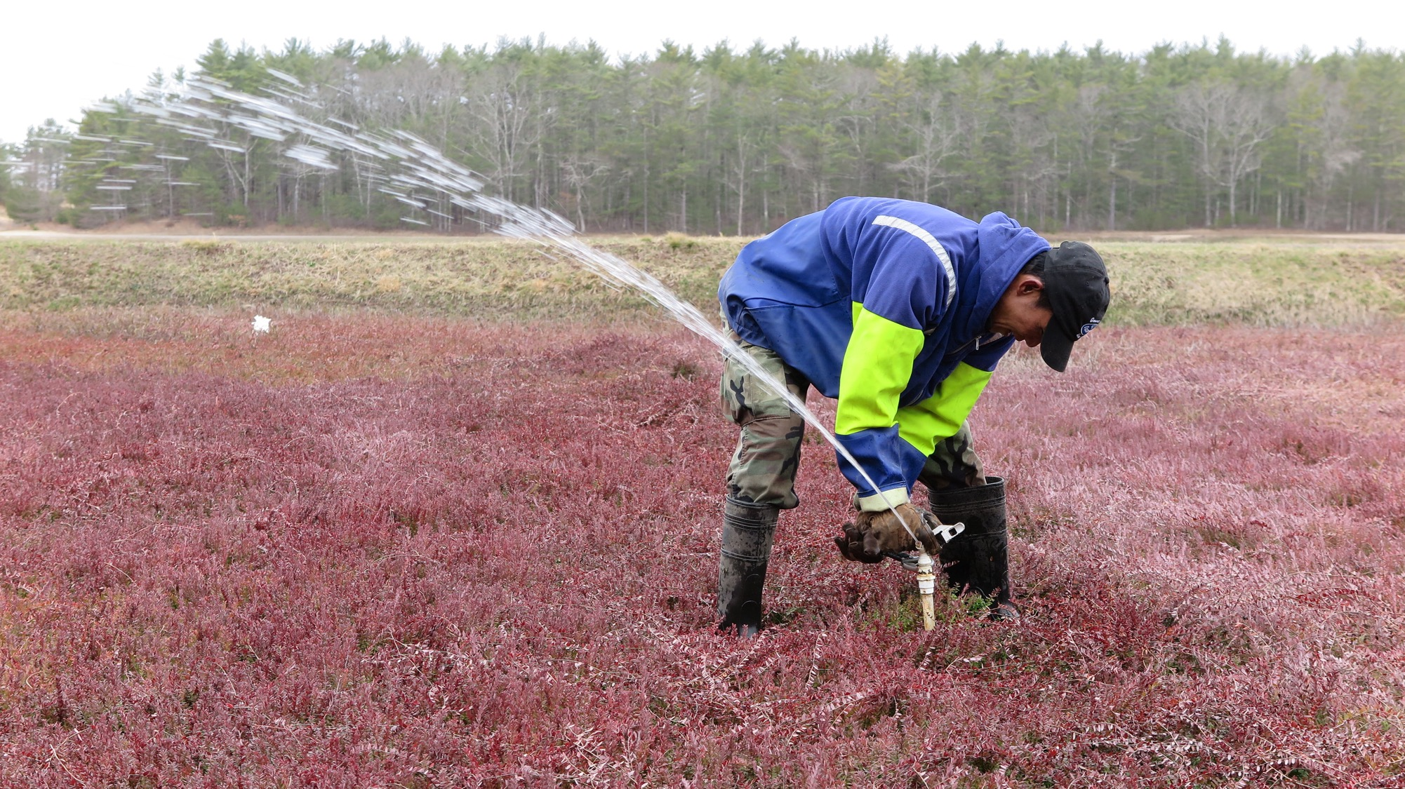

Slide 3
Prepare Irrigation System to Maximize Uniformity:
Prepare Sprinklers:
Prior to install:
-Size nozzles for wear, replace as necessary.
-Inspect and address worn riser bottoms to minimize leakage.
-Clean out filters (if used).
Post Install: Work the kinks out by:
-Check for leaky seals.
-Check for abnormal impact speed. (hitting too rapidly, too slowly)
-Check for abnormal spray pattern.
-Stake heads to keep straight, reduce wobble and wear.
-Dye test systems every few years and after any modifications.
Pop Ups: Walk the lines!!

Slide 4
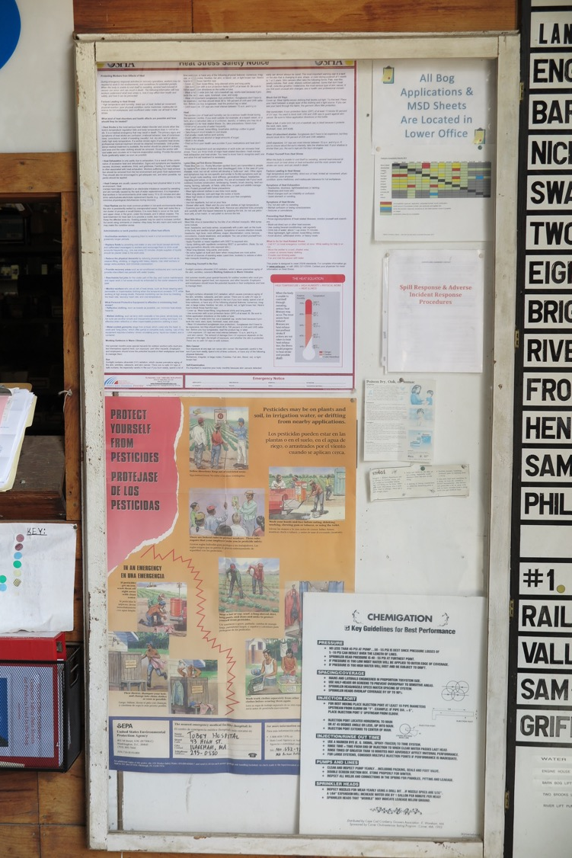
Heat Stress Safety Notice
Worker Protection

Slide 5
Spill Response Procedure

Slide 6
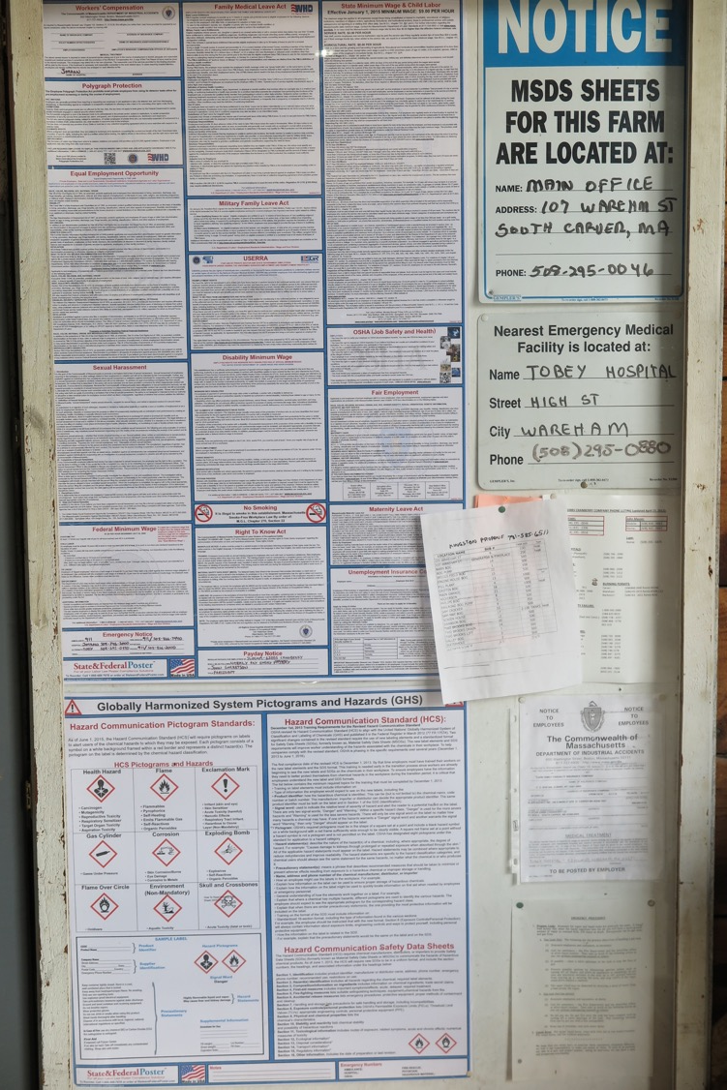
GHS Chart

Slide 7
SDS Location

Slide 8
Nearest Hospital

Slide 9
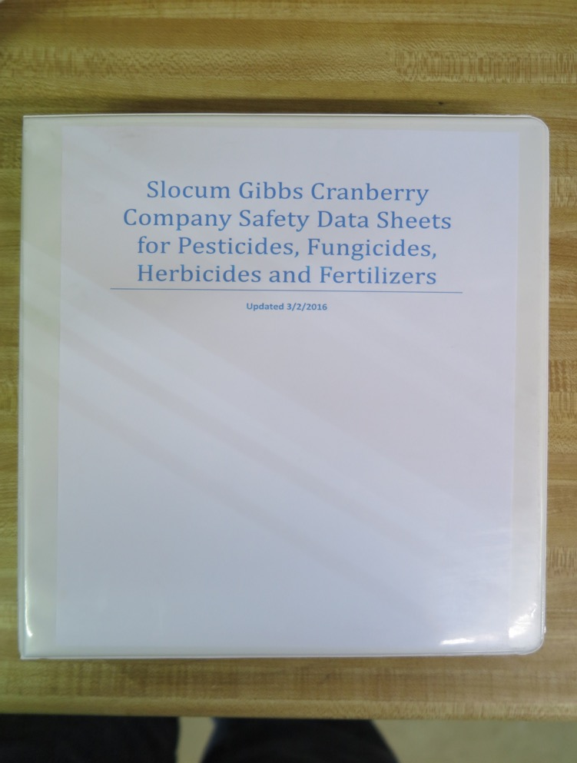
Keep SDS in all Trucks Applying/Transporting Products

Slide 10
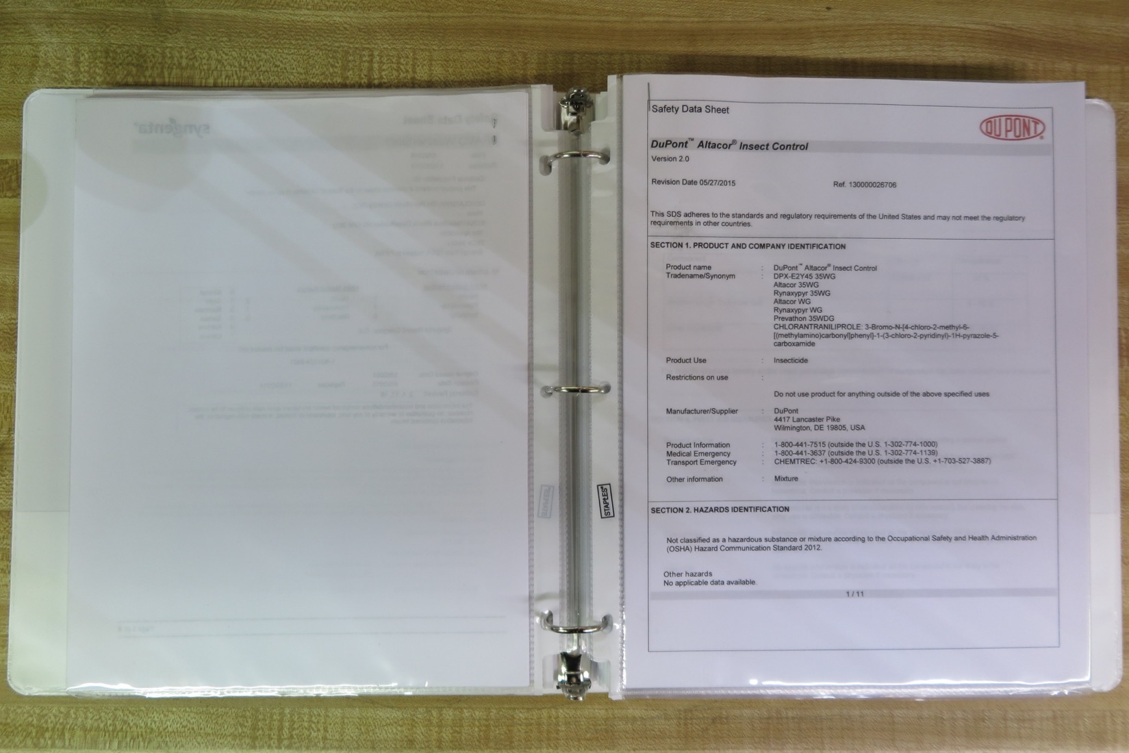

Slide 11
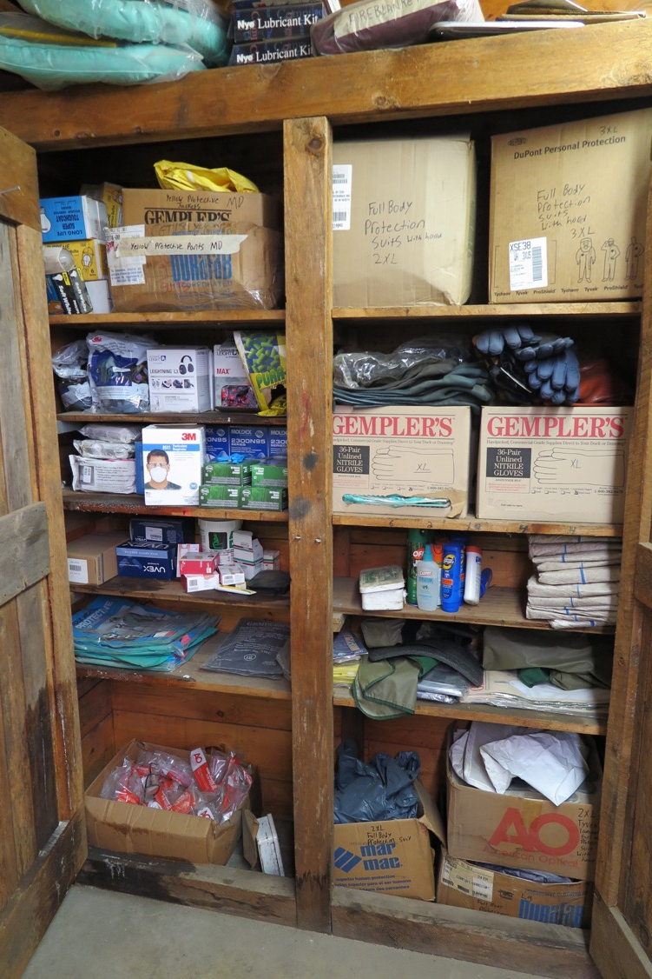
PPE Closet

Slide 12
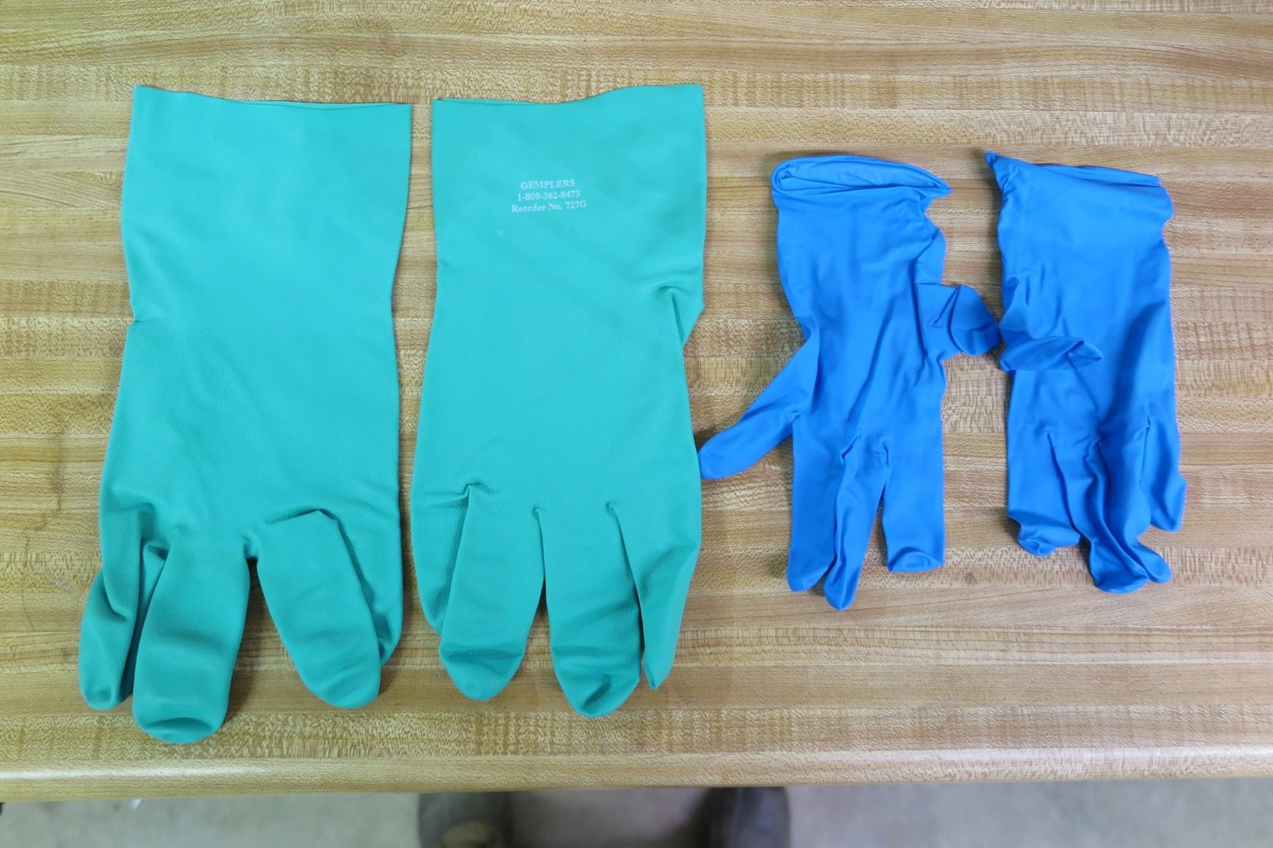
Nitrile Gloves
(15mil) (8mil)

Slide 13
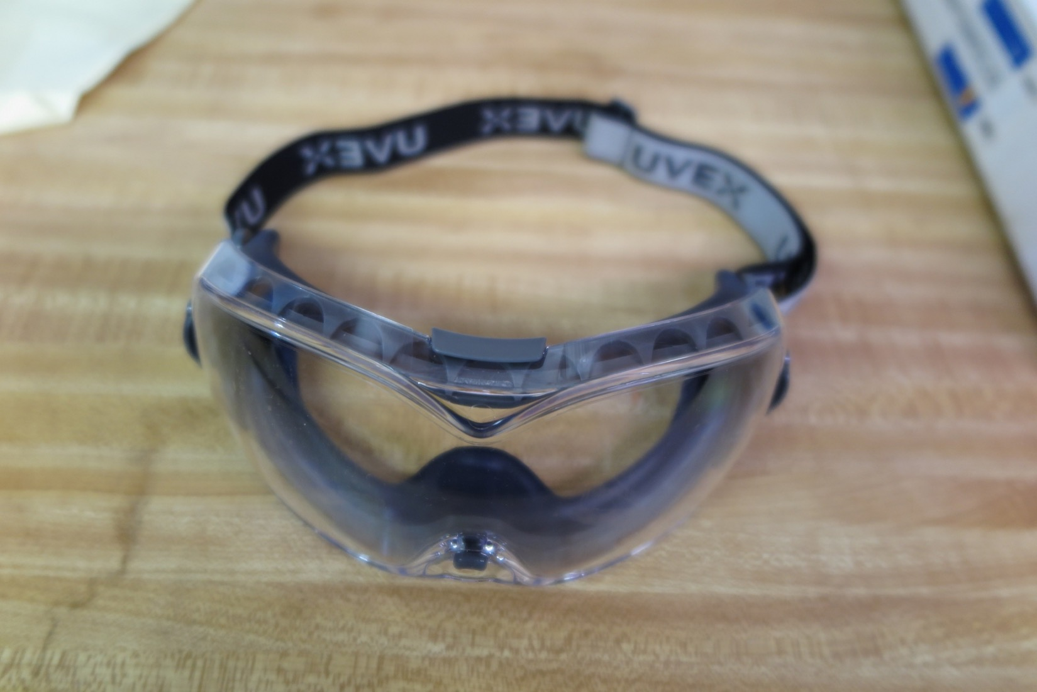
Eye Glasses

Slide 14
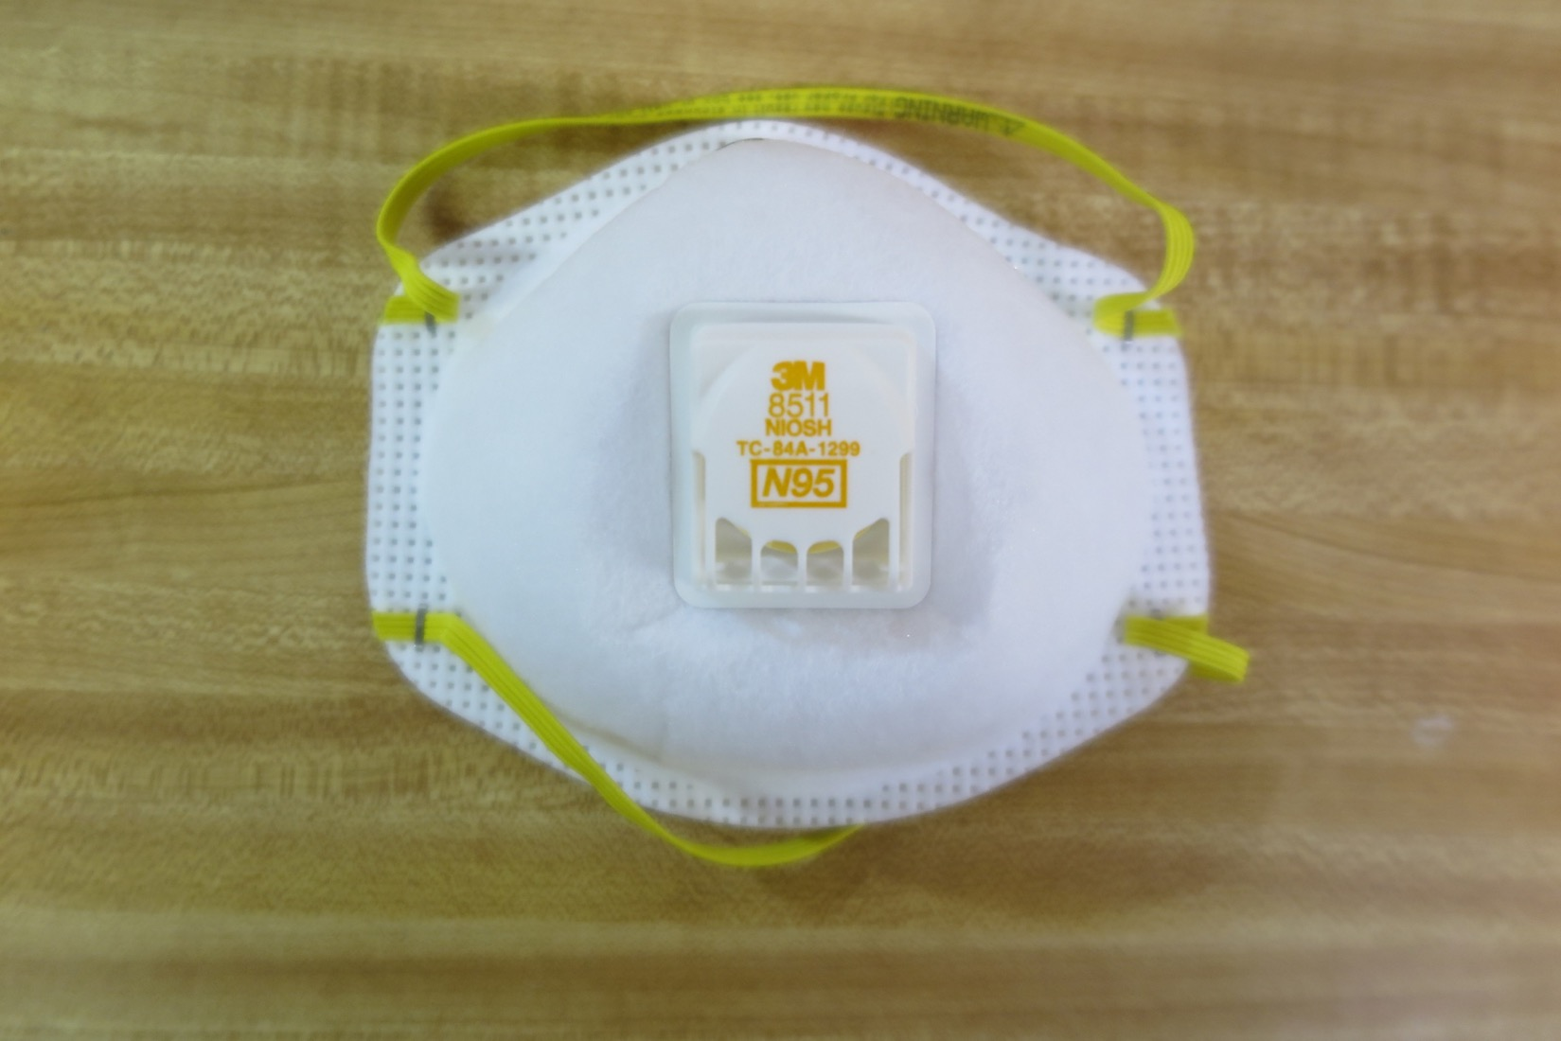
N95

Slide 15
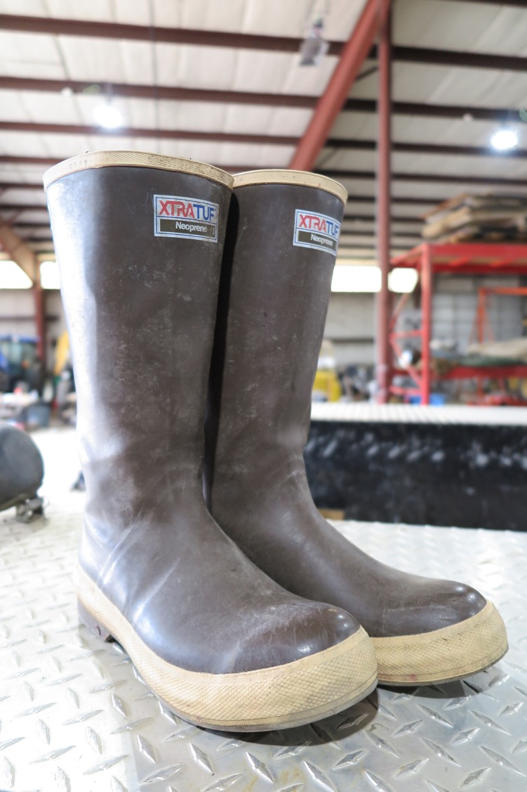
Rubber Boots
(Chemical Resistant)

Slide 16

Protective Coveralls

Slide 17
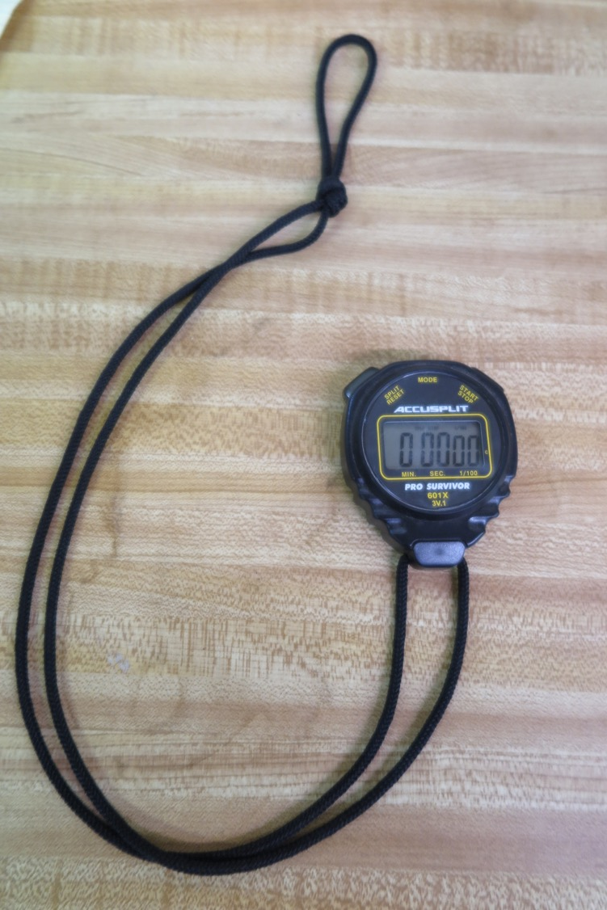
Stop Watch

Slide 18
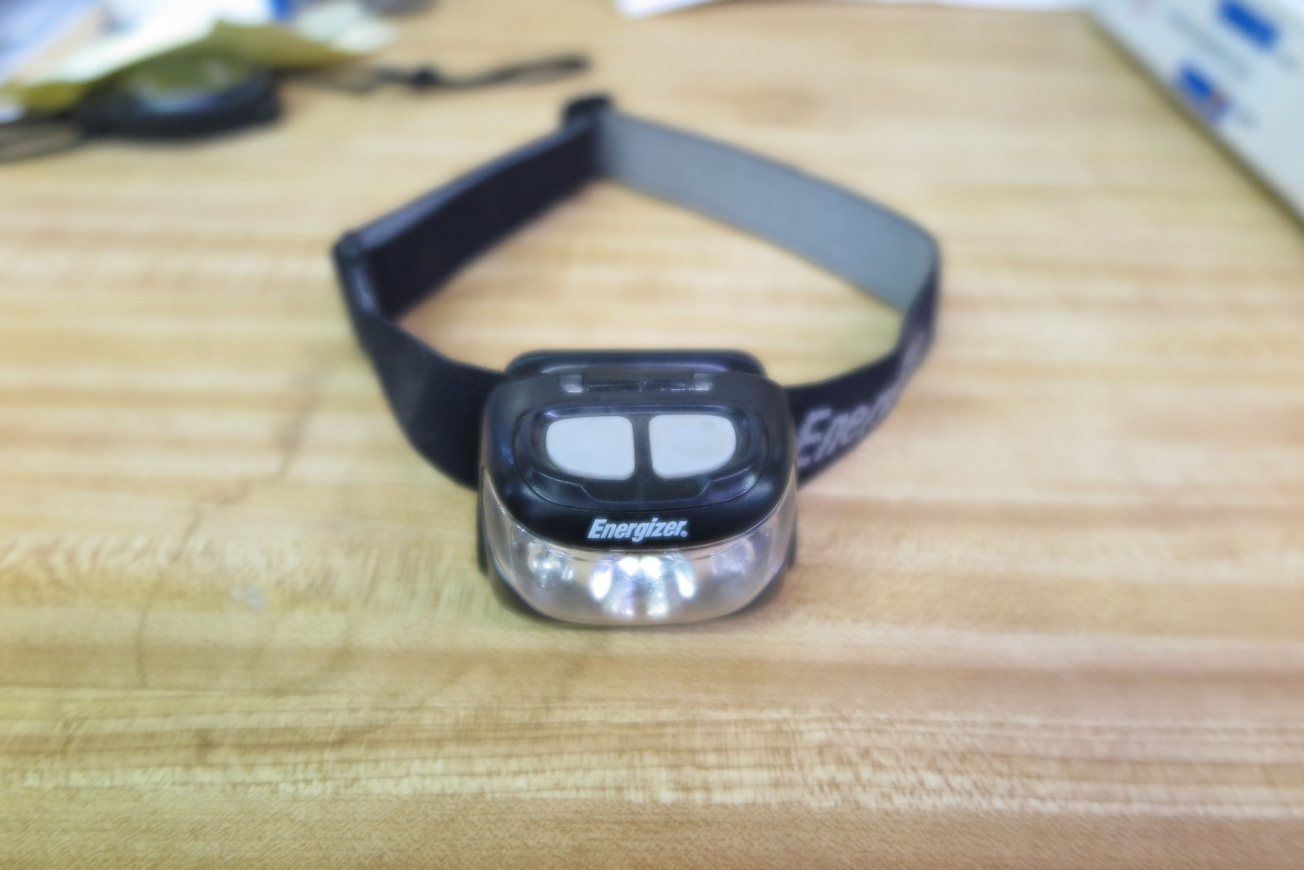
Head Lamp

Slide 19
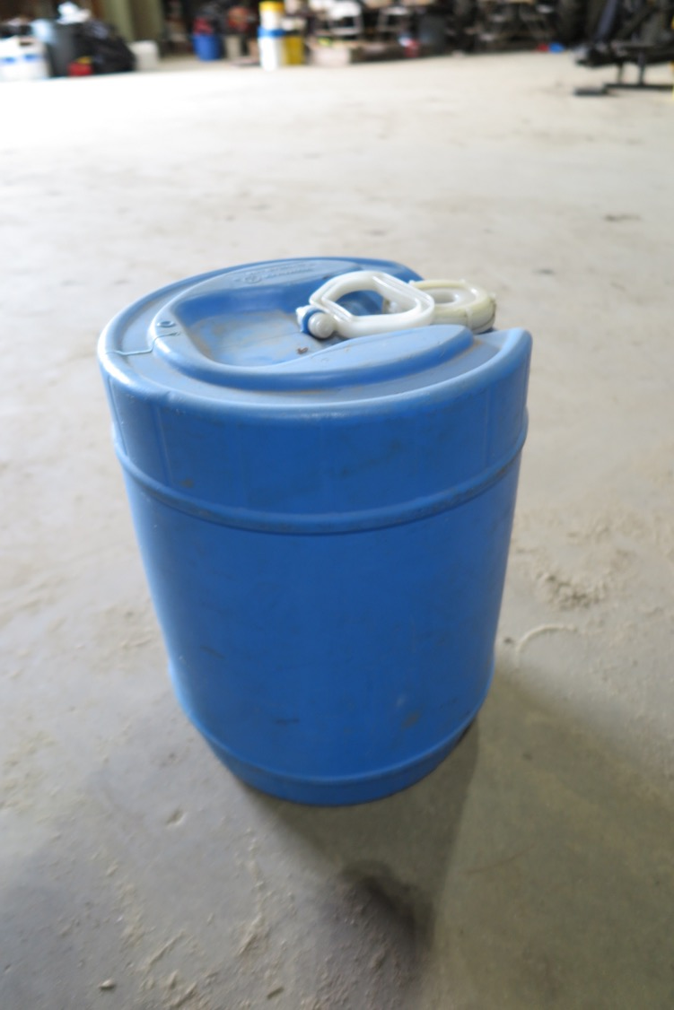
6 Gal Clean Wash Water

Slide 20
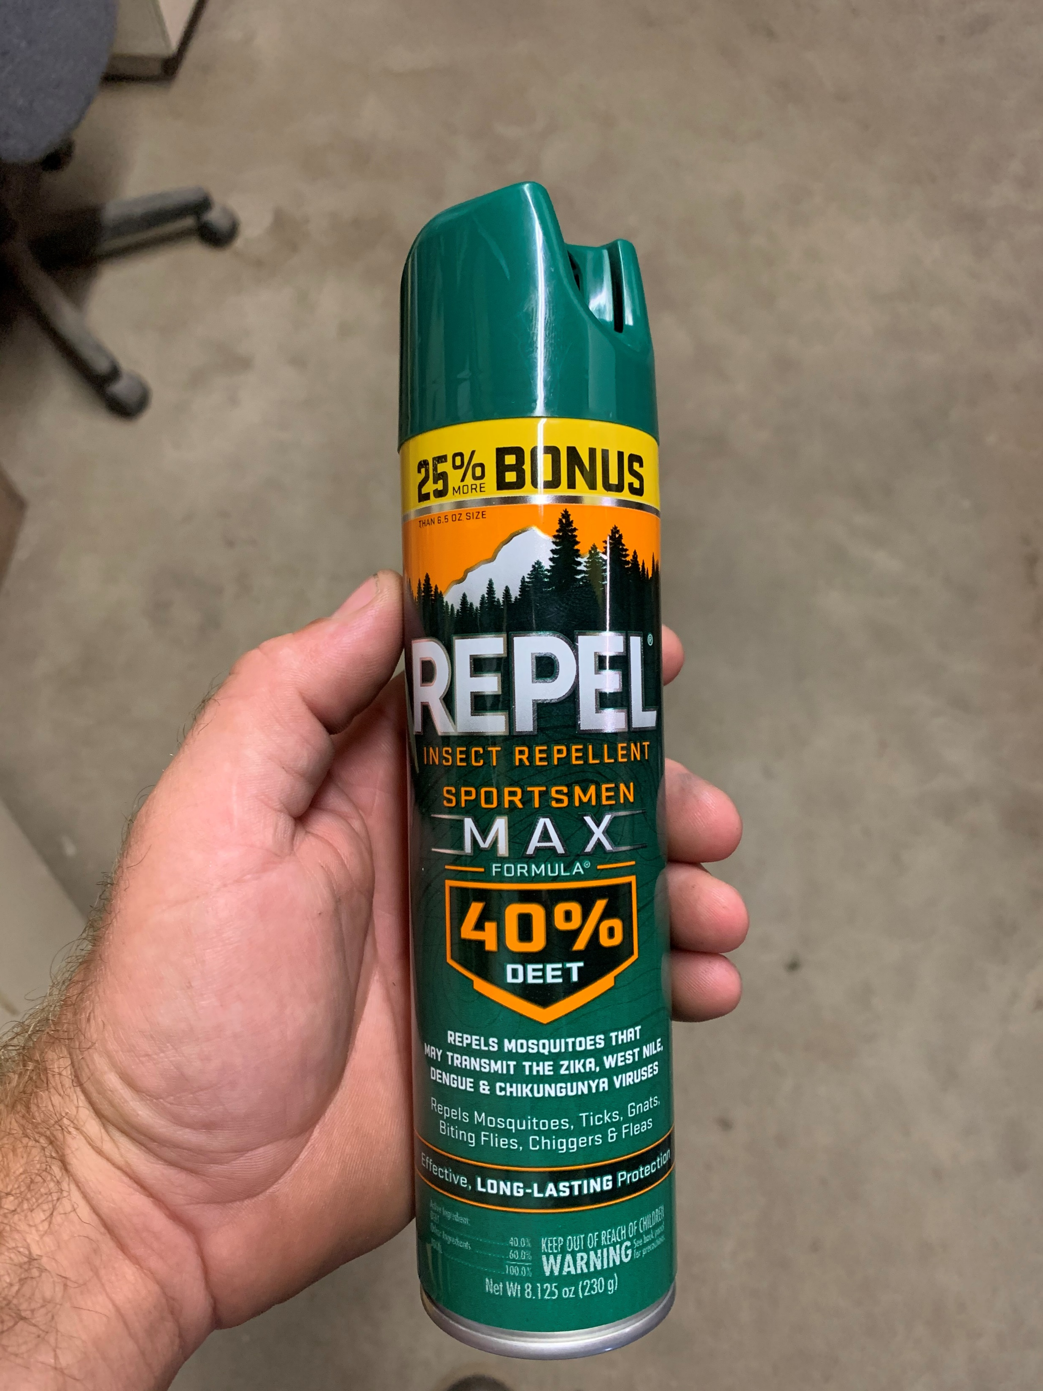
Bug Spray

Slide 21
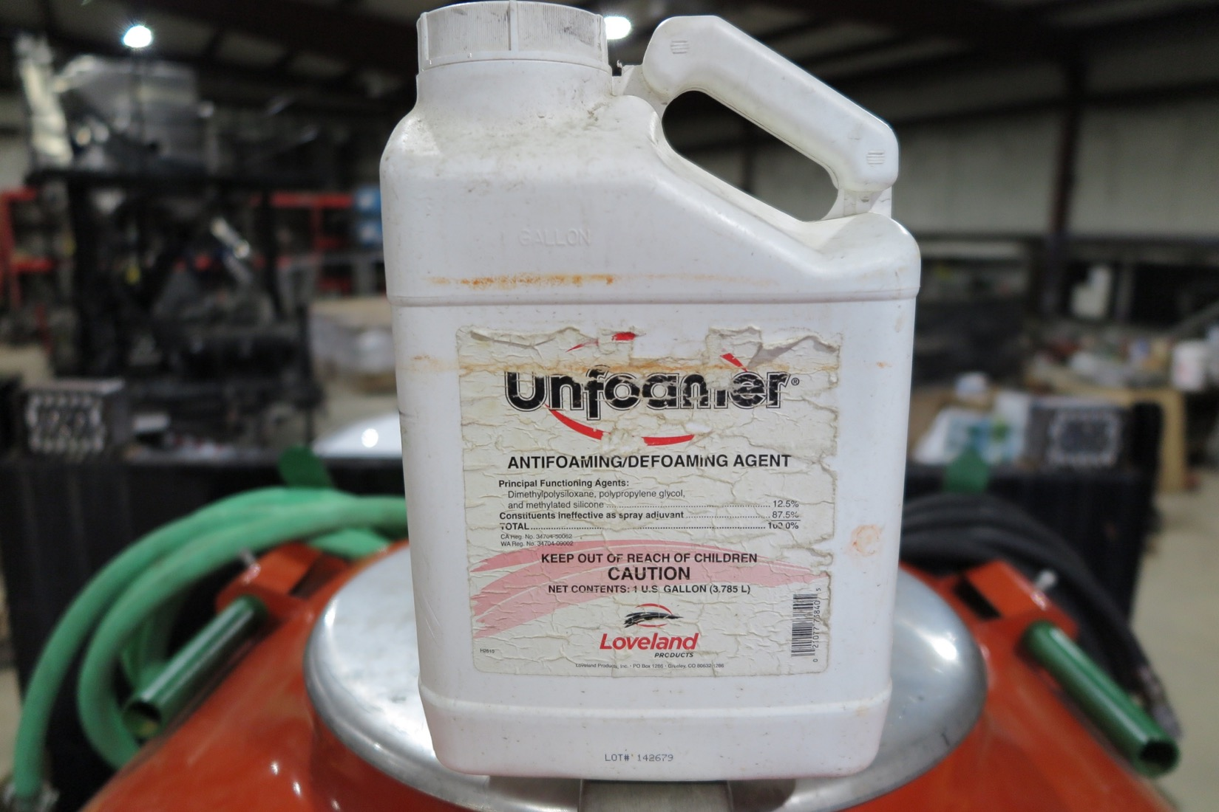

Slide 22
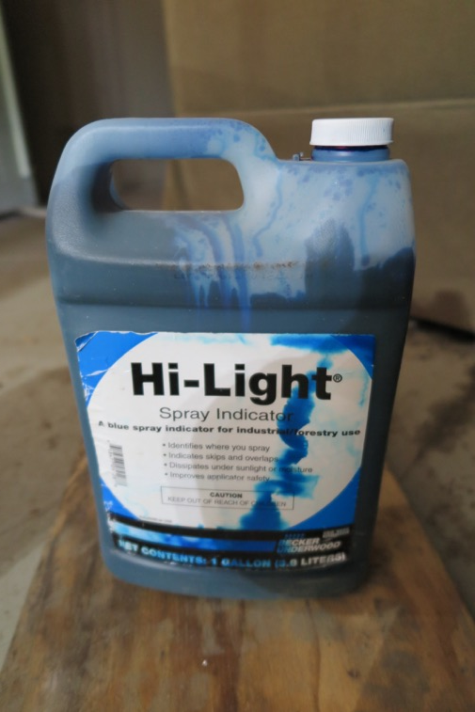
Injection Time: Rinse Time:
1-5 AC 6 Min (Determined by conducting a dye test)
5-10 AC 7 Min
10-15 AC 8 Min
15 AC+ 9 Min+
*Adjust for rinse sensitive materials
*Beaton model

Slide 23
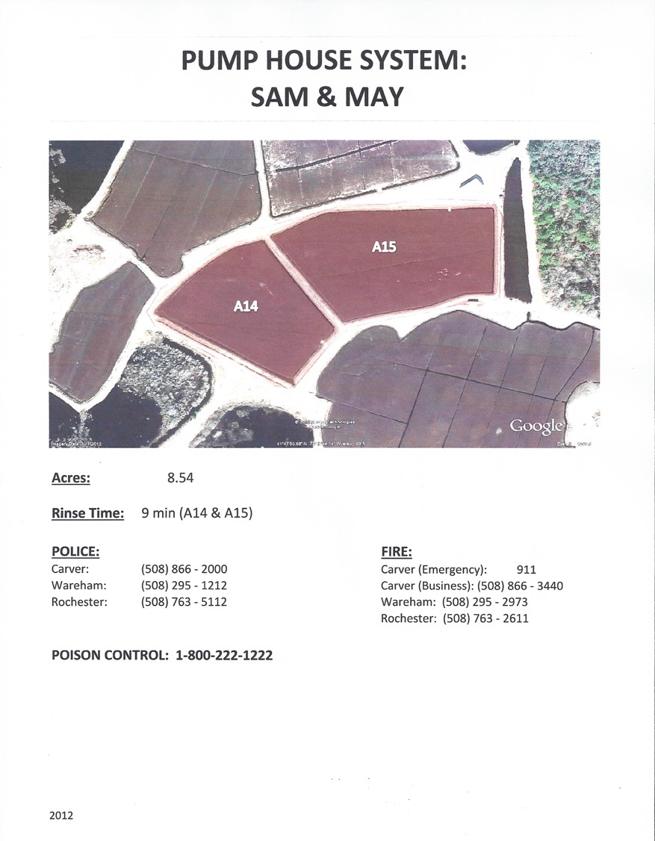

Slide 24
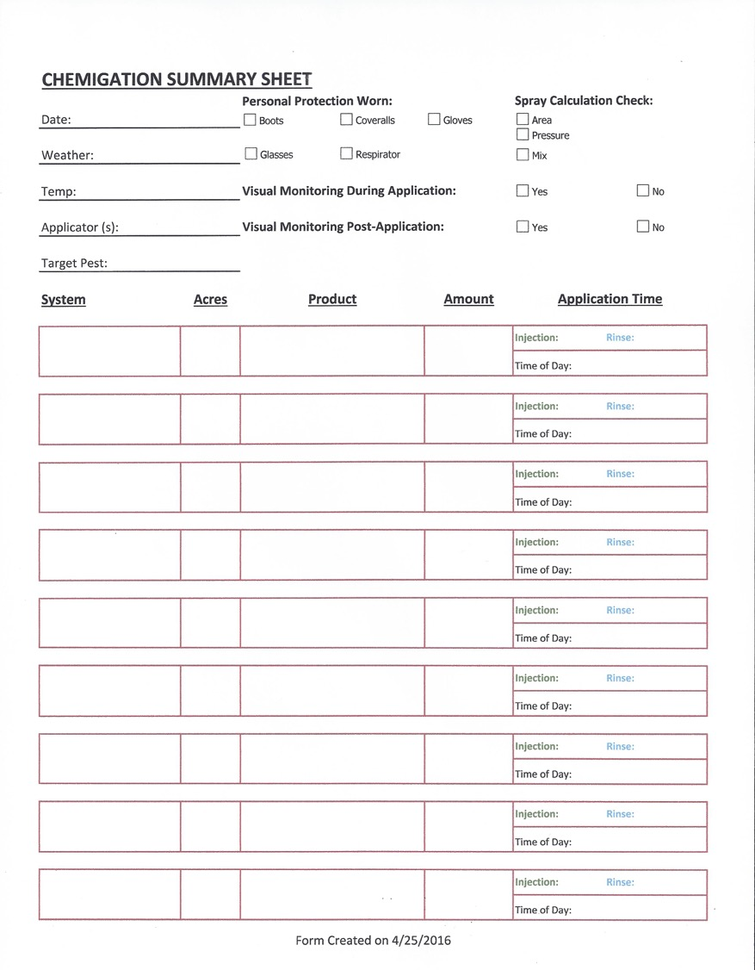
Phillips 10.68
Delegate @6oz 64.08oz
LI700 @4oz 42.72oz
Barn Bog 17.81
Actara @4oz 71.24oz
LI700 @4oz 71.24oz

Slide 25
Shawn 6/2
Phillips: Delegate: 2 Full + 12oz
LI700: 43oz
Barn Bog: Actara: 2 Full + 10oz
LI700: 70oz
Totals: Delegate: 3 Full
Actara: 3 Full
LI700: 1 Gal

Slide 26
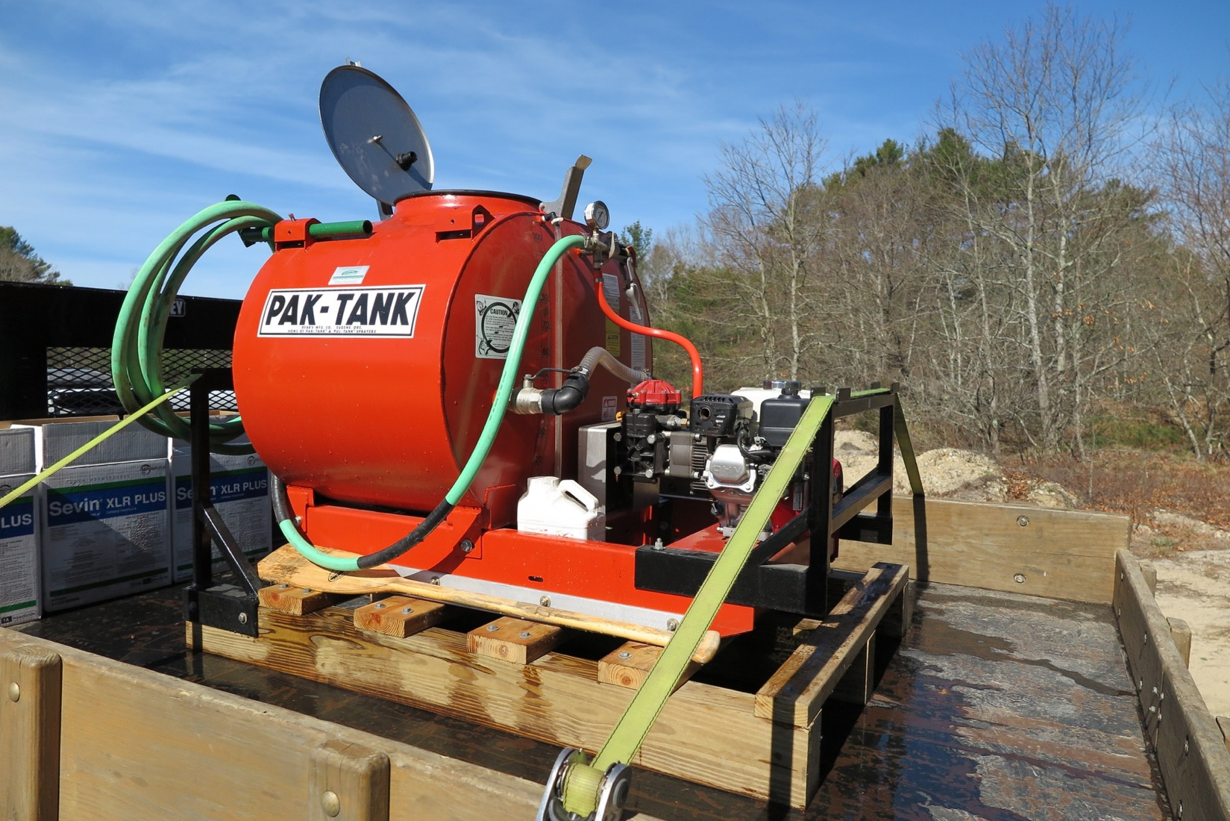

Slide 27
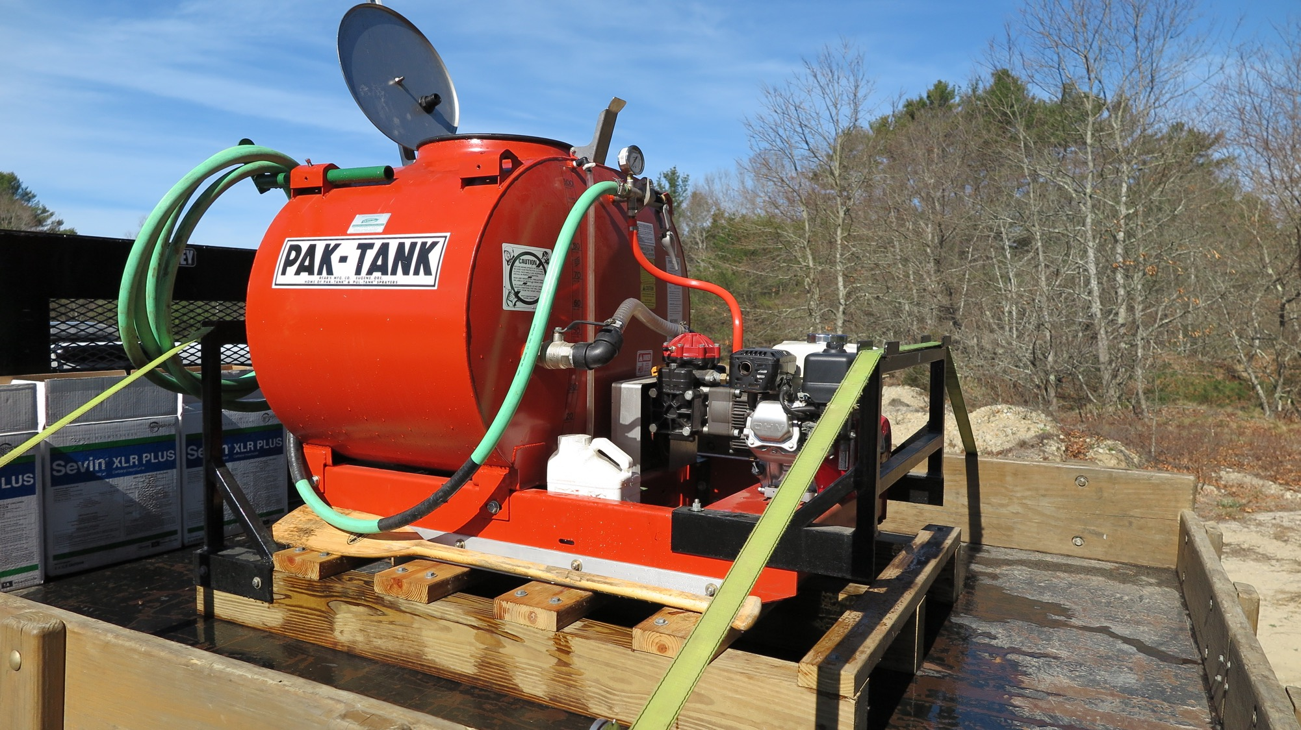
Chemigation Abilities:
-Inject at variable speeds.
-Adjust relief valve
-Adjust engine RPM
-Both recirculates and agitates while running.
-Adjust amount of water.
-Mix/inject just about any product.

Slide 28
100GAL Stainless Tank

Slide 29
HyPro
Pump

Slide 30
6.5HP Honda

Slide 31
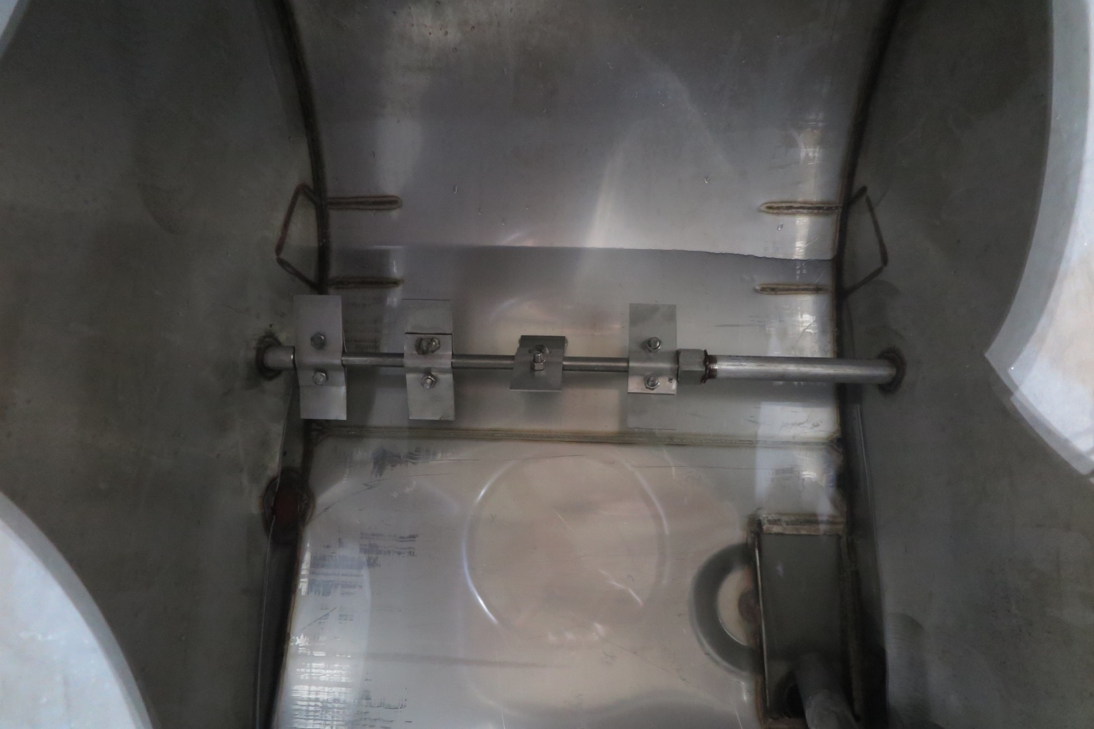

Slide 32
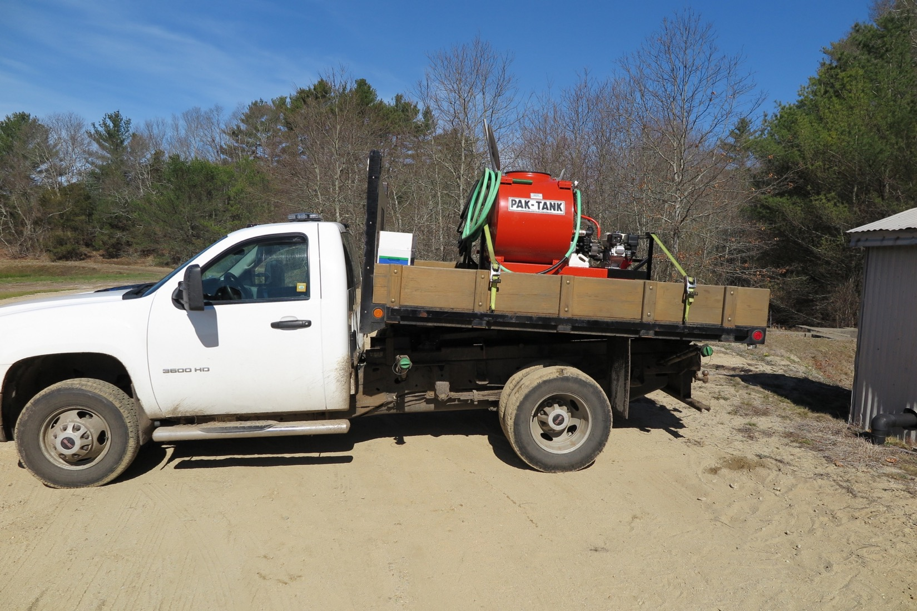

Slide 33
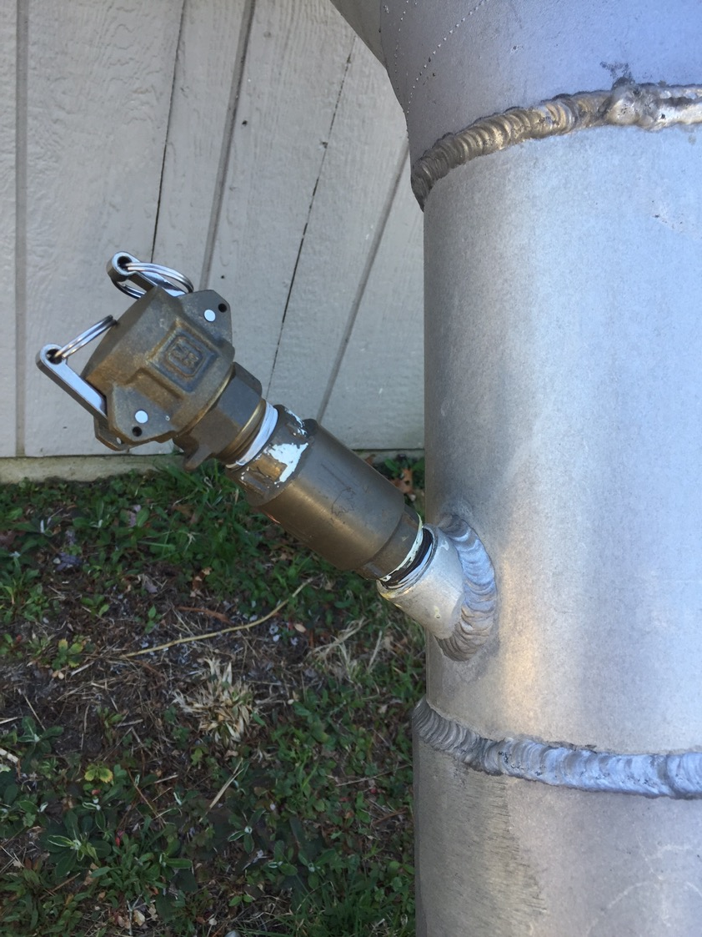
Injection Port: ¾” Check Valve

Slide 34
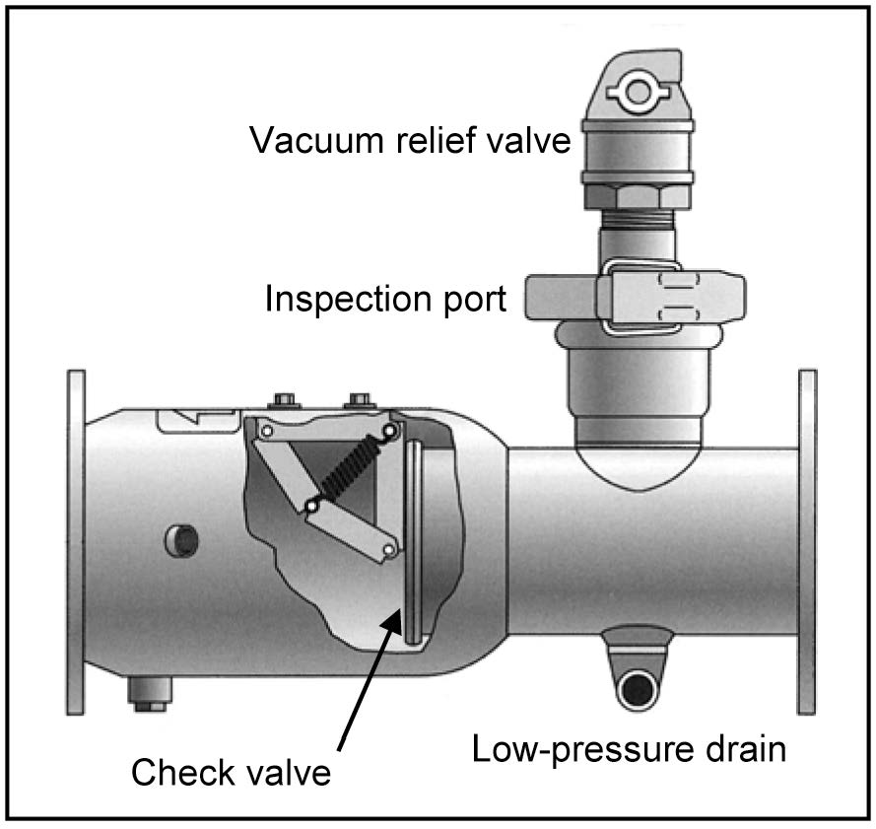

Slide 35
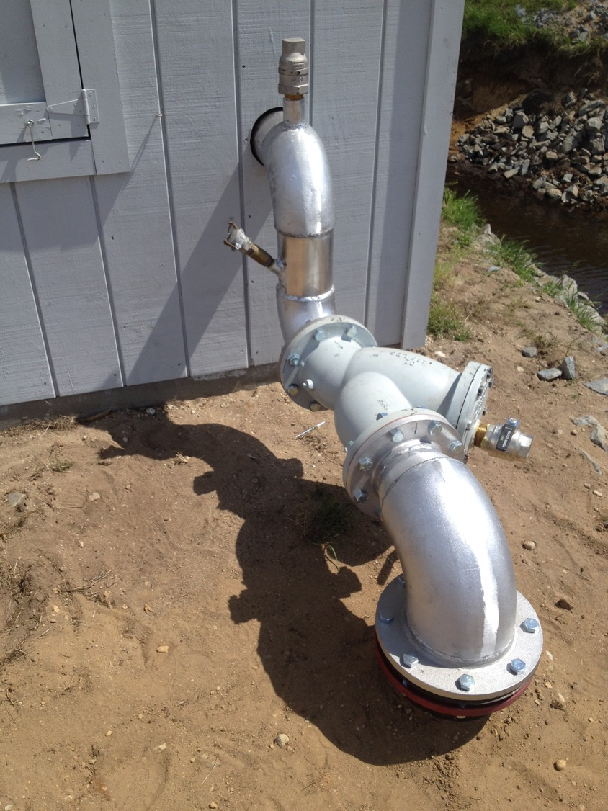

Slide 36
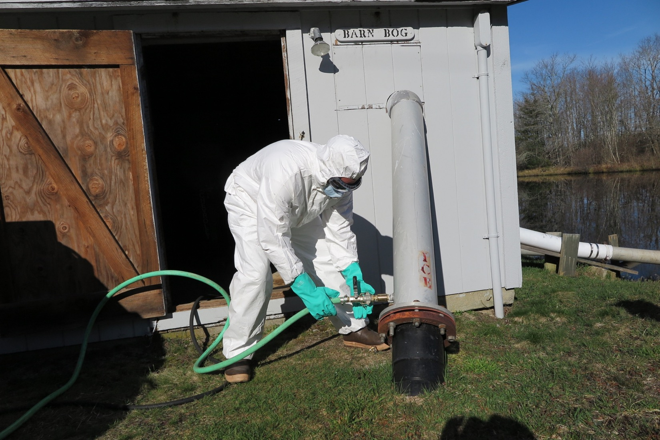

Slide 37
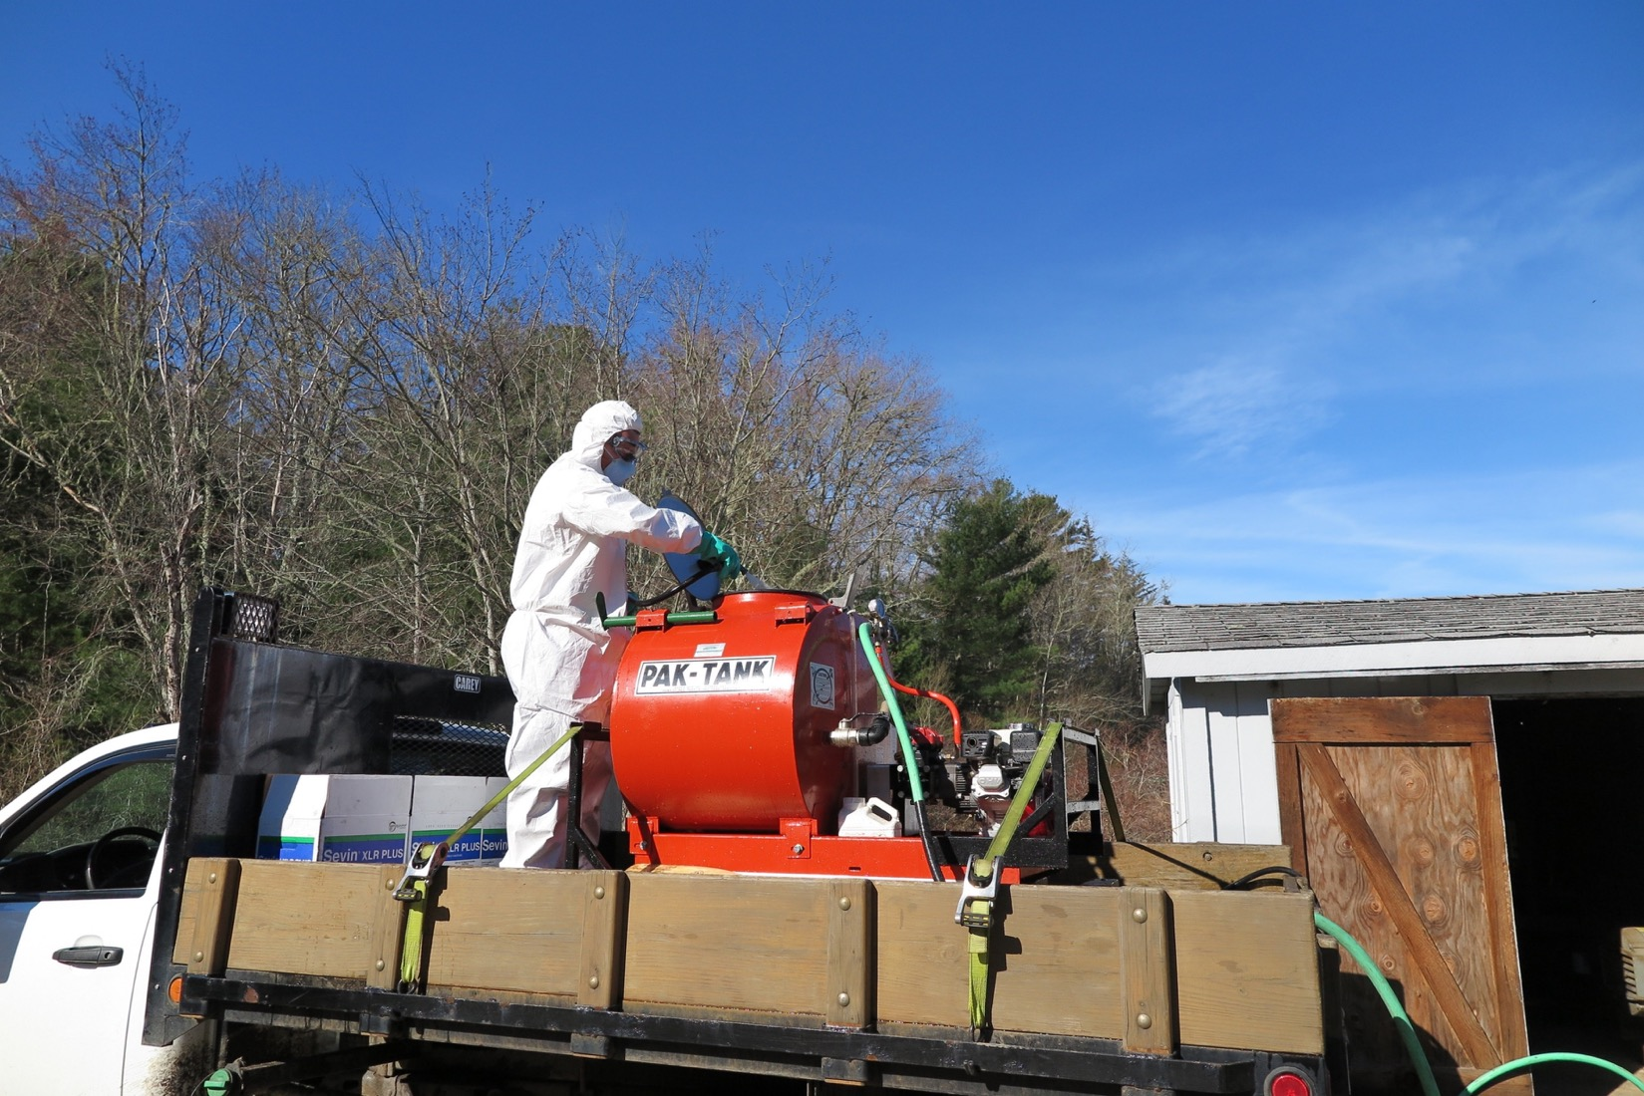

Slide 38
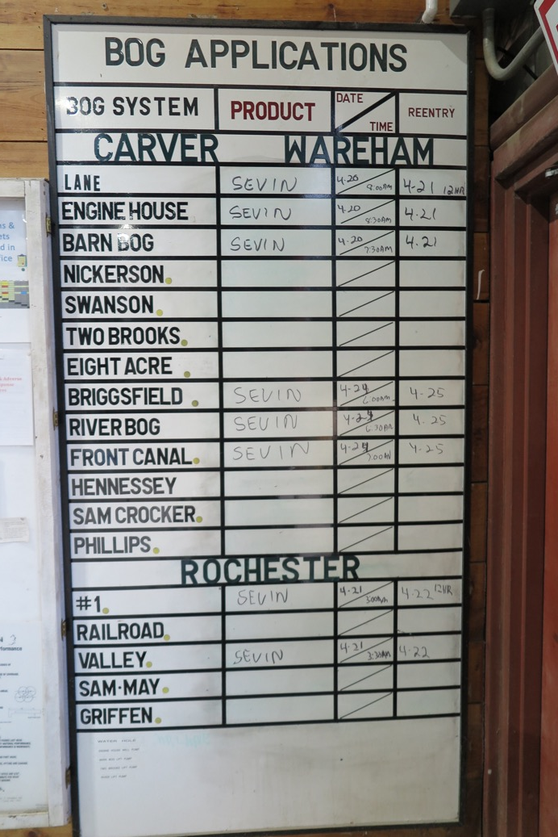
Post applications in a central location!
-Bog System
-Product Applied
-Date/Time of Application
-Date/Time of Reentry

Slide 39
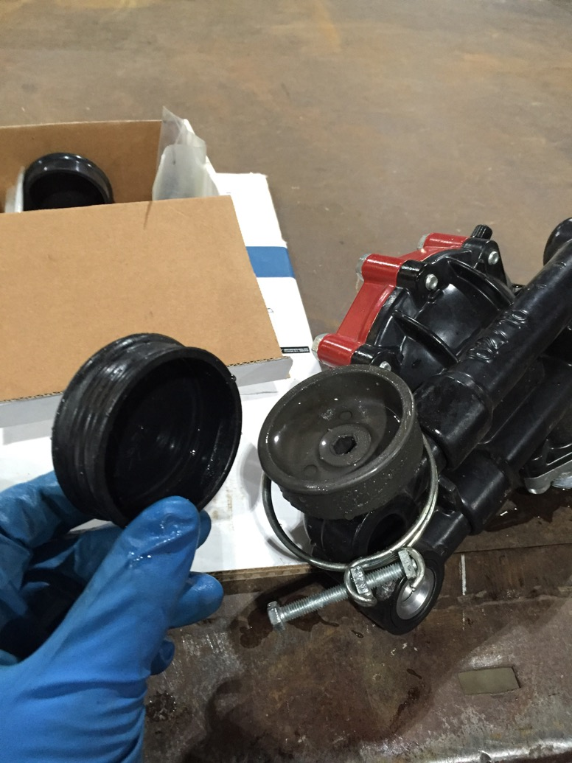
Maintain Equipment to Reduce Failures

Slide 40
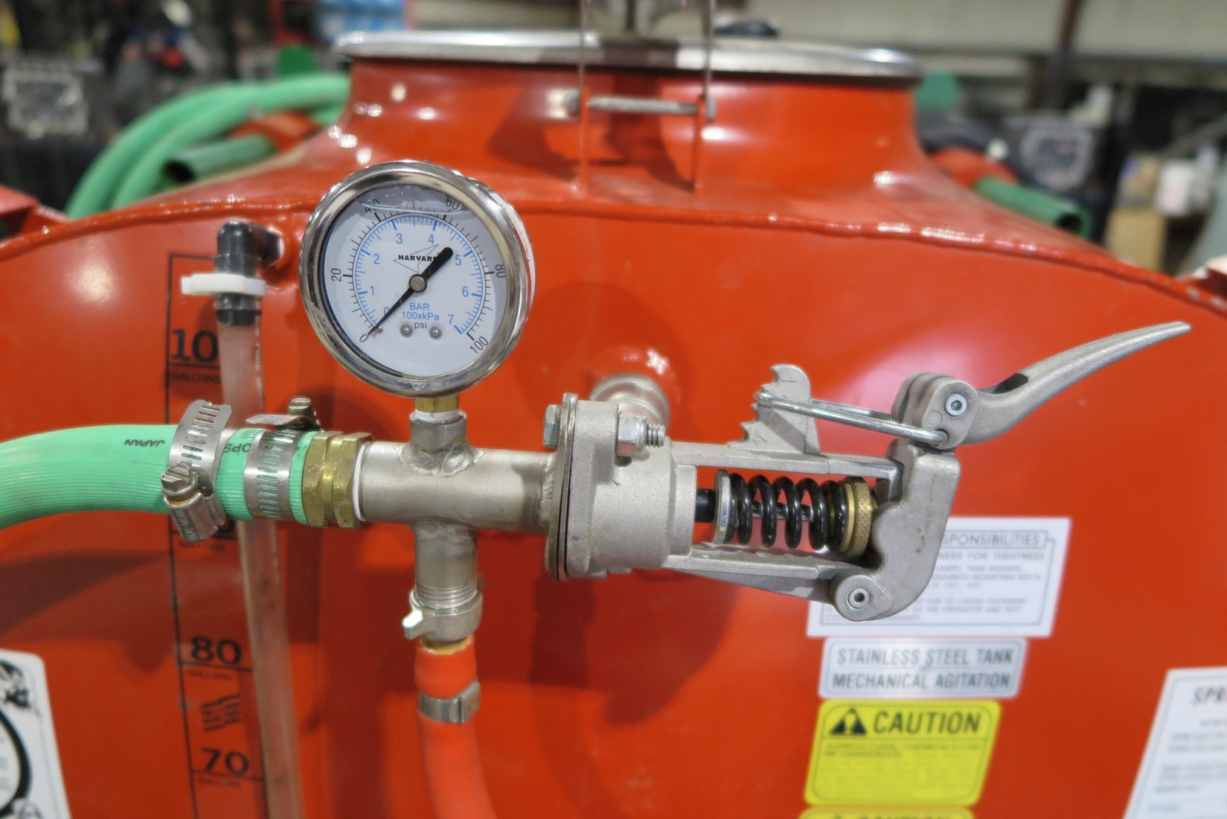

Slide 41
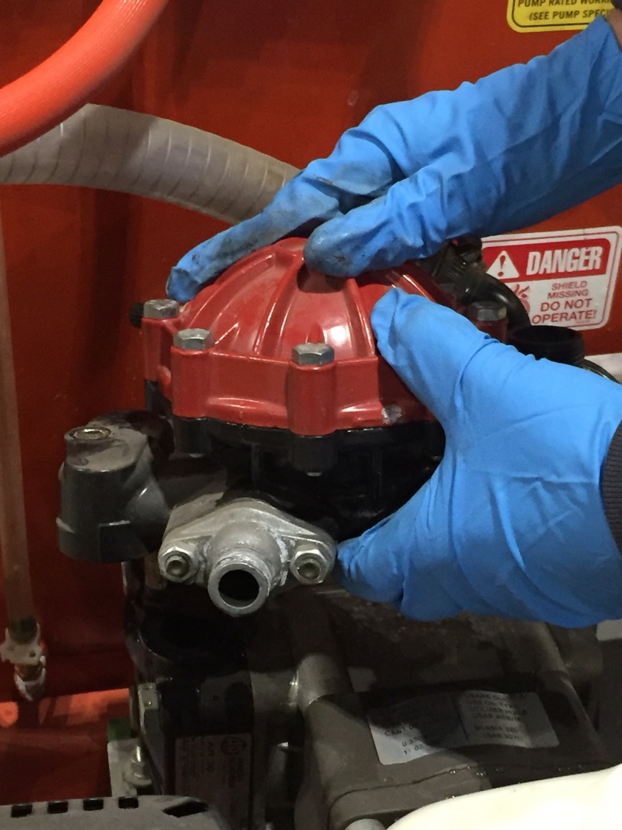

Slide 42
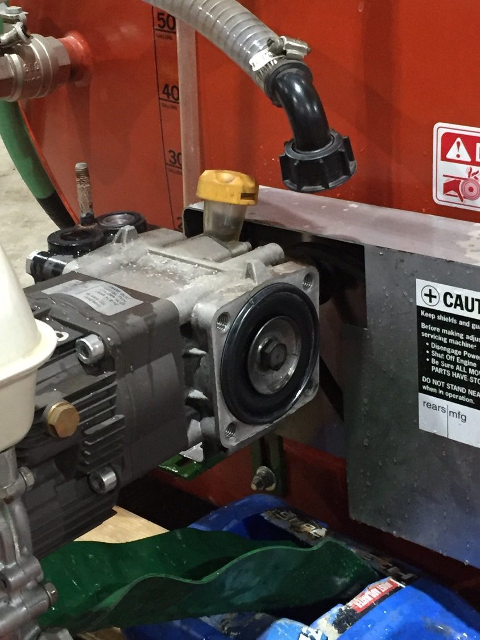

Slide 43
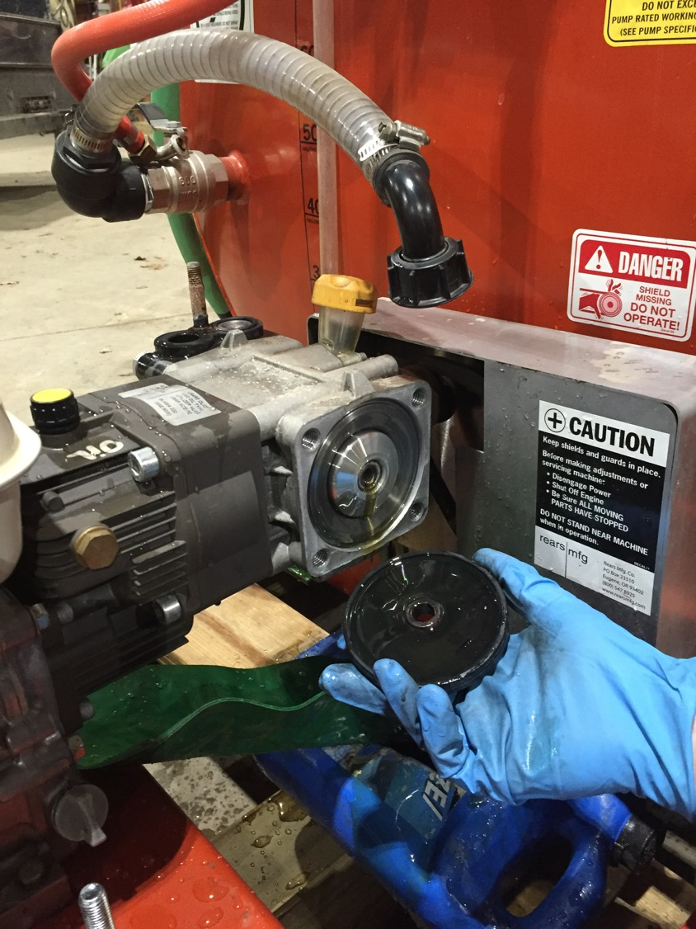

Slide 44
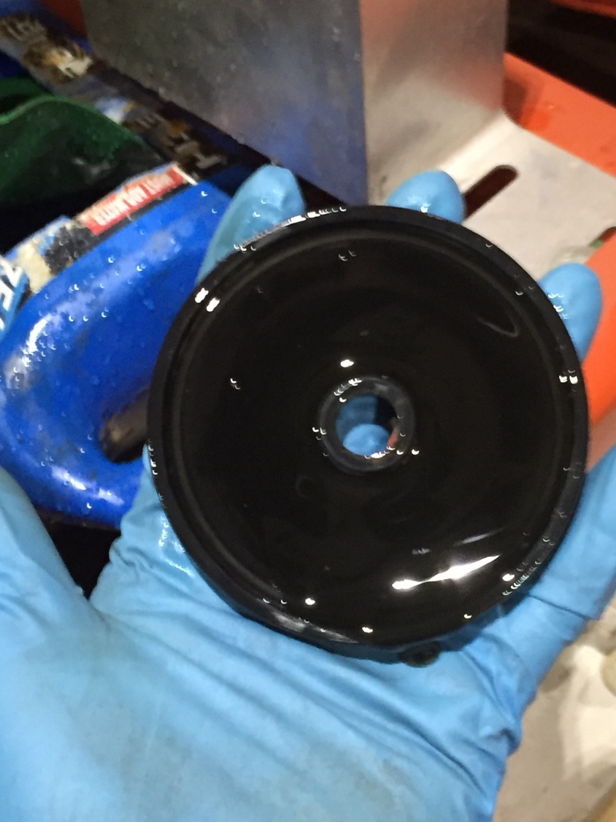

Slide 45
Fertigation
Higher Coefficient of Uniformity Important
Newly Installed Systems:
-90% Coefficient of Uniformity
-40’x50’ Spacing
-Hunter I-20-12”
-#3.5 Nozzle (3.03gpm)
Injection Time?

Slide 46
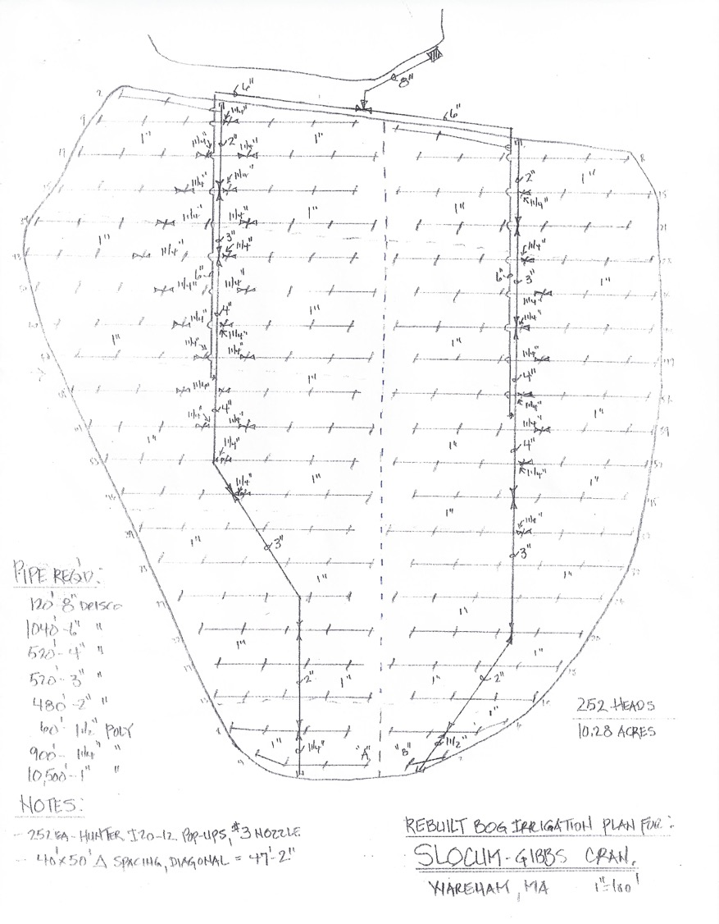
Acres: 10.7
Wash off time: 3 Min 40 Sec
(1st Head to Last Head)

Slide 47
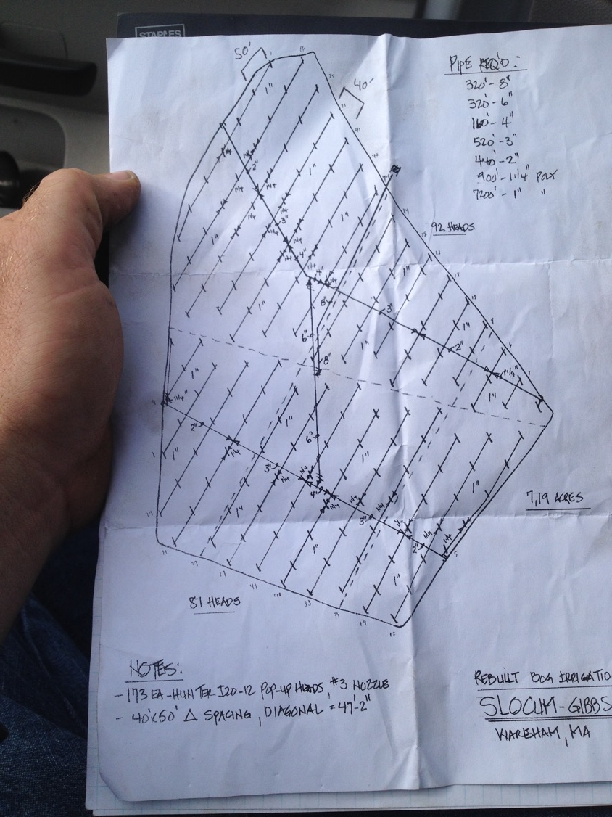
Acres: 7
Wash Off Time: 2 min 50 sec

Slide 48
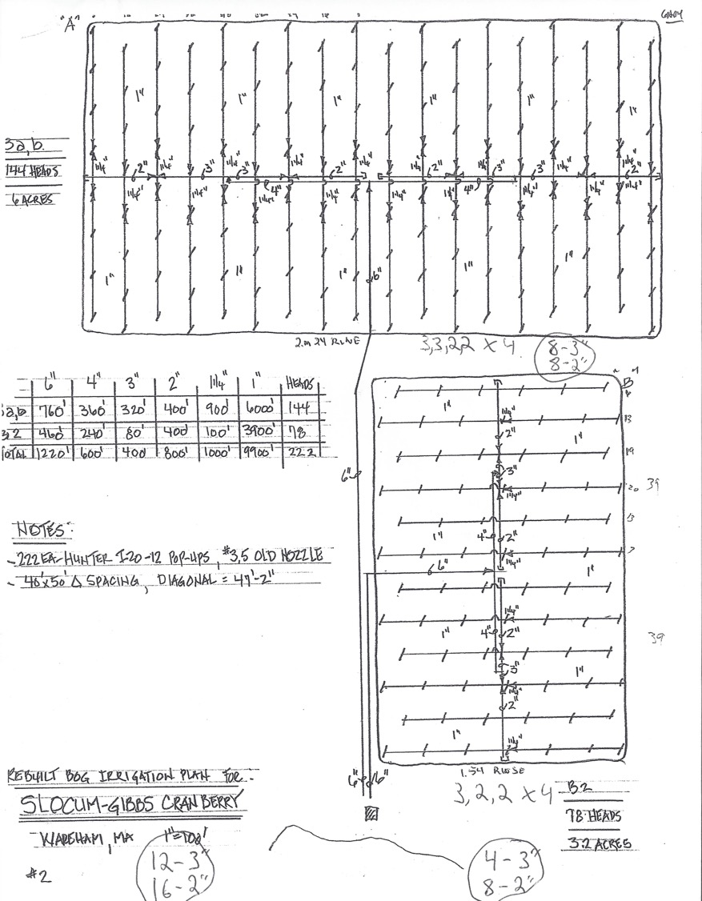
Acres: 6.0
Wash off Time: 2 min 30 sec
Acres: 3.25
Wash Off Time: 2 min

Slide 49
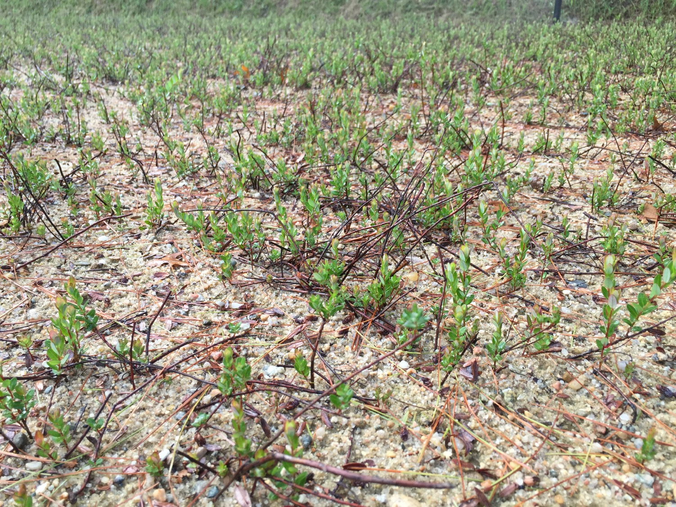
Phillips
Mid July
2015

Slide 50
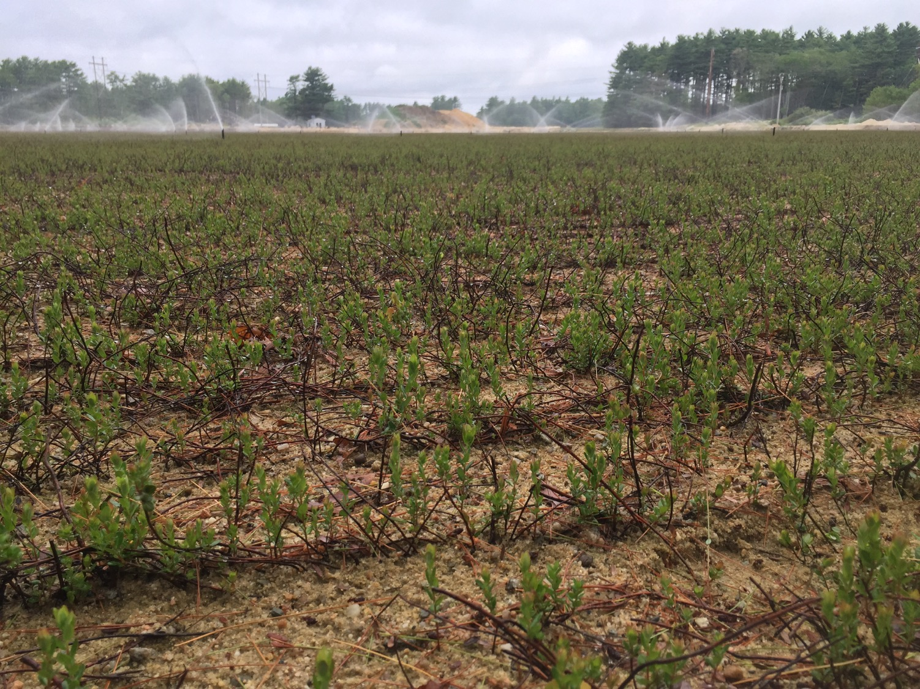
Phillips
End July
2015

Slide 51
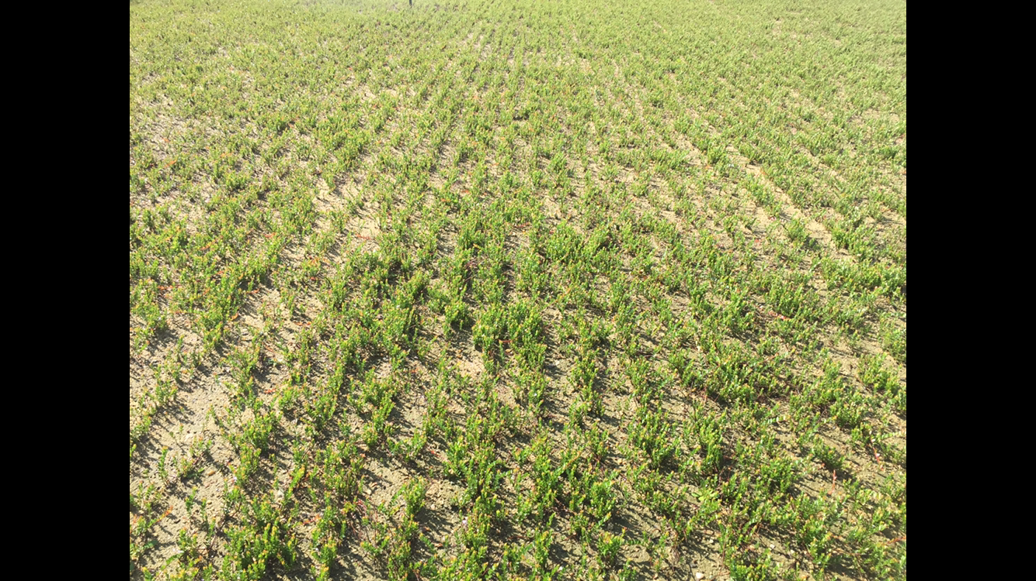
Phillips
Mid Aug
2015

Slide 52
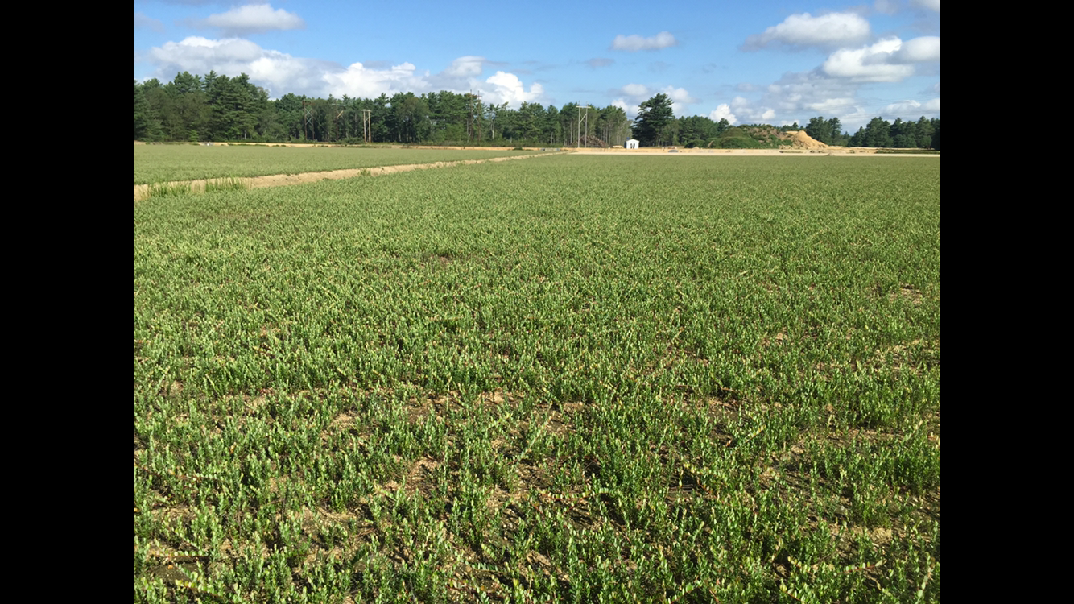
Phillips
End Aug
2015

Slide 53
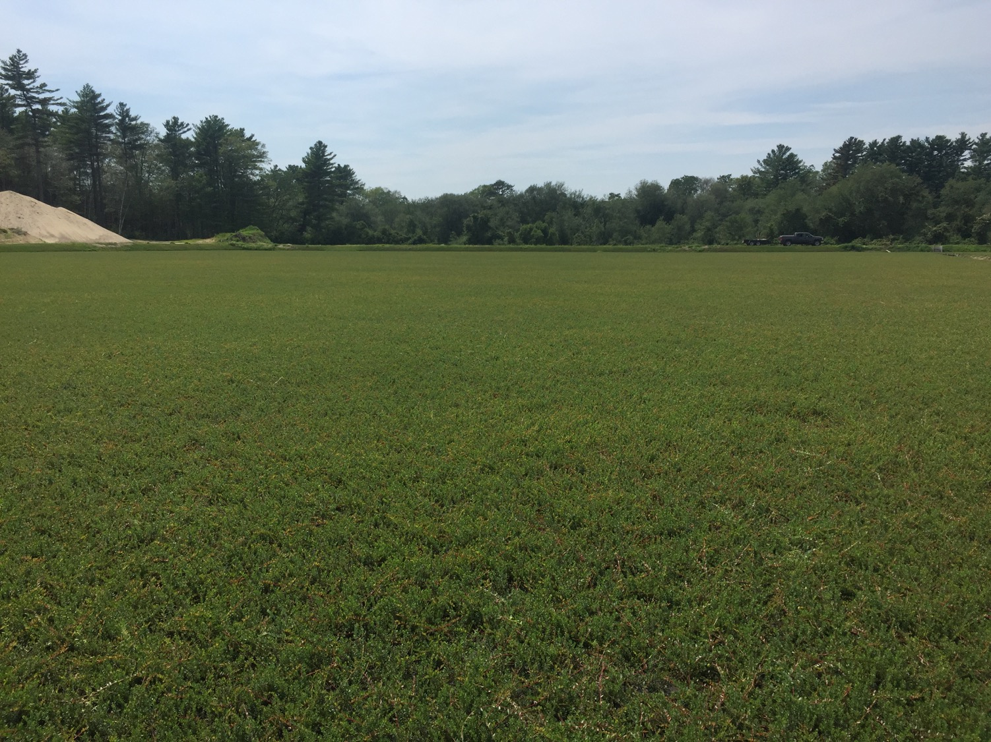
Sam Crocker
2nd Year

